Slide 1
Welcome to
Euros@p-Spring School for NWRSA
In Weimar

Slide 2

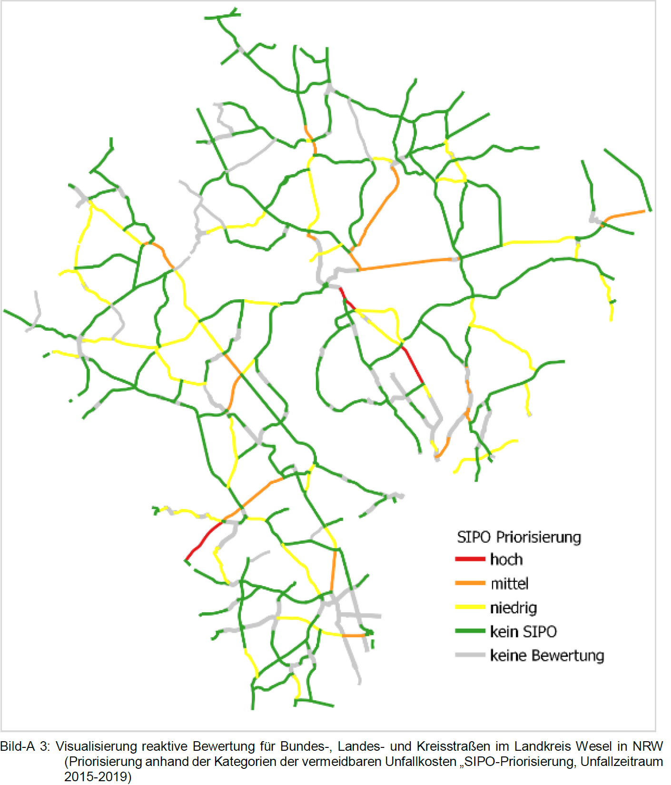

What is the ESN-Method?
ESN - Recommendations for safety analysis of road networks
standardized method for systematically identifying safety potentials
Notes:
Ziel ist die Ausweisung von Abschnitten, auf denen infrastrukturelle Ver­besserungen eine hohe Sicherheitswirkung erwarten lassen.
Zur Ableitung von Mafsnahmen ftir die ausgewiesenen Abschnitte sind weitergehende Analysen, wie z. B. das Bestandsaudit, erforderlich.
Ziel:
Investitionsentscheidungen unterstützen und
Monitoring der Verkehrssicherheitsarbeit.
Eine Bewertung von Innerortsstralsen ist aufgrund derzeit fehlender aktueller Grundunfall­kostenraten nicht möglich. Grundunfallkostenrate fehlt.

Slide 3
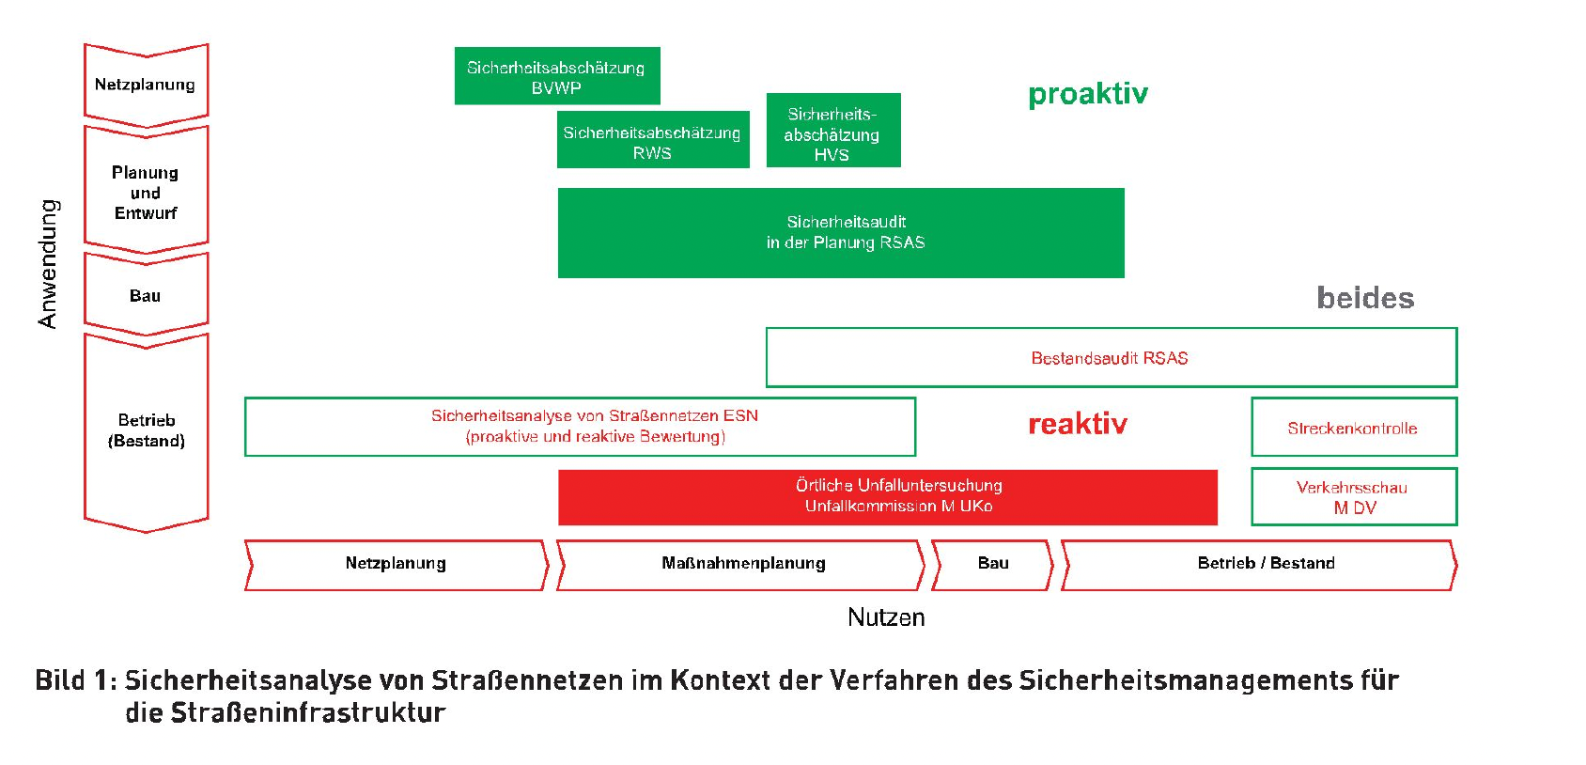
Road Safety Management System in Germany

Slide 4
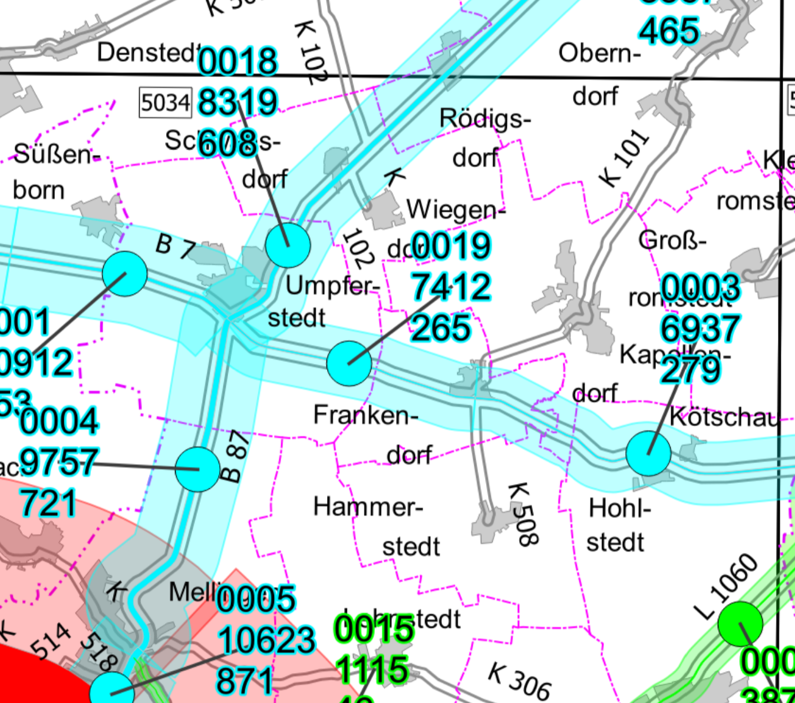
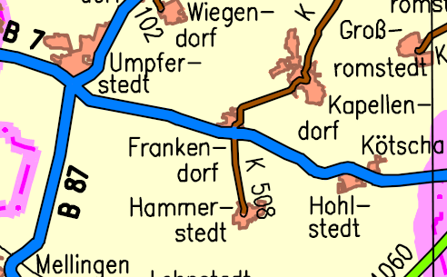
Required data
Segmented road data
(Classified)
Traffic volume data
Accident data (categorized)

Slide 5
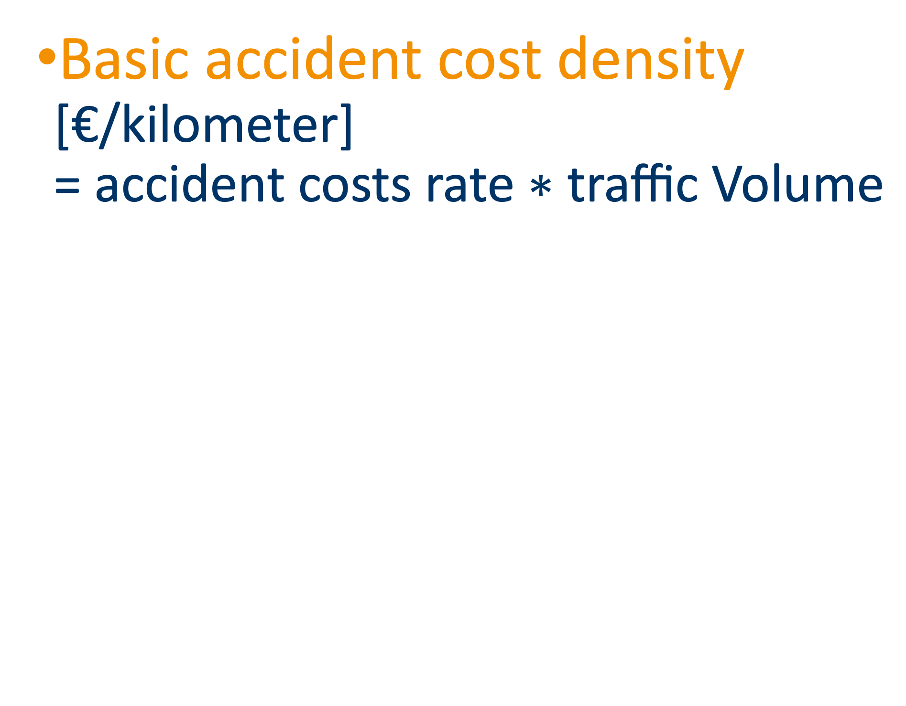
Road segmentation
Traffic volume data
Segmented road data
(Classified)
Separate and combined
segmentation for routes and intersections
Accident data (categorized 1-4 or 1-6)
Basic accident cost density
[€/kilometer]
= $\text{accident} \text{costs} \text{rate}\text{ ∗ }\text{traffic} \text{Volume}$
Average accident cost rate
[€/per 1.000 Vehicules]
Roadtype | €
Motorway | 15
country Road | 35
urban road | 51
expected ACD

Slide 6
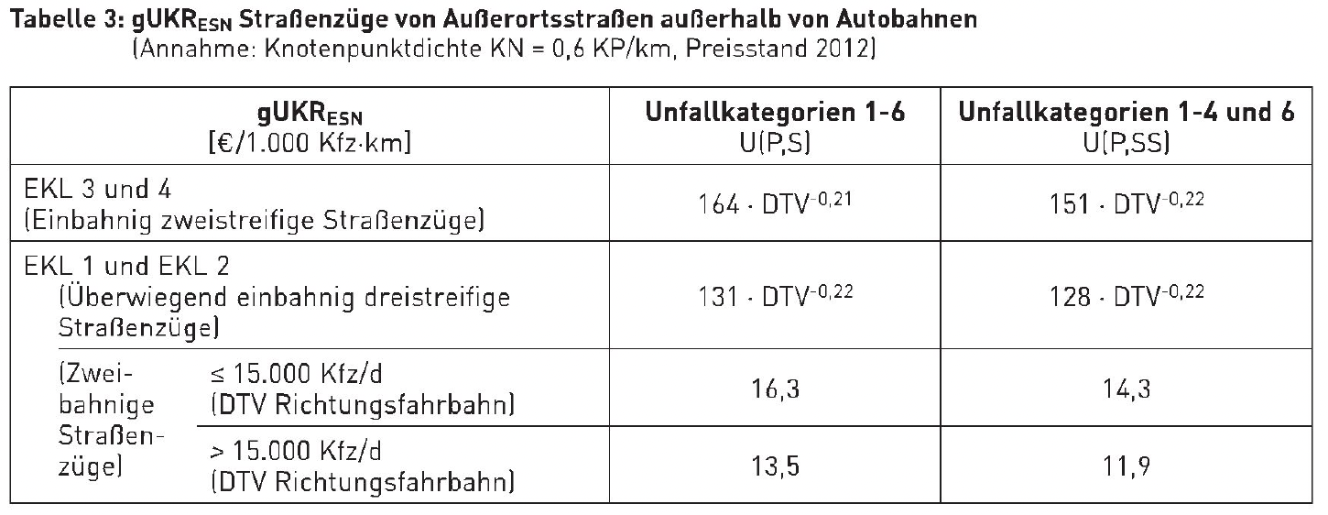
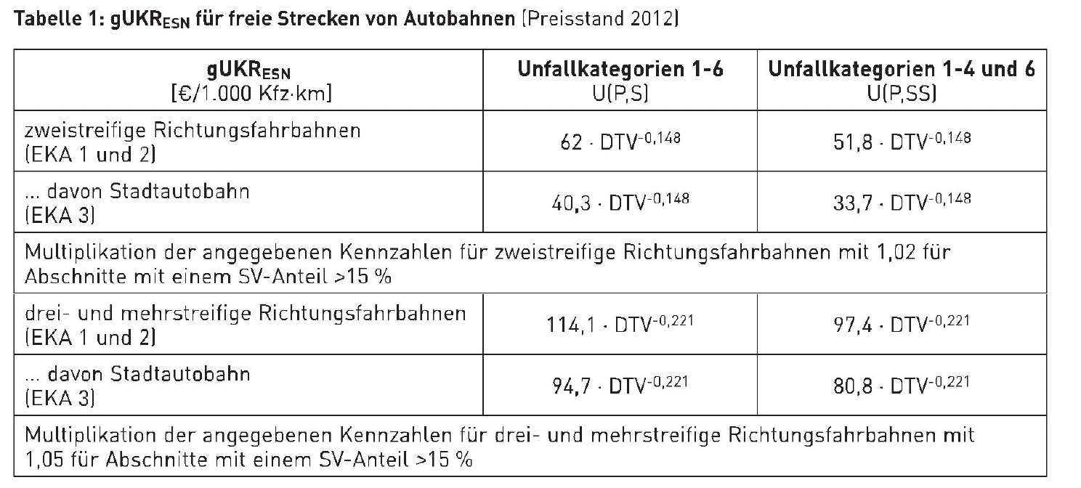
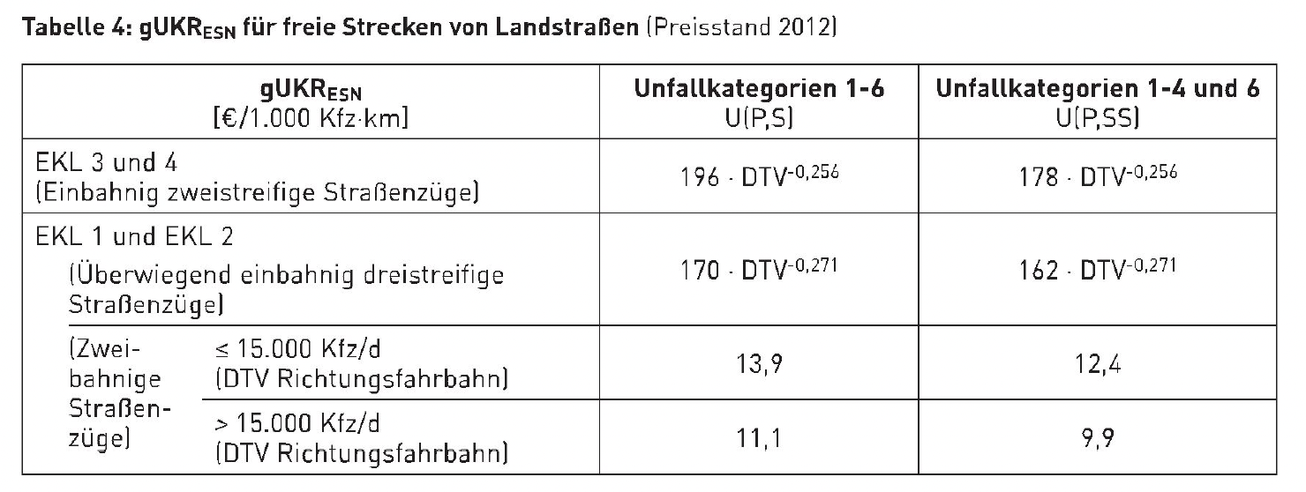
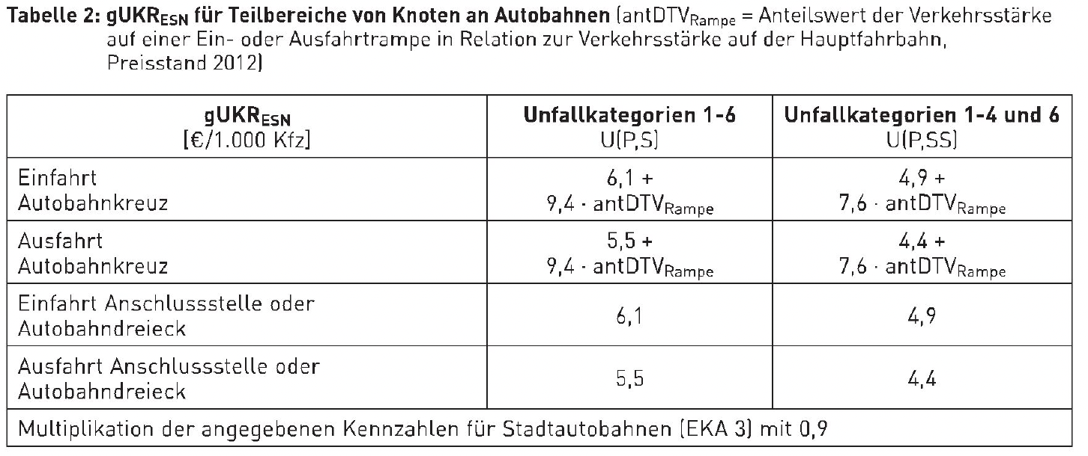
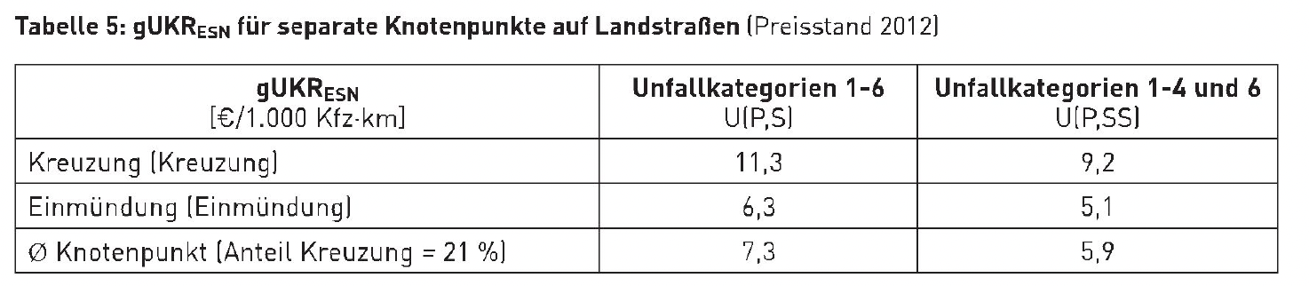
Expected Accident Costs
Traffic volume data
Rural Roads
Average accident cost rate
[€/per 1.000 Vehicules km]
Accident data (categorized 1-4 or 1-6)
Basic accident cost density
[€/kilometer]
= $\text{accident} \text{costs} \text{rate}\text{ ∗ }\text{traffic} \text{Volume}$
Motorway
expected ACD
Notes:
- divided or undivided road
- number of lanes per direction of travel,
- type of partial interchange on highways
distinguished by entrance or exit (highway junction, highway triangle, interchange),- Definition of urban highway1
- three or more junction arms at at-grade junctions (only if junctions are to be evaluated separately from the open road).

Slide 7
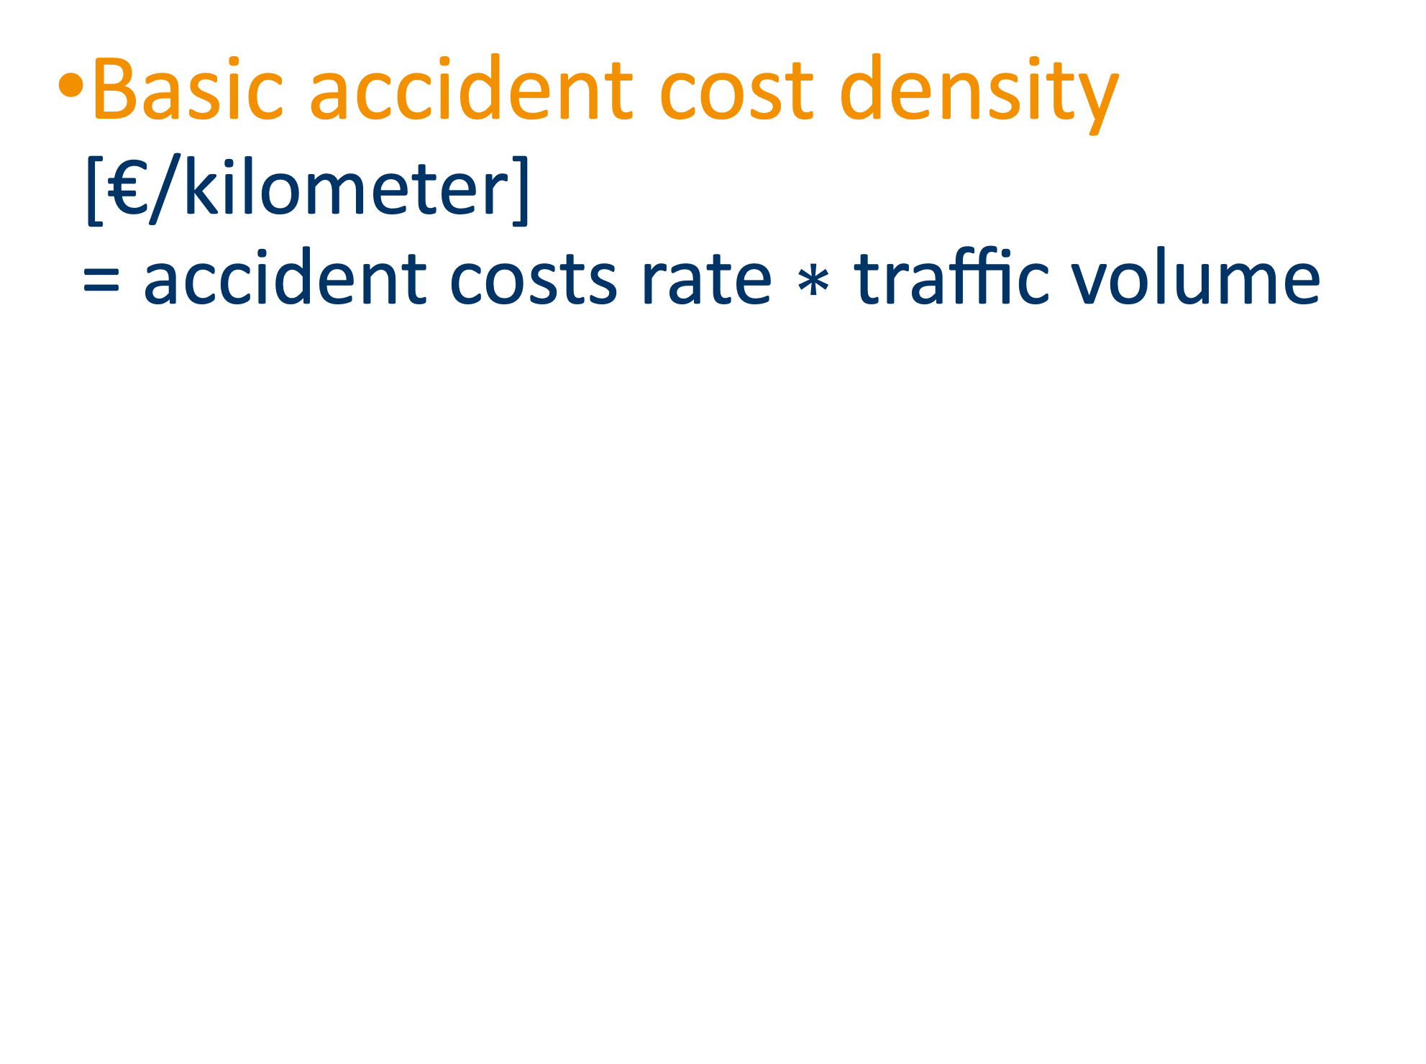
Expected Accident Costs
Segmented road data
(Classified)
Basic accident cost density
[€/kilometer]
= $\text{accident} \text{costs} \text{rate}\text{ ∗ }\text{traffic} \text{v}\text{olume}$
Accident data (categorized 1-4 or 1-6)
Average accident cost rate
[€/per 1.000 Vehicules]
Safety potential
Traffic volume data
expected ACD
Incurred ACD

Slide 8
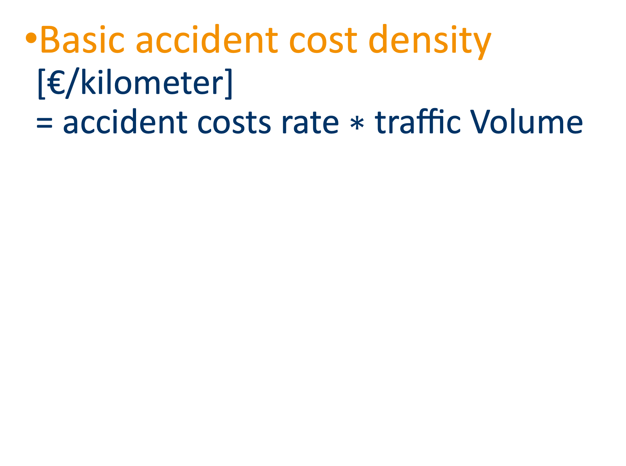
Current Accident Costs
Basic accident cost density
[€/kilometer]
= $\text{accident} \text{costs} \text{rate}\text{ ∗ }\text{traffic} \text{Volume}$
expected ACD
Segmented road data
(Classified)
Accident data
Traffic volume data
Roadtype | €
Motorway | 15
country Road | 35
urban road | 51

Slide 9
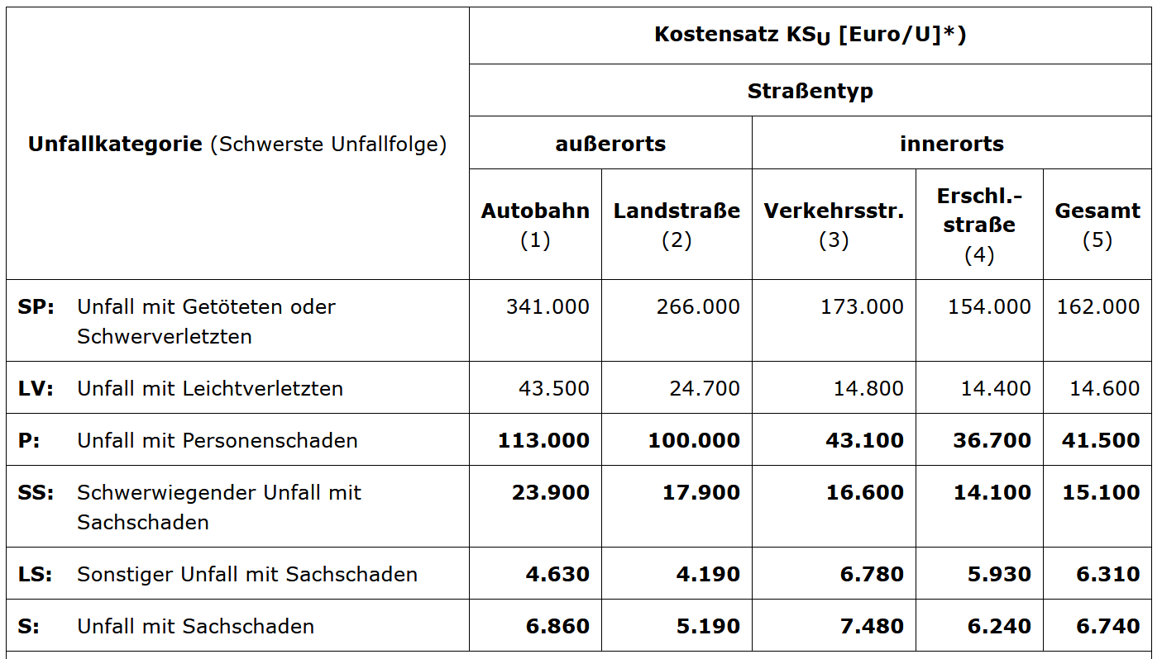
Current Accident Costs
Road segment length
Categorized accident data
Average accident cost rate
[€/per 1.000 Vehicules]
Incurred ACD
Traffic volume data
Roadtype | €
Motorway | 15
country Road | 35
urban road | 51

Slide 10
Current Accident Cost Density
Accident data
= incurred ACD
Number of accidents * Unit cost / Segment length
expected ACD
Notes:
Hinweise zu Unfallkostensätzen
H Uks

Slide 11
Safety potential
Safety potential
Characterized by avoidable accident cost density
High safety potential means more benefits by improvements of the road infrastructure
Incurred ACD
expected ACD

Slide 12
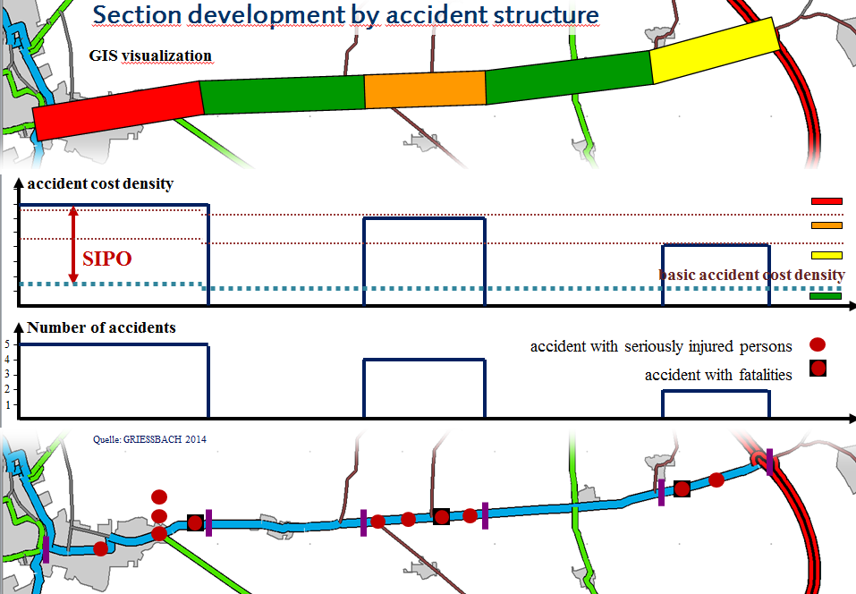
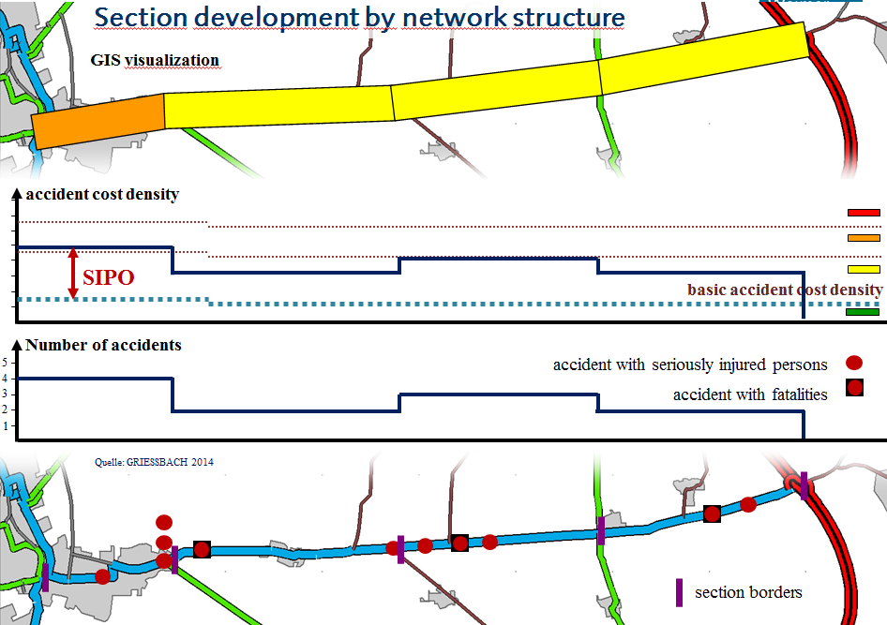
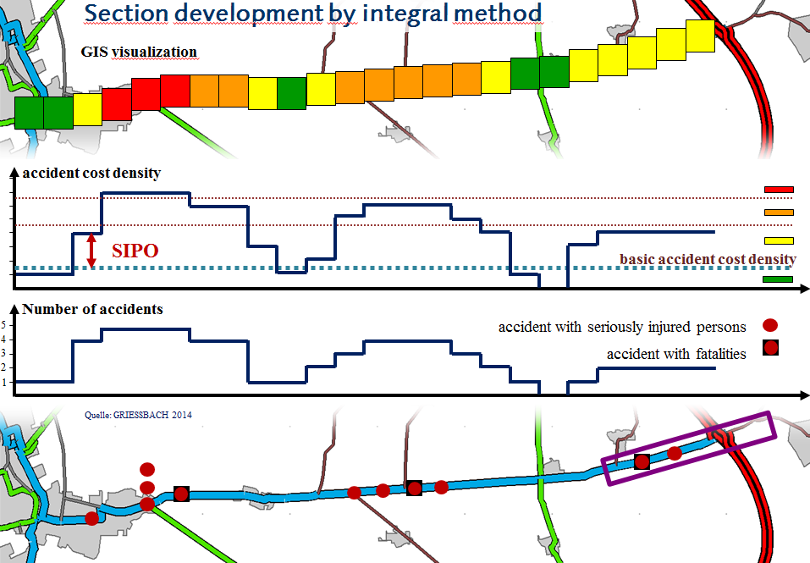
Classification
Safety potential
Incurred ACD
avoidable accident costs
high SP
medium SP
low SP
no SP
accident cost density
expected ACD
Road segments
0 Pt.
1 Pt.
3 Pt
4 Pt
5 Pt
Section development by accident structure
Section development by network structure
Section development
by integral method
Notes:
sort segments by avoidable accident costs
HP 20%
MP 20% - 60%
LP 60% - 100%

Slide 13
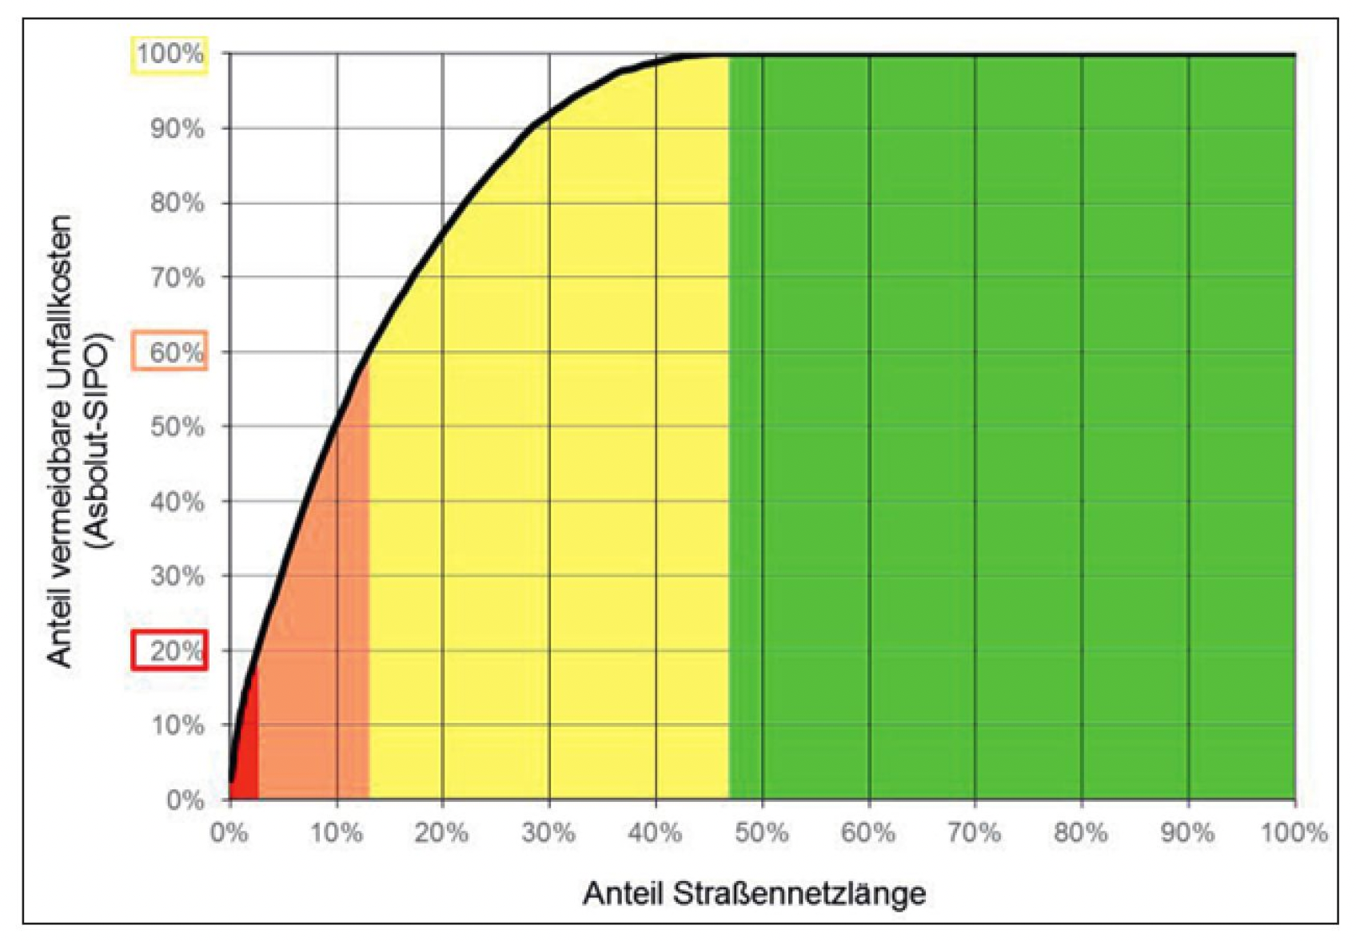
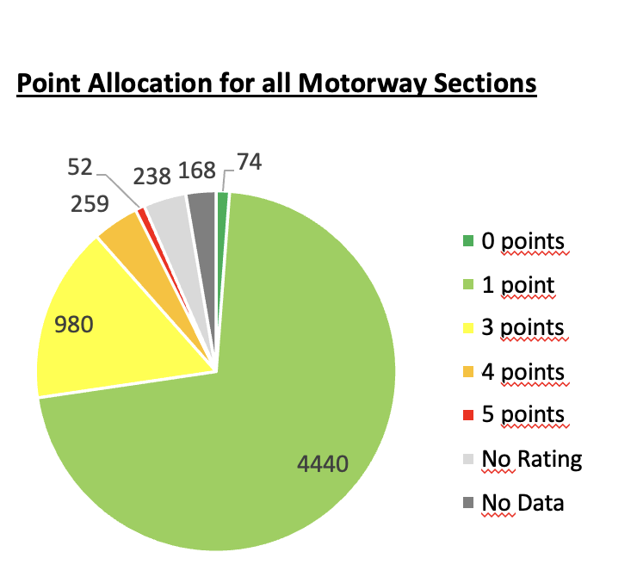
Reactive Safety Potential
Abbildung: Heinrichs/Autobahn GmbH

Slide 14
Section development comparison of three approaches of old ESN
by accident structure
by network structure
by integral method
accident cost density
high SP
medium SP
low SP
no SP
accident cost density
expected ACD
Road segments

Slide 15
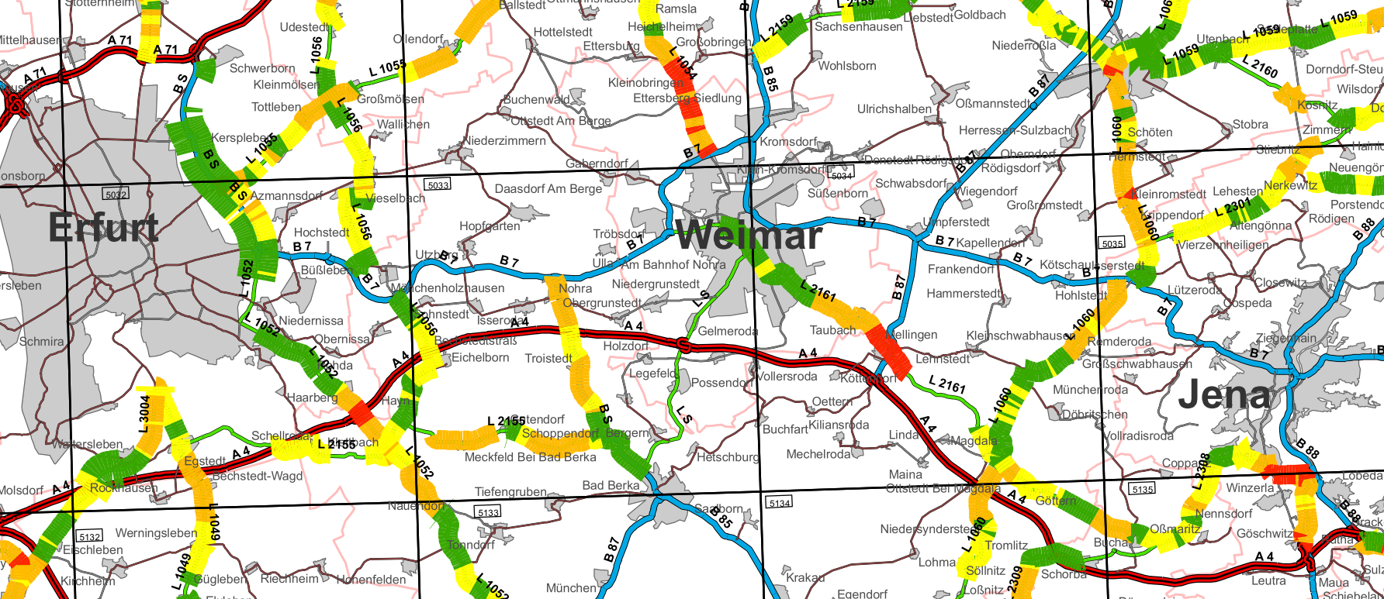
Example of mapping safety potentials
Mapping and priorization of the calculated safety potentials (SAPO)
Safetyanalyse Thuringia, GRIESSBACH 2013
Section development by accident structure
Section development by network structure
Section development
by integral method

Slide 16
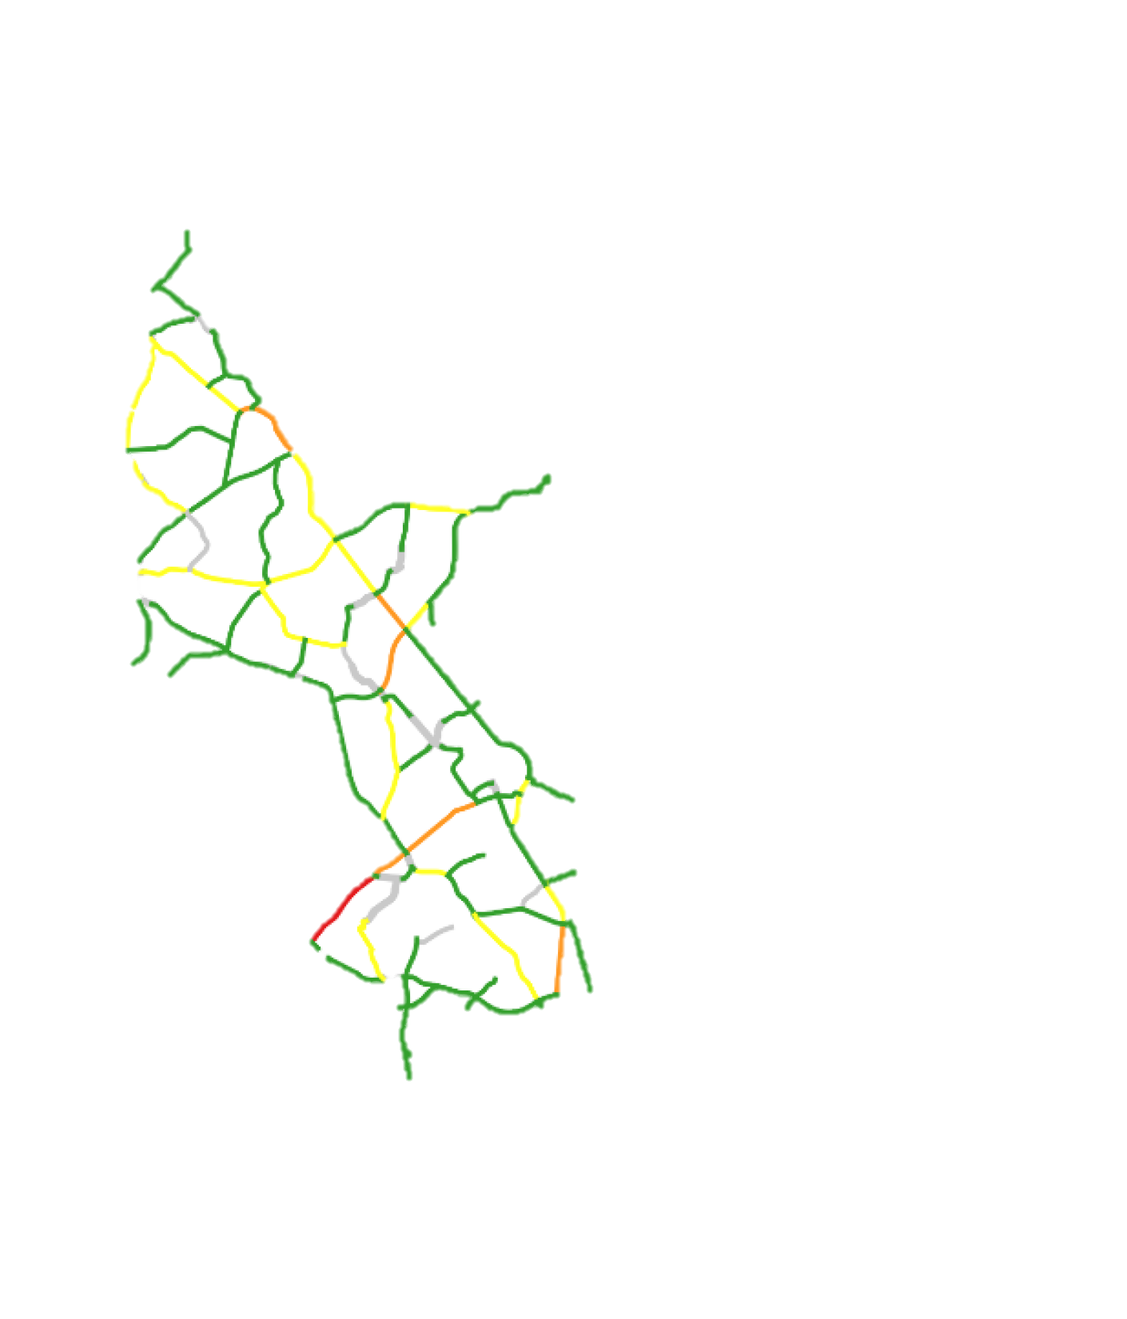
Indicative elements
Separate evaluation
for each indicative element
Selection of element by data availability
1 | Distance of trees from the road
2 | Radius and ratio of consecutive radii
3 | Steep slope
4 | Limited Lane width
5 | Existence of Areas with poor drainage
6 | pavement friction
7 | Existence of pedestrians and cyclists Infrartucture
1 | Obstacles
2 | Horizontal alignment
3 | Vertical alignment
4 | Cross-section
5 | Surface drainage
6 | Road surface condition
7 | Facilities for pedestrians and cyclists
8 | left-turn lanes at intersections,
Points assigned:
  0 pt. = no deficit
  up to 3 pt. = significant deficit
  up to 5 pt. = critical deficit
Notes:
Grundlage dafur sind empirische Analysen aus Forschungsprojekten, welche den Zusammenhang zwischen Haufigkeit und Schwere von Ver­kehrsunfa.llen sowie Infrastrukturmerkmalen quantifiziert haben
- Hindernisse im Seitenraum,
- horizontale Trassierung inklusive Relationstrassierung,
- vertikale Trassierung,
- Gestaltung von Knotenpunkten,
- Querschnittsgestaltung ( u. a. Fahrbahnbreiten, bauliche Mitteltrennung, Seitenstreifen ),
- Vorhandensein von Anlagen fur den Fufš- und Radverkehr,
- Griffigkeit und entwasserungsschwache Zonen.

Slide 17
Grading
ZEB = Condition Survey and Assessment
BISStra = Federal Road Information System
Evaluation of…
Data Source …
Distance of trees from the road | tree register (included in BISStra)
Radius and ratio of consecutive radii | BISStra
sope | ZEB
Lane width | ZEB
Existence of Areas with poor surface drainage | ZEB
pavement friction | ZEB
Existence of pedestrians and cyclists Infrartucture | BISStra
Data source
ZEB = Condition Survey and Assessment
BISStra = Federal Road Information System
1 | Obstacles
2 | Horizontal alignment
3 | Vertical alignment
4 | Cross-section
5 | Surface drainage
6 | Road surface condition
7 | Facilities for pedestrians and cyclists
1 | Distance of trees from the road
2 | Radius and ratio of consecutive radii
3 | Steep slope
4 | Limited lane width
5 | Existence of Areas with poor drainage
6 | Skid Resistance
7 | Existence of pedestrians and cyclists infrartucture
Points assigned:
  0 pt. = no deficit
  up to 3 pt. = significant deficit
  up to 5 pt. = critical deficit
=
Notes:
rote" Einstufung: besonders sicherheitskritisches Defizit,
gelbe" Einstufung: bedeutendes Defizit
grüne" Einstufung: kein Defizit in relevanter Grofšenordnung
Die Gesamtbewertung geht von folgenden Mafsgaben aus:
- Eine ungiinstige reaktive Bewertung kann nicht durch eine giinstige bzw. sichere proaktive Bewertung verbessert werden.
- Die Unterschiede der Sicherheitsrelevanz, das heifst der Starke des Einflusses eines Infra­strukturmerkmals auf das Unfallgeschehen und der proaktiven Elemente, wird iiber unterschiedliche Maximalpunktzahlen beriicksichtigt. Beispiel: Wahrend ungeschiitzte Hindernisse im Seitenraum maximal eine Punktzahl von S erreichen konnen, kann der Fahrbahnzustand (Griffigkeit und entwasserungsschwache Zonen) nur maximal die Punkt­zahl von 3 erreichen.

Slide 18
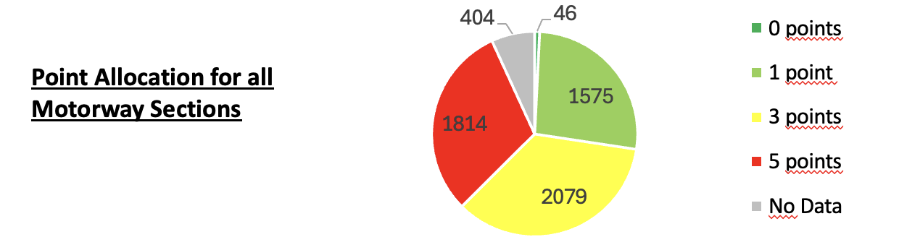
1. Obstacles
5 | > X Obstacls, distance < 4,5 m
3 | > X Obstacls, distance < 10 m
1 | Obstacles with safety barrier
0 | No Obstacles
X =1/335 m , (X= min 2)

Slide 19
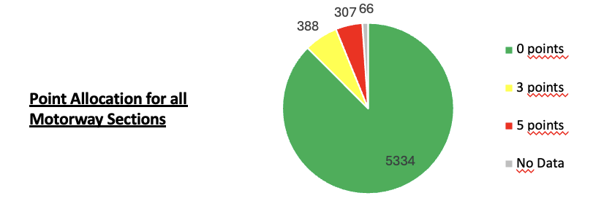
2. Horizontal alignment
5 | Values > 20% below the standard
3 | Values < 20% below the standard
0 | Values according to standard

Slide 20
3. Vertical alignment
3 | Exceeding max slope on > 100 m
1 | Exceeding max slope on > 100 m
0 | Slope according to standard
Point Allocation for all Motorway Sections

Slide 21
4. Cross-section
4 | Road width < 6 m, on > 50% of the distance or on motorways no shoulder, on > 30% of the distance
3 | Average lane width < 3.35 m, on > 50% of the network or Road width < 6 m, on > 20% of the distance
2 | Average lane width > 3.75 m, on > 50% of the network
0 | All width according to standard, on > 50% of the network
Point Allocation for all Motorway Sections

Slide 22
6. Road surface condition - Skid Resistance
3 | Insufficient grip (< 0.37) on > 10% distance
1 | Insufficient grip (< 0.37) on < 10% distance
0 | sufficient grip
Point Allocation for all Motorway Sections

Slide 23
5. Surface drainage
3 | > 1 Area with poor drainage on 100 m
1 | 1 Area with poor drainage on 100 m
0 | No Area with poor drainage
Point Allocation for all Motorway Sections

Slide 24
7. Facilities for pedestrians and cyclists
4 | Facilities on < 20% of distance
2 | Facilities on < 80% of distance
0 | Facilities on > 80% of distance

Slide 25
8. Left-turn lanes at intersections
5 | Absence of a left-turn lane in a priority road or left-turn lane in non priority road or no dedicated left-turn signal sequence
3 | Intersections without left-turn lanes
0 | no detected deficits

Slide 26
Proactive assessment
Overall assessment uses on the
highest single score
feasible even with incomplete data
number of indicators be easily extended
+
+
+
=

Slide 27
Final priority grade
Priority level based on reactive safety potential
can be increased by +1 through proactive assessment
+
+
5
4 |  |  |  | ∑2 ≥ 8 ∑n ≥ 14
3
0/1 |  |  |  |  | Min 2x5 &1x3
 | 0 | 2 | 3 | 4 | 5
Priotity 1
Priority 2
Priority 3
Priority 4
No Priority
+
Reactive grade
=
Proactive grade
Notes:
∑ 2 Faktoren >8
∑ aller faktoren > 14

Slide 28

Evaluation Process and Result
Overall rating
Source: Joshua Heinrichs
        Determining the categories and scores for each layer (reactive and proactive)
        Determining the maximum score for the proactive layer
        Determining the overall rating
Empty – No Rating
 | Reactive |  | Proactive | Overall rating
 | None of the following categories |  |  | No priority
a. | <3 | AND | max. ≥ 4 | Priority 4
b. | =3 | AND | max. < 3
a. | <3 | AND | min. 2x = 5 AND min. 1x ≥ 3 | Priority 3
b. | =3 | AND | ≤ 3
c. | =4 | AND | max. < 4
a. | =4 | AND | Sum of the two highest proactive elements ≥ 8 | Priority 2
b. | =4 | OR | Sum of all proactive elements ≥ 12 for Motorways (≥ 14 for Federal and State roads)
 | =5 |  |  | Priority 1
Priority 4
No Priority
Priority 3
Priority 1
Priority 2
Total number: 6.138 motorway sections
Priority 1 and 2: 138 motorway sections
Notes:
Warum reaktiv noch so hoch: Datenverfügbarkeit der proaktiven Elemente, man wollte keine Abschnitte übersehen, die reaktiv noch auffällig sind
Sichtweiten -> keine Mehthodik gefunden
Hintergrund: max wurde gewählt, damit Methodik erweitert werden kann -> ein Element schlecht, andere gut trotzdem auffällig
Unterschiede Gewichtung: Seite 78 Forschungsbericht
HVS: Unfallschwere Indikator -> Baum schwererer Unfall anstatt Griffigkeit
Lageplan mehr Einfluss als Höhenplan -> Radien

Slide 29
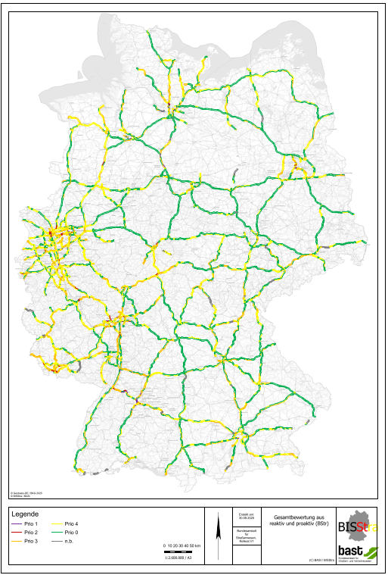
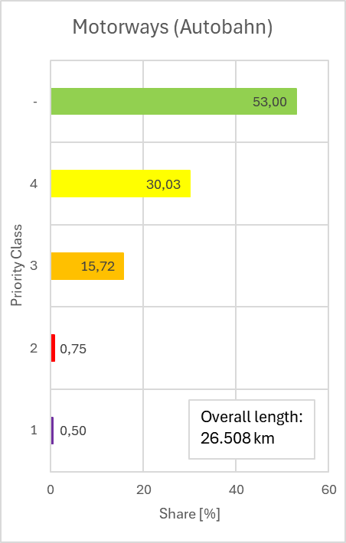
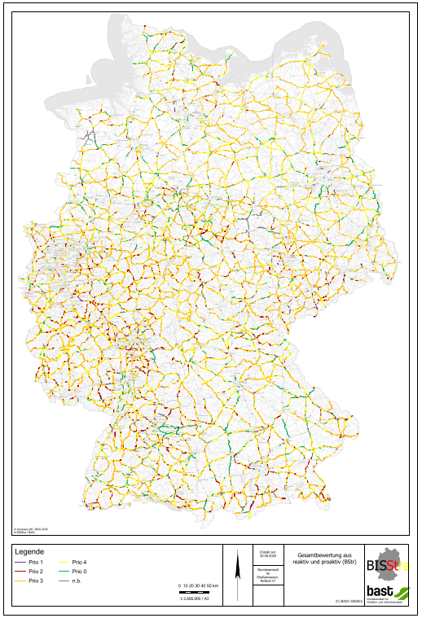
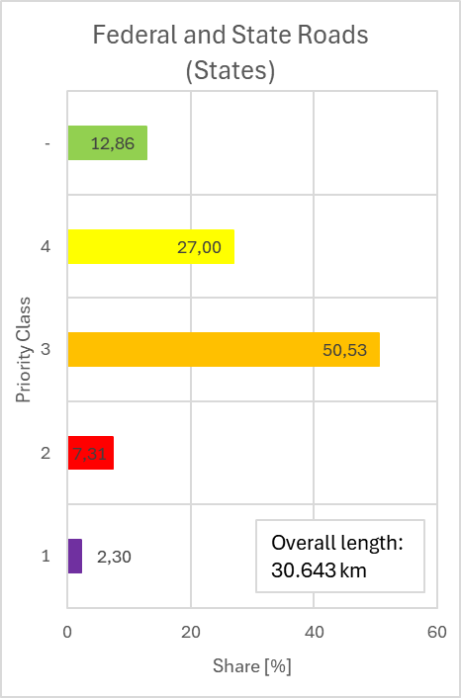
Evaluation Process and Result
Results - Maps
    Overall Results for Motorways
    Overall Results for Federal and State Roads
Fulfill EU-directive 2019/1936 requirements
Is efficient through use of existing data bases
Is simple in the grading system
Is flexible according to data availabilities
but …
The number of indicators should be expanded by important risk factors
(such as visibility and speed)
The grading system should be evaluated and adapted if necessary
(proactive impact is low)
Other segmentation methods enable more precise identification of safety potential

Slide 30
Conclusion of the new ESN
The facelift of the established ESN method …
Fulfill EU-directive 2019/1936 requirements
Is efficient through use of existing data bases
Is simple in the grading system
Is flexible according to data availabilities
but …
The number of indicators should be expanded by important risk factors
(such as visibility and speed)
The grading system should be evaluated and adapted if necessary
(proactive impact is low)
Other segmentation methods enable more precise identification of safety potential

Slide 31
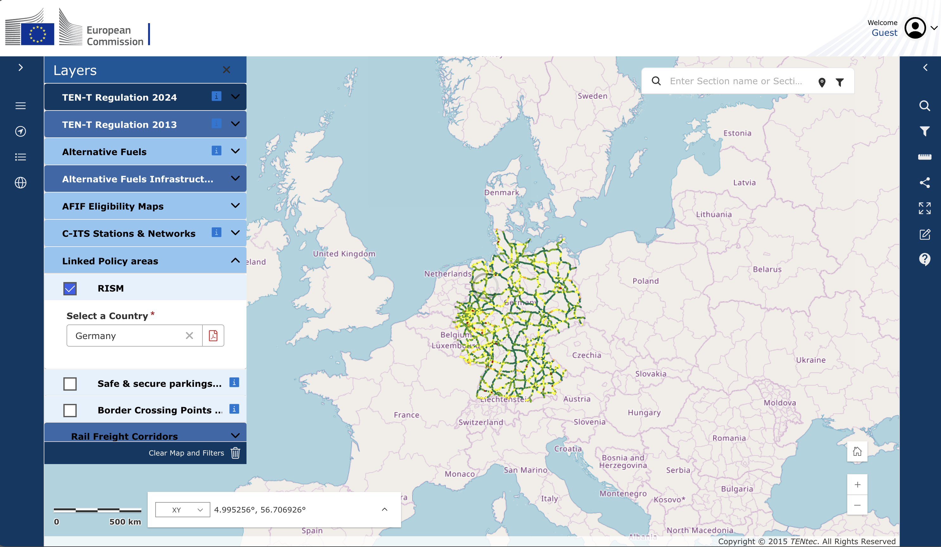
Link to European Monitoring
https://webgate.ec.europa.eu/tentec-maps/web/public/screen/home

Slide 32

Thanks for your attention!
Wido Hamel, M.Sc.
Bauhaus-Universität Weimar
wido.hamel@uni-weimar.de

