Slide 1
Lecture 3.9 Selection of countermeasures

Slide 3
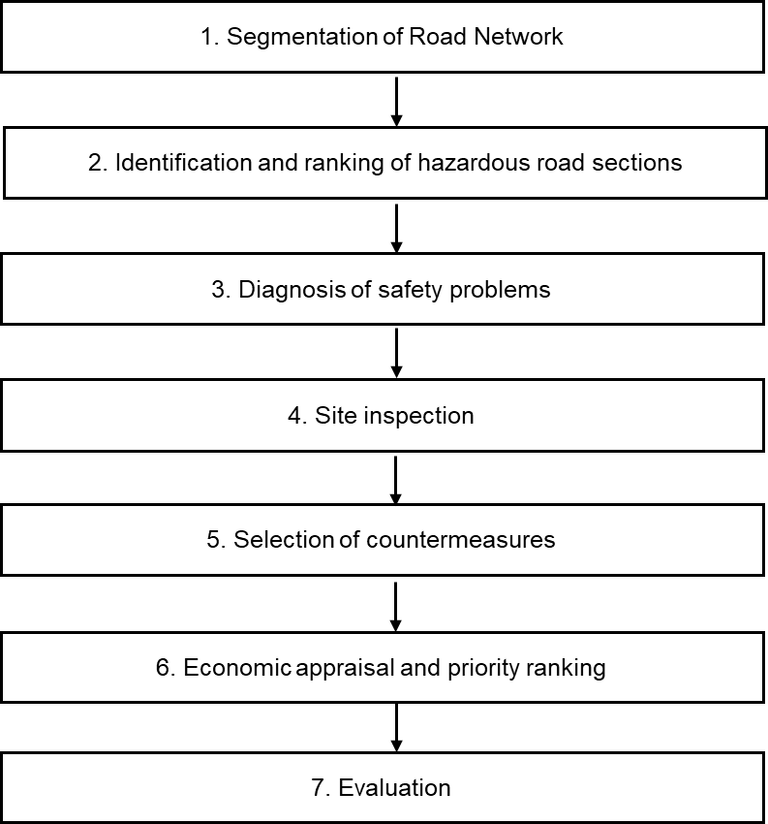
The stages of the NSM process based on accident data

Slide 4
Background at this stage
The hazardous sites have been identified based on accident statistics.
Site inspections at these sites have been carried out and safety problems
have been identified.

Slide 5
Calculate accident costs for each hazardous section
Calculate the total accident costs for each subsection based on the number of accidents of various types and the societal costs of the accidents.
The societal costs of the various types of accidents on each subsection
are calculated based on:
The Value of a Statistical Life: 6.2 Mill EUR (Schoeters, et al., 2022)
The Value of a Statistical Serious Injury: 950,000 EUR (Schoeters, et al., 2022)
The cost of a damage only accident is 1,500 EUR (Trafikverket, 2024)

Slide 6
Proposal for countermeasures
After identifying the main accident contributory factors under the diagnosis step, a proposal for countermeasures is made for each section considering each safety concern involving technical and budgetary considerations.
If more than one concern was identified for the section in question, more than one potential countermeasure should be proposed.

Slide 7

One source for countermeasures
https://highways.dot.gov/safety/proven-safety-countermeasures

Slide 8
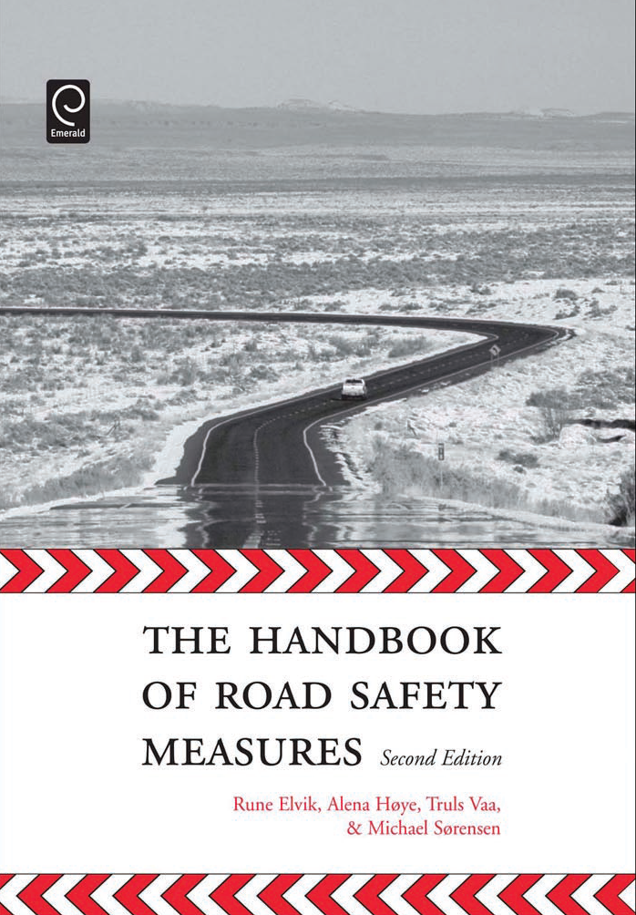
Cost-effective countermeasures have been composed by:
Elvik, et al. (2009) The Handbook of Road Safety Measures
https://www.tshandbok.no/

Slide 9
The Handbook of Road Safety Measures
Road Design and Road Furniture measures
Cycle lanes and tracks
Motorways
Bypasses
Urban arterial roads
Channelisation of junctions
Roundabouts
Redesigning junctions
Staggered junctions (reconfiguring crossroads to two T-junctions)
Grade-separated junctions
Black spot treatment
Cross-section improvements
Roadside safety treatment
Improving road alignment and sight distance
Reconstruction and rehabilitation of roads
Guardrails and crash cushions
Game accident measures
Horizontal curve treatments
Road lighting
Improving tunnel safety
Rest stops and service areas

Slide 10
The Handbook of Road Safety Measures
Part I – Introdution
Traffic safety theori
Part II – Effects of 142 traffic safety countermeasures in 9 areas:
General-Purpose Policy Instruments
Road Design and Road Furniture
Road maintenance
Traffic Control
Vehicle Design and Protective Devices
Vehicle and Garage Inspection
Driver Training and Regulation for Professional Drivers
Public Education and Information
Police Enforcement and sanctions

Slide 11
The Handbook of Road Safety Measures
For each countermeasure the following issues are described
Problem and objectives
Description of the measure
Effects on acccidents
Effects on mobility and the environment
Costs
Cost/benefit analysis

Slide 12
Selection of countermeasures
When thinking about appropriate countermeasures, the following issues to be considered:
Cost-effectiveness. Low-cost measures should be prioritised - some measures may be effective but may be unnecessarily expensive.
Long-lasting, i.e., the initial effect does not wear off as drivers get used to them.
Will not increase unsafety (not causing other types of accidents, or nuisances).
Will its implementation need considerable publicity campaign or heavy police enforcement?
Can the necessity of its implementation be explained to decision makers?

Slide 13
Economic assessment of countermeasures
The Handbook of Road Safety Measures indicates the safety effect of the identified countermeasure as a percentual decrease of accidents.
This percentual decrease yields the monetary benefit of the measure.
The handbook (often) also indicates the costs of implementing a certain countermeasure.
To assess the proposed countermeasures, the economic criteria “net benefits” can be used.
The net benefit approach assesses countermeasures by their safety benefits minus construction costs and it yields the most desirable alternative with the highest net benefit:
Net Benefit = Benefits – Costs
For a countermeasure to be economically justified, its net benefits should be greater than zero. For each section with any countermeasure with negative benefits, the “do-nothing” alternative
is considered more favourable.
The output from the economic assessment is a list of hazardous sections with their
Net Benefit values.

Slide 14
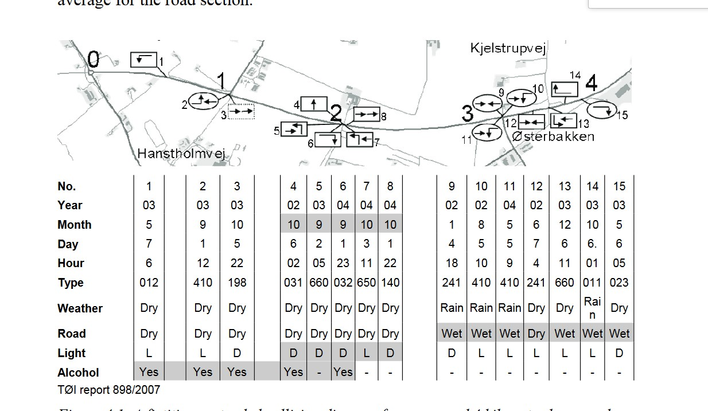
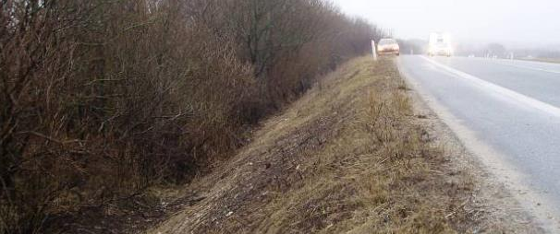
Example
A subsection of a hazardous section
Damage only
Severy injury
Two single crashes occurred, leaving the carriageway. Both crashes occurred on wet road surface.
One with damage only and one with injury.
1 injury accident: cost 950,000 EUR and 1 damage only accident: cost 1,500 EUR
Total accident costs: 951,500 EUR
The site visit revealed a steep slope along the road.
(Sorensen, 2006)
Proposal for countermeasure: Installing guard rails along the section with steep slope on the road side.

Slide 15
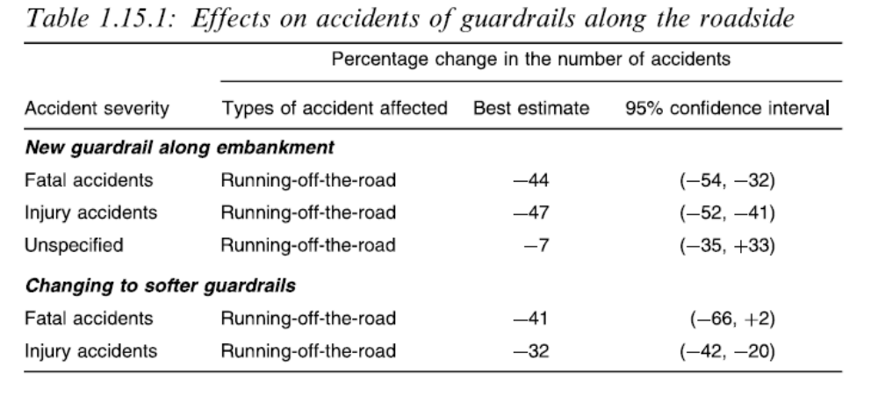
The Handbook of Road Safety Measures
Effects on acccidents

Slide 16
Net benefit of proposed countermeasures
Safety effect of Installing guard rails on injury accidents along the section according to the
Handbook of Road Safety Measures: -47%
Benefits: (951,500*0.47) = 447,205 EUR
Costs of Installing guard rails and their maintenance in 5 years along a 1 km road section (both sides): 50,000 EUR
Net benefit = Benefits – Costs 447,205 – 50,000 = 397,205 EUR
The measure is wort-while

Slide 17
References
Elvik, et al. (2009) The Handbook of Road Safety Measures.
Schoeters, A., Large, M., Koning, M., Carnis. L., Daniel, S., Mignot, D., , R., Wijnen, W., Bijleveld, F., van der Horst , M. (2022) Economic valuation of preventing fatal and serious road injuries. Results of a Willingness-To-Pay study in four European countries. Accident Analysis and Prevention 173 (2022) 106705.
Soerensen, M. (2006) Grå strækninger i det åbne land – Udvikling, anvendelse og vurdering af alvorlighedsbaseret metode til udpegning, analyse og udbedring af grå strækninger (in Danish). English title: Hazardous road sections in rural areas – development, application and assessment of severity-based methods for identification, analysis and improvement of hazardous road sections. PhD thesis. Aalborg University, Denmark.
Trafikverket (2024) Samhällsekonomiska Kalkylvärden - ASEK 8.0. Bilaga till Trafikverkets publikation Analysmetod och samhällsekonomiska kalkylvärden för transportsektorn (ASEK). Swedish Road Administration.

