Slide 1
Segmentation of the road network, Linking accidents to the individual road sections - Lecture

Slide 2
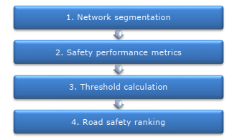
Steps of Network Wide Road Safety Assessment-reactive
The methodology consists of four steps:

Slide 3

Main Segmentation Issues
Divided vs. Undivided Roads
Definition of Homogeneous Sections
Section & Junction Length

Slide 4

Divided vs. Undivided Roads
Divided Roads
Undivided Roads
Motorways & primary divided roads
Roads without a physical median barrier
Segmentation is performed per direction of travel
Crashes relate only to vehicles traveling in that direction
Each carriageway is treated as an independent element
Segmentation includes both directions together
Crashes may involve opposing traffic interactions
If directional crash data is unavailable for both directions are included in a single segment

Slide 5
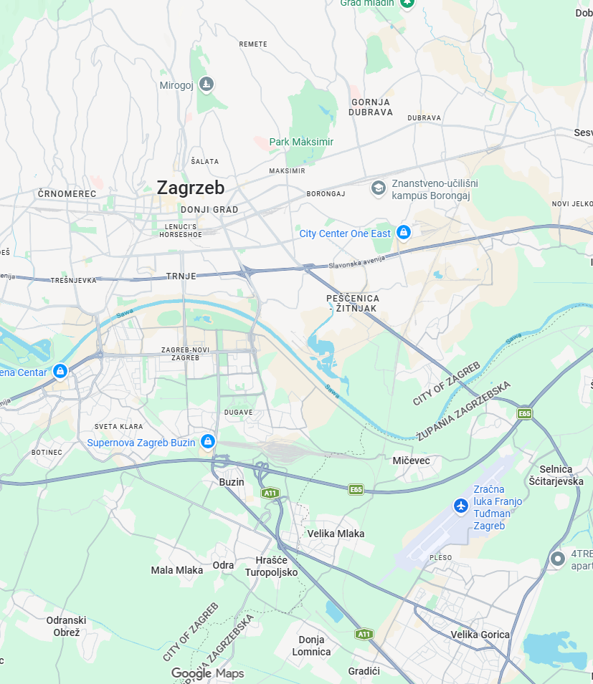
Netwok segmentation - general points
A road can be divided into smaller parts based on one of the following three approaches:
  Sections that include both road segments and junctions
  Sections that include only road segments and junctions (of predefined dimensions)
  Sections that include only road segments and junctions (of measured dimensions)
- Across a specific road category (e.g., rural motorways) more than one approaches can be selected. What matters is not to mix segmentation approaches along the same road.
- Roads are divided in (roughly) homogeneous sections.

Slide 6
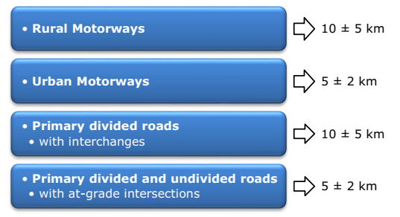
Recommended section lengths per road category.

Slide 7
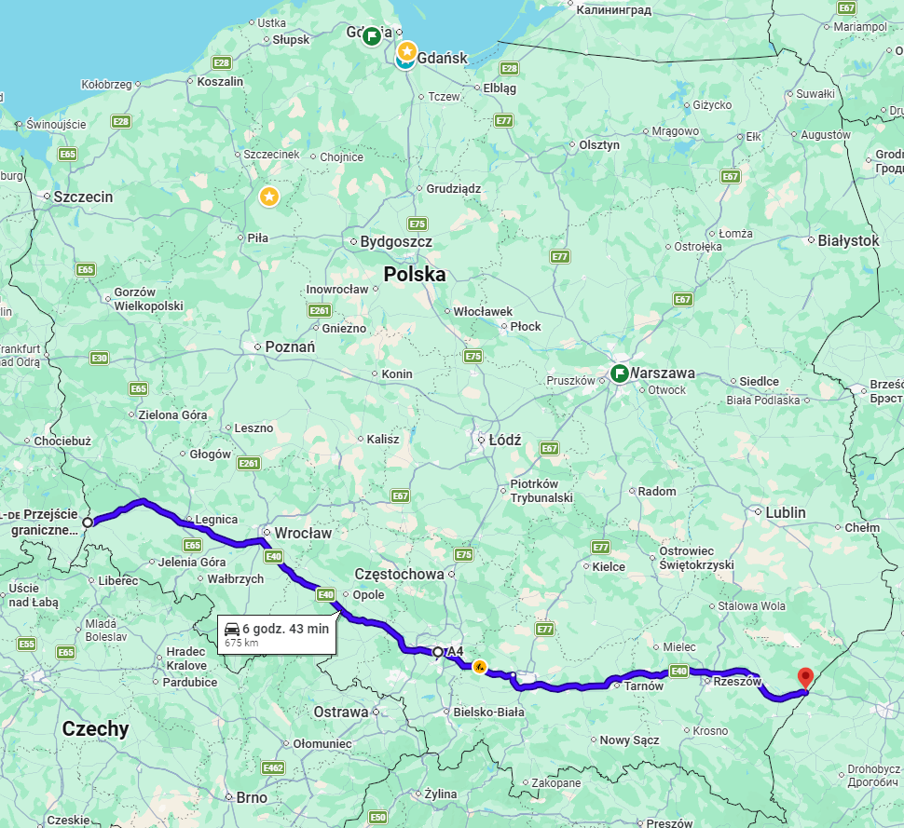
Crash collection data
Motorway A4 – 680 km length
West – East connection
Total number of accidents (3 years) – 415

Slide 8
Crash collection data
Sections: 5 km – 136 sections
Boarder of accidents | Sum of accidents | % of total | Section numbers | Length [km] | % total of len
>=5 | 203 | 48.9 | 27 | 135 | 19.9
>=10 | 95 | 22.9 | 8 | 40 | 5.9
>=15 | 74 | 17.8 | 6 | 30 | 4.4
>=20 | 21 | 5.1 | 3 | 15 | 2.2
Sections: 10 km – 68 sections
Sections: 15 km – 46 sections
Boarder of accidents | Sum of accidents | % of total | Section numbers | Length [km] | % total of len
>=5 | 334 | 80.5 | 38 | 380 | 55.9
>=10 | 137 | 33.0 | 9 | 90 | 13.2
>=15 | 91 | 21.9 | 5 | 50 | 7.4
>=20 | 91 | 21.9 | 5 | 50 | 7.4
Boarder of accidents | Sum of accidents | % of total | Section numbers | Length [km] | % total of len
>=5 | 386 | 93.0 | 36 | 540 | 78.3
>=10 | 235 | 56.6 | 15 | 225 | 32.6
>=15 | 154 | 37.1 | 8 | 120 | 17.4
>=20 | 105 | 25.3 | 5 | 75 | 10.9

Slide 9
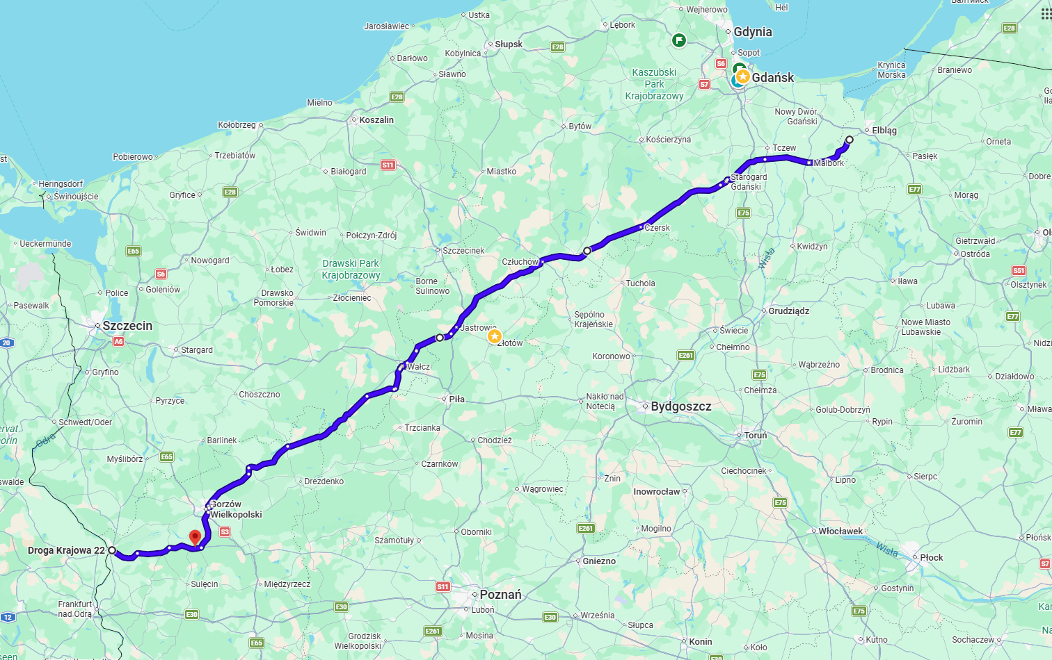
Crash collection data
National road 22 – 390 km length
West – North East connection
Total number of accidents (3 years) – 188

Slide 10
Crash collection data
Sections: 3 km – 130 sections
Boarder of accidents | Sum of accidents | % of total | Section numbers | Length [km] | % total of len
>=5 | 59 | 31.4 | 9 | 45 | 6.9
>=10 | 27 | 14.4 | 4 | 20 | 3.1
>=15 | 16 | 8.5 | 3 | 15 | 2.3
>=20 | 0 | 0.0 | 2 | 10 | 1.5
Sections: 5 km – 78 sections
Sections: 7 km – 56 sections
Boarder of accidents | Sum of accidents | % of total | Section numbers | Length [km] | % total of len
>=5 | 62 | 33.0 | 13 | 130 | 16.7
>=10 | 37 | 19.7 | 6 | 60 | 7.7
>=15 | 0 | 0.0 | 2 | 20 | 2.6
>=20 | 0 | 0.0 | 2 | 20 | 2.6
Boarder of accidents | Sum of accidents | % of total | Section numbers | Length [km] | % total of len
>=5 | 77 | 41.0 | 18 | 270 | 32.1
>=10 | 29 | 15.4 | 7 | 105 | 12.5
>=15 | 19 | 10.1 | 4 | 60 | 7.1
>=20 | 0 | 0.0 | 2 | 30 | 3.6

Slide 11
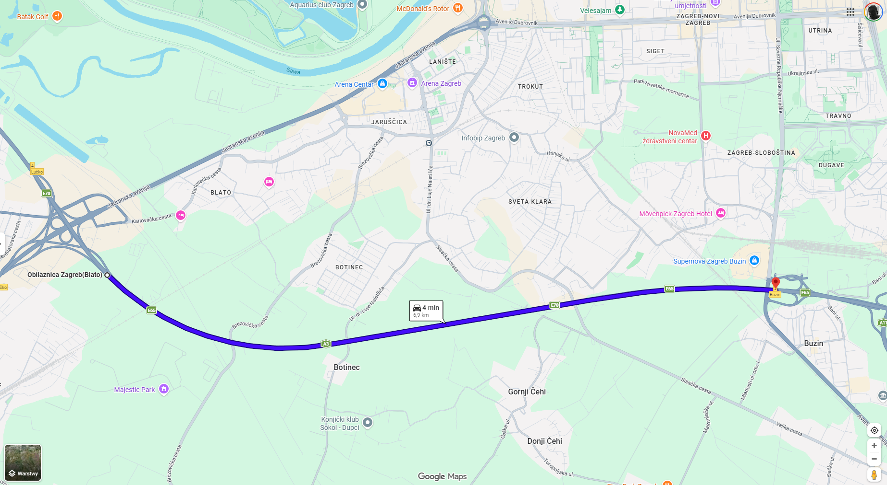
Definition of Homogeneous Road Sections
Boundary Definition
A road section is the stretch of road between two junctions — whether interchanges (grade-separated) or at-grade intersections.
Junctions serve as natural delimiters for the network.
7 km

Slide 12
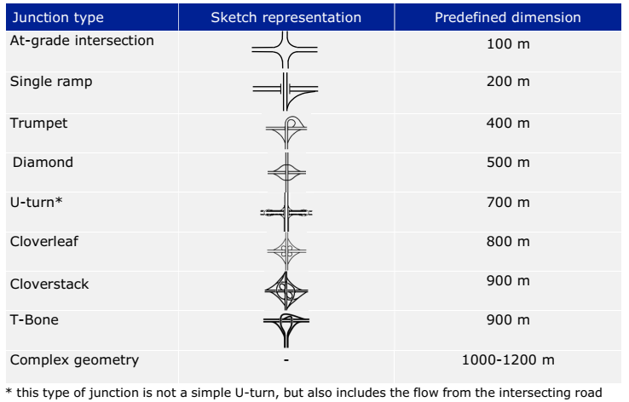
Predefined Junction Dimensions

Slide 13
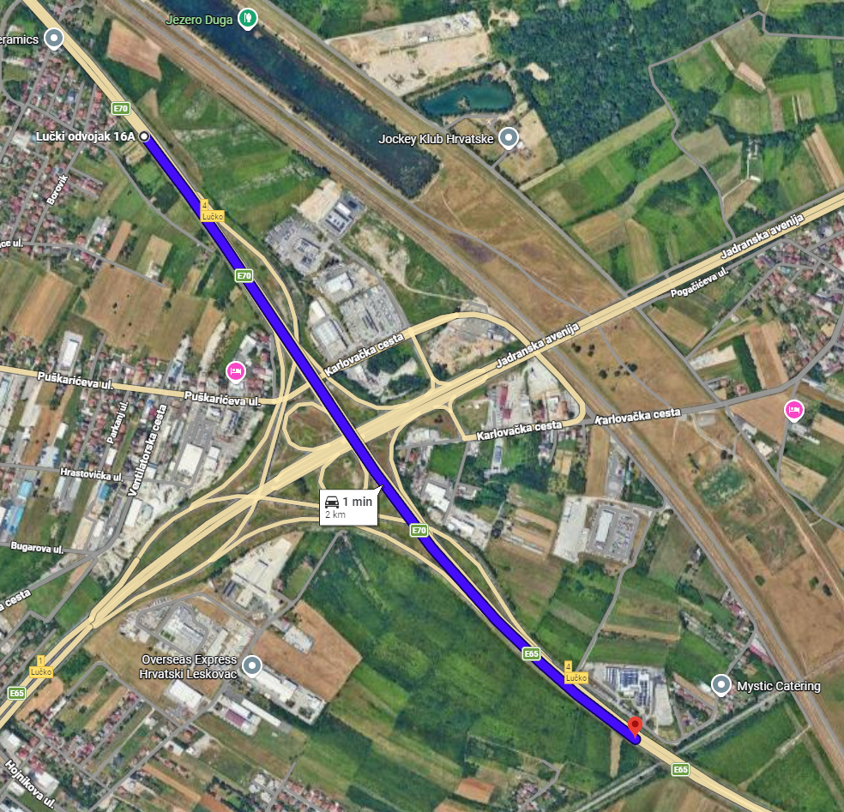
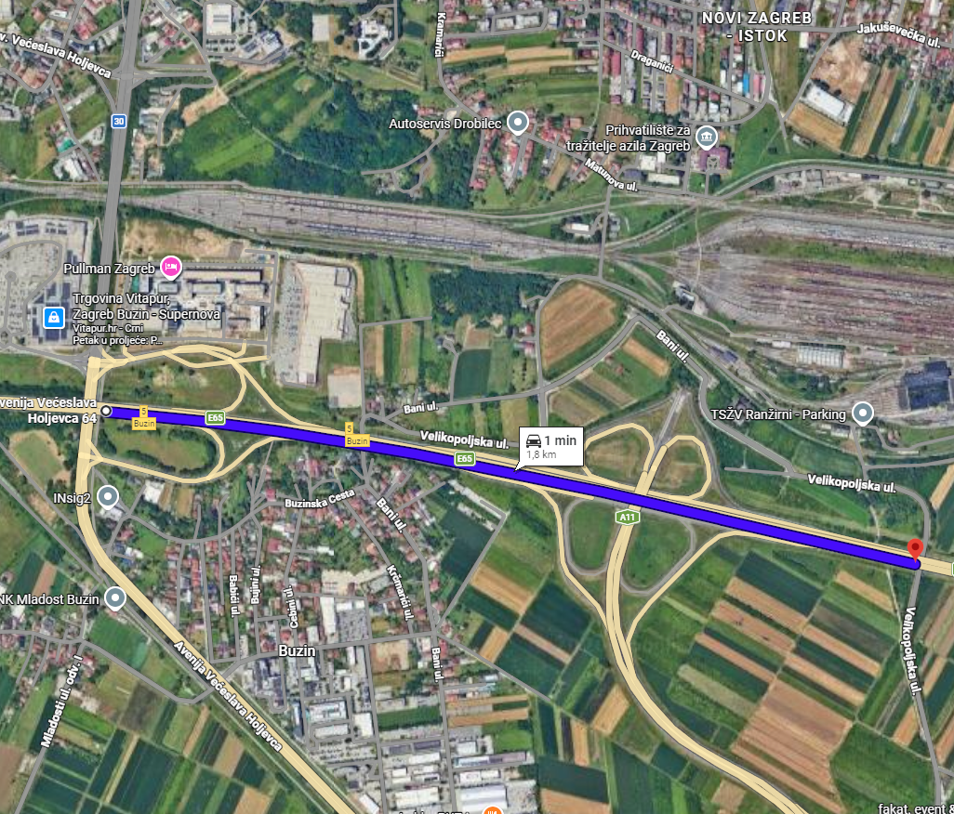
Calculated the real distance of interchange
Between the beginning of the exit ramp and the end of the entry ramp
2 km
1.8 km

Slide 14
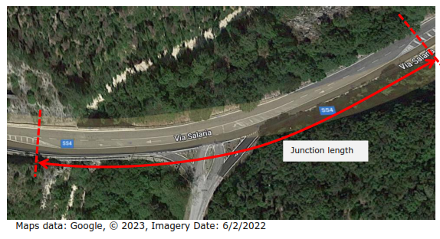
Calculated the real distance of intersection
Between the beginning of the turn left line to the end of the entry line
2 km
1.8 km

Slide 15
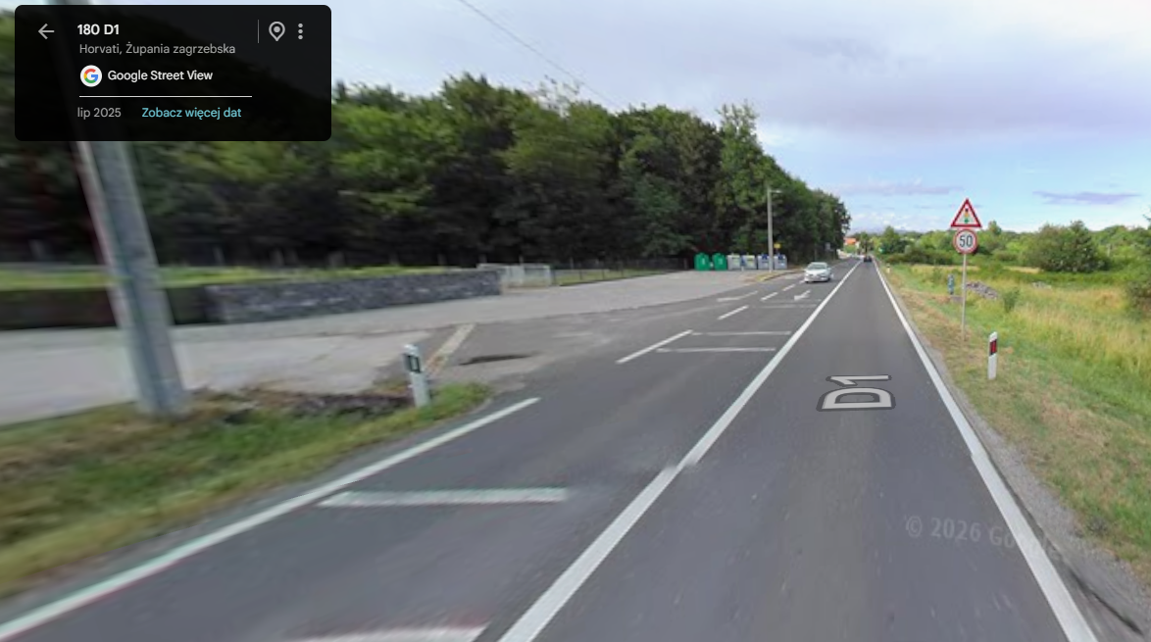
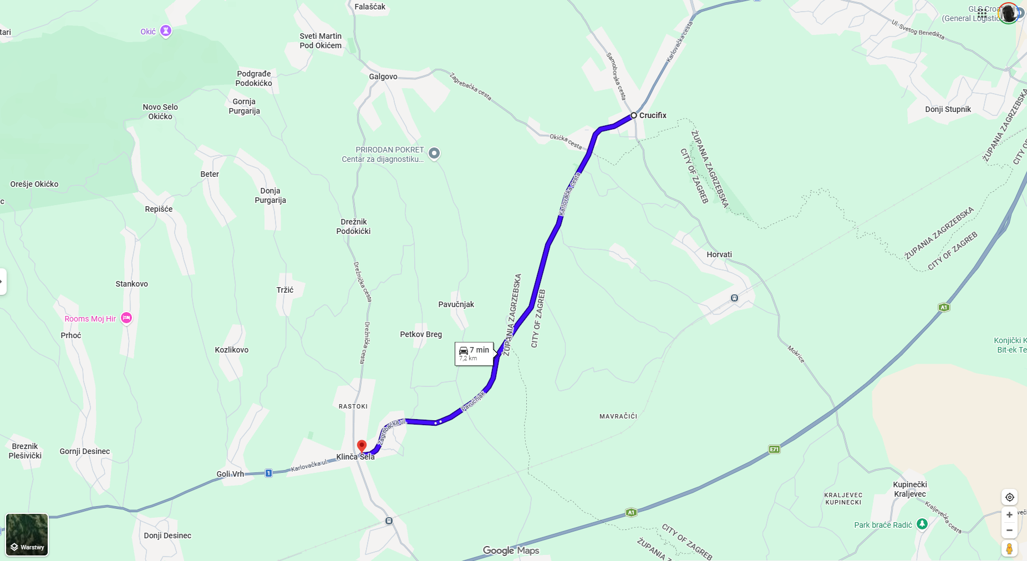
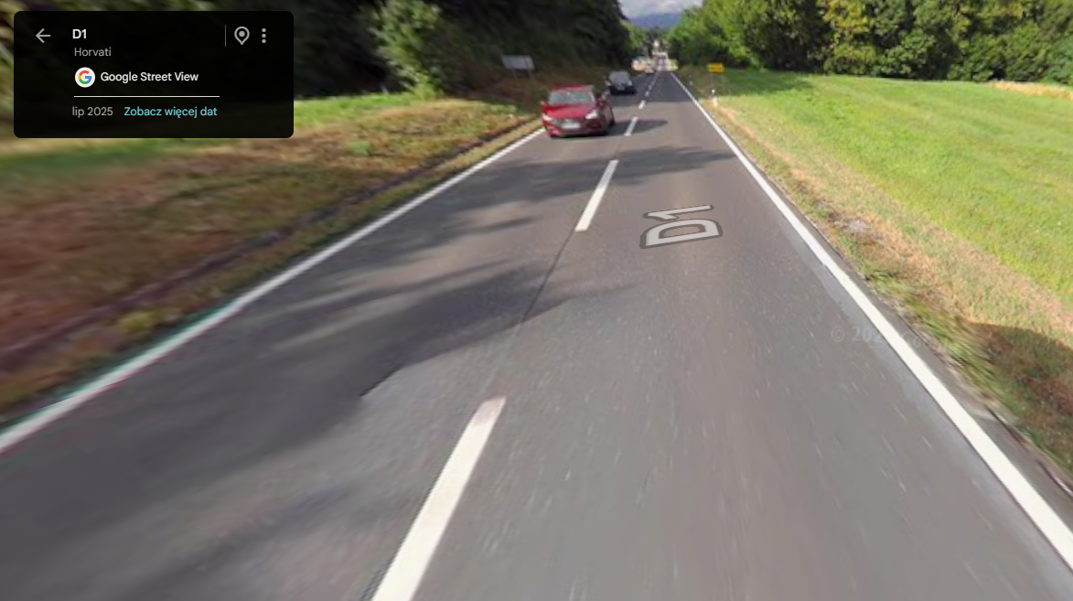
Definition of Homogeneous Road Sections
Subdivision Requirement
If road characteristics change within a stretch between two junctions, such as the number of lanes, speed limit, or alignment, the section must be further subdivided to maintain homogeneity.

Slide 16
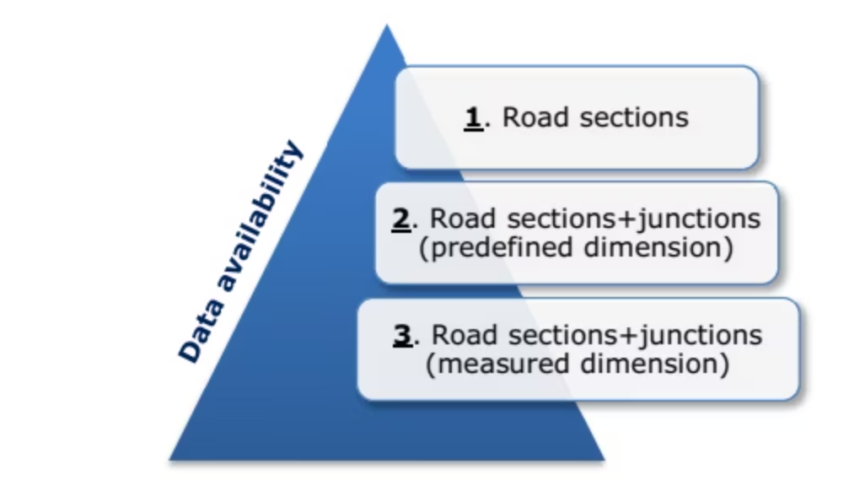
Network Segmentation Approaches
The choice of segmentation approach depends on the quality and completeness of available roadway and crash location data. Three approaches are defined, ranging from simplified to fully detailed, each suited to different data environments.

Slide 17

Undivided Roads
1st Approach – Homogeneous Road Sections
Rough Segmentation — Divide network using junction midpoints as approximate boundaries
Refine by Homogeneity — Subdivide further wherever road characteristics change within a stretch
No Junction Assessment — Junctions are not separately evaluated — crashes are absorbed into adjacent sections

Slide 18

Undivided Roads
The main criteria
Length 5 ± 2km
Divided by:
  upper category roads (motorway),
  the same category roads (national)
  lower category roads (regional)
Divided by:
  Number of lanes (number of lanes for straight-ahead traffic)
  Horizontal alignment (A distinction should therefore be made between tortuous road sections (i.e., with a series of sharp bends) and straight/ gently curving sections)
  Traffic volume (A new section should be defined where there are major changes in the traffic volume)

