Slide 1
Segmentation of the road network, Linking accidents to the individual road sections - Practical

Slide 3

Practical
1
Software
2
Source of data
3
Type of data
4
Task

Slide 4


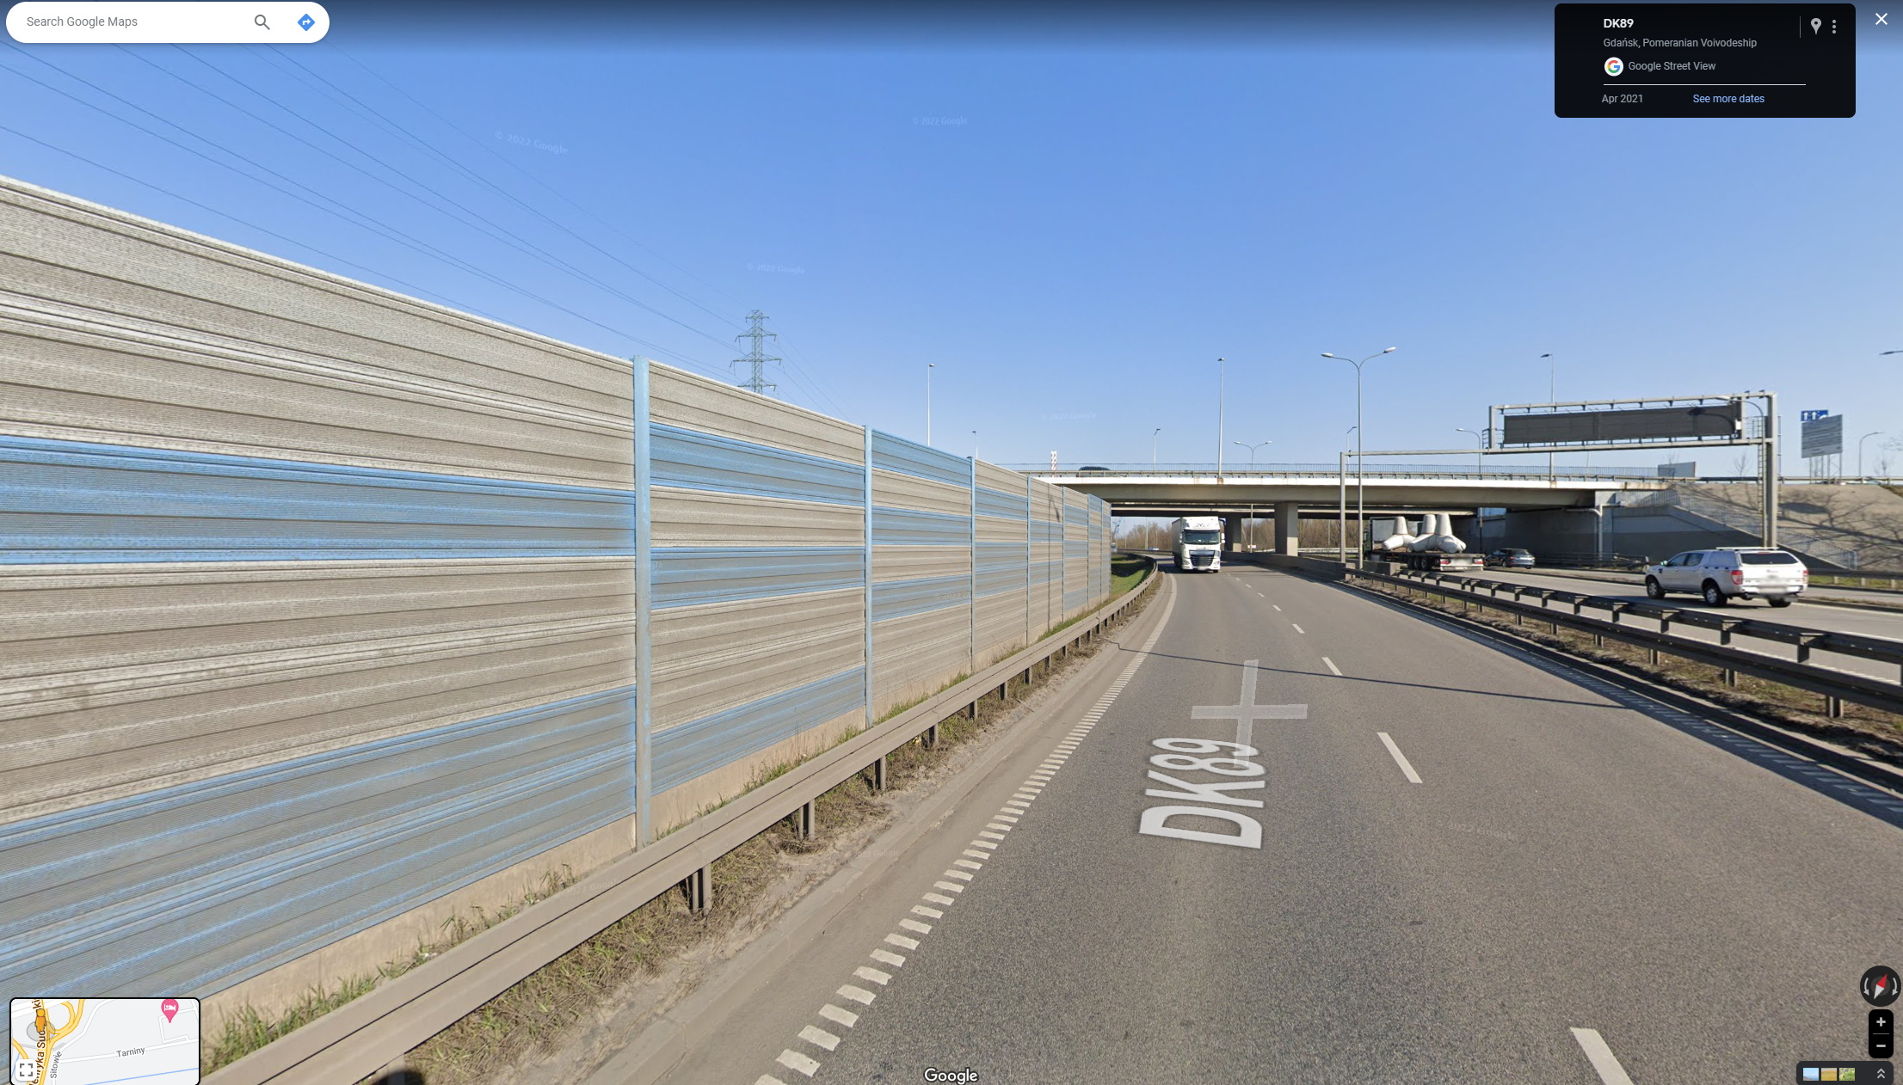
1.
Software

Slide 5
1. Software
We can use the following software to analyse road sections:
  YouTube – to watch prepared videos from Interchanges
  Maps.google.com (street view) - to watch the area of interchanges
  Google Earth - software for displaying prepared *.kmz, *.kml files. The software does not have advanced editing data processing functions - freeware

Slide 6
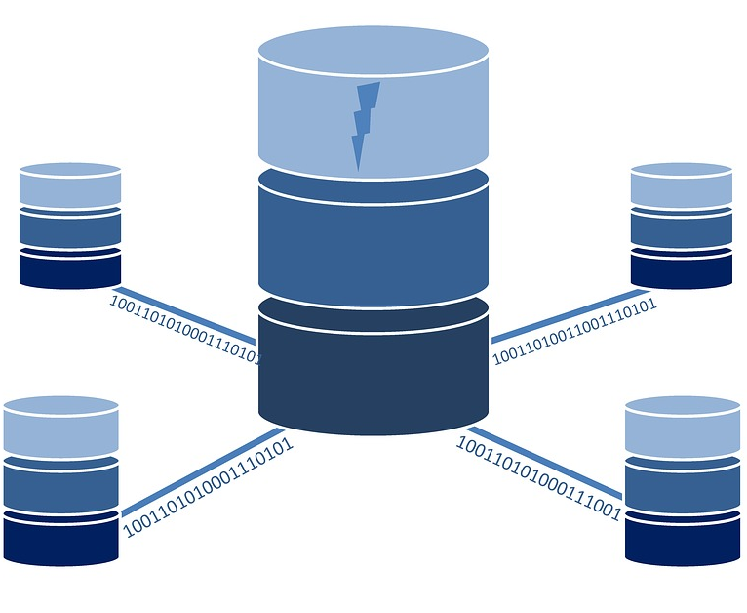
2.
Source of data

Slide 7

2. Source of data
The prepared video was recorded on Polish roads between 2016 and 2023
The data was compiled by Gdansk University of Technology
Data may be used by Creative Commons NonCommercial license
Data are available at Youtube channel: Infro@d - European Digital Education (youtube.com/@Infrod-EuropeanDigitalEducatio)
Playlist - INFRO@D Roadside safety management - Regional Roads

Slide 8
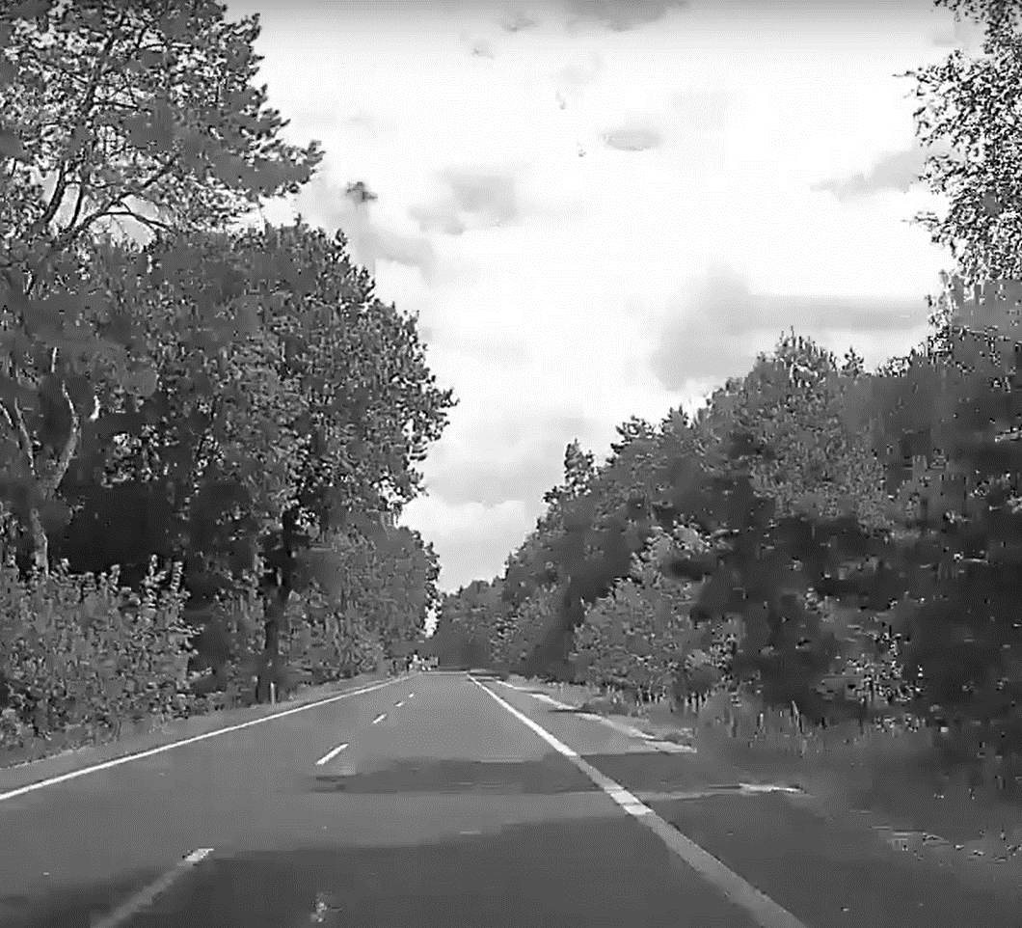
3.
Type of data

Slide 9
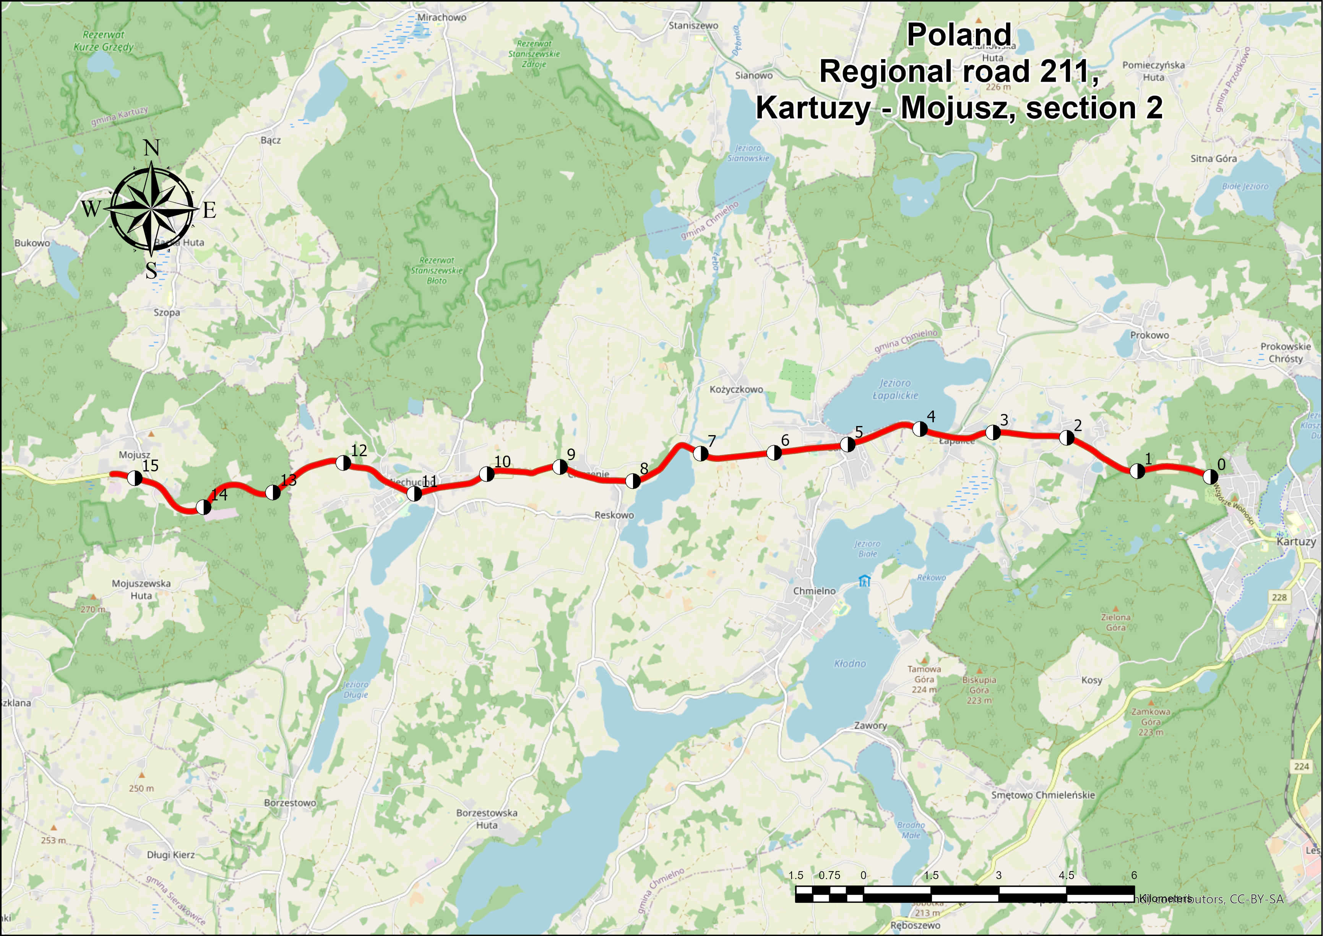

3.1. Type of data
Data includes road sections:
  21 Regional roads
Data are provided in four types of data:
  Video files
  PDF files
  Shapefiles – polylines, points
  KMZ data - polylines, points

Slide 10

4.
Task

Slide 11
TASK
Divide the sections into segments in accordance with NWRSA requirements
Assess a section of Road 221 by specifying selected road parameters
Working in groups of 2 people

Slide 12
Data range
The data pertains to Poland’s territory
ID | Road nb | Section name | Section nb | cross section | Length | ID | Road nb | Section name | Section nb | cross section | Length
1 | 211 | Kartuzy - Mojusz | 2 | 1x2 | 15307 | 12 | 256 | Trzeciewiec - Bydgoszcz | 1 | 1x2 | 12473
2 | 211 | Dzierzazno - Zukowo | 3 | 1x2 | 7925 | 13 | 283 | Zielona Gora - Kielpin | 1 | 1x2 | 11148
3 | 214 | Koscierzyna Wybudowanie - Stezyca | 1 | 1x2 | 8952 | 14 | 408 | Lany Wielkie - Kotlarnia | 1 | 1x2 | 15812
4 | 218 | RR218 - Koleczkowo | 1 | 1x2 | 14611 | 15 | 408 | Kotlarnia - Kedzierzyn Kozle | 2 | 1x2 | 14320
5 | 221 | Koscierzyna - Szumies Krolewski | 1 | 1x2 | 15504 | 16 | 430 | Mosina - Lubon | 1 | 1x2 | 12079
6 | 221 | Trzepowo - Czapielsk | 2 | 1x2 | 16968 | 17 | 521 | Kwidzyn - Prabuty | 1 | 1x2 | 15755
7 | 221 | Czapielsk - Jankowo Gdanskie | 3 | 1x2 | 9612 | 18 | 527 | Mikołajki Pomorskie - Dzierzgon | 1 | 1x2 | 15898
8 | 224 | Szemud - Wejherowo | 1 | 1x2 | 11189 | 19 | 631 | Zegrze - Zielonka | 1 | 1x2 | 15722
9 | 224 | Przodkowo - Kartuzy | 2 | 1x2 | 7817 | 20 | 726 | Rawa Mazowiecka - Rzeczyca | 1 | 1x2 | 16178
10 | 240 | Bladzim - Swiecie | 1 | 1x2 | 15496 | 21 | 878 | Janow Lubelski - Zadziary | 1 | 1x2 | 19486
11 | 244 | Jastrzebie - Tryszczyn | 1 | 1x2 | 13558

Slide 13
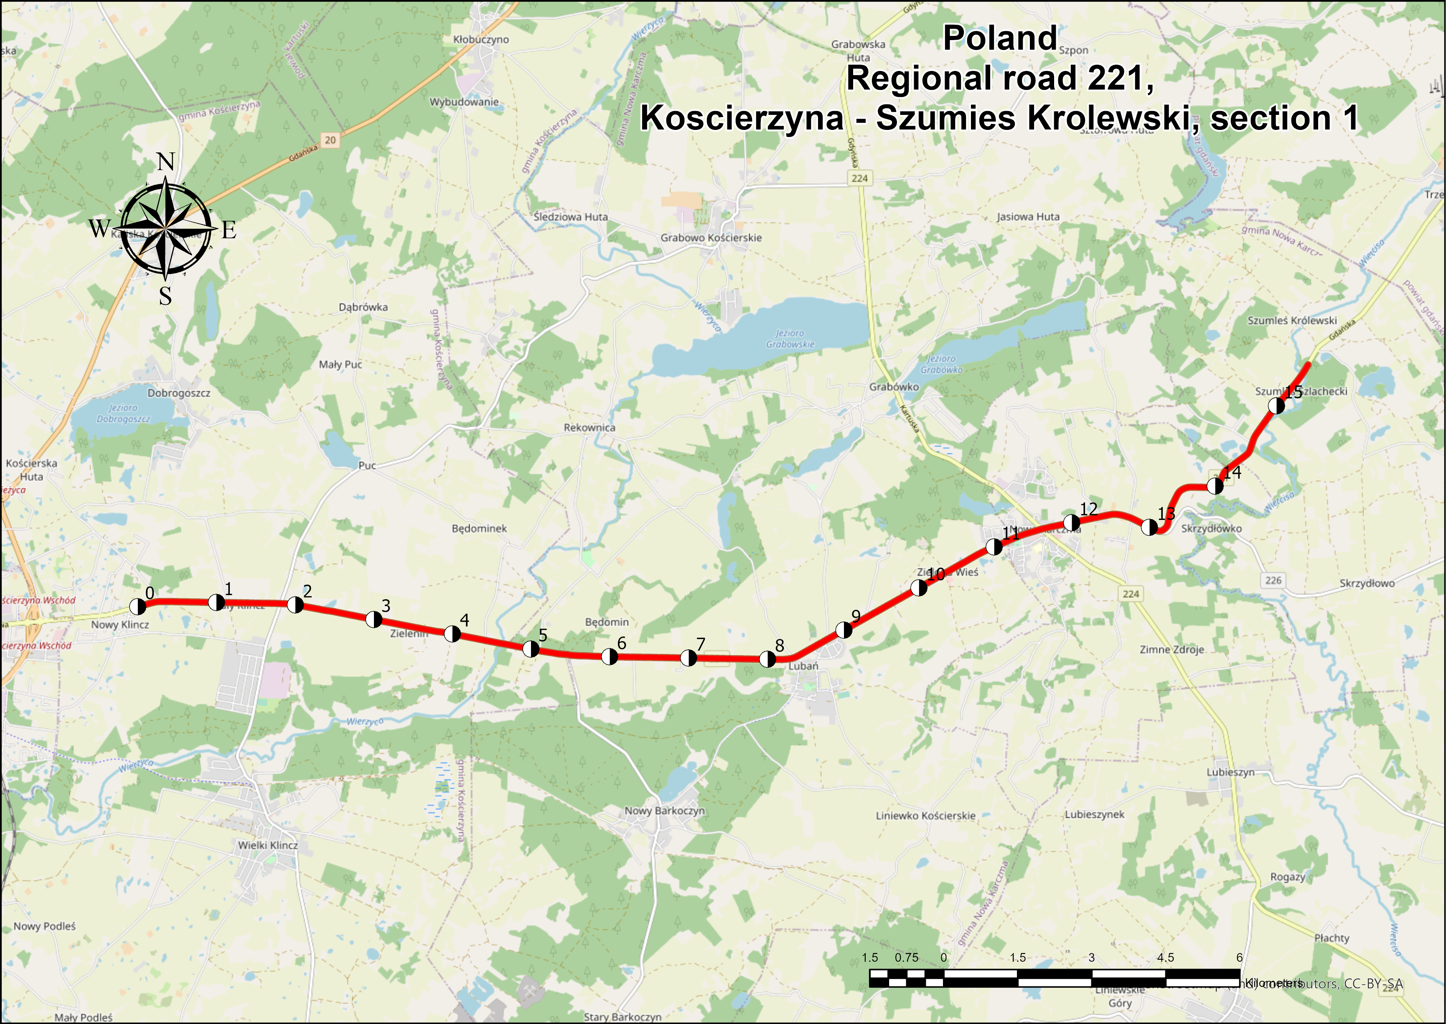
Map
google_maps_link

Slide 14
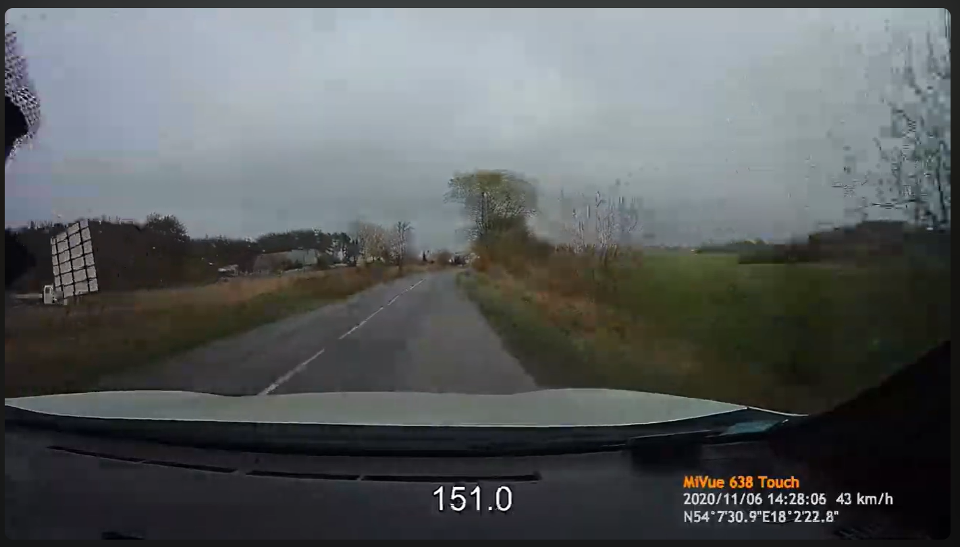
Video
youtube_link

Slide 15
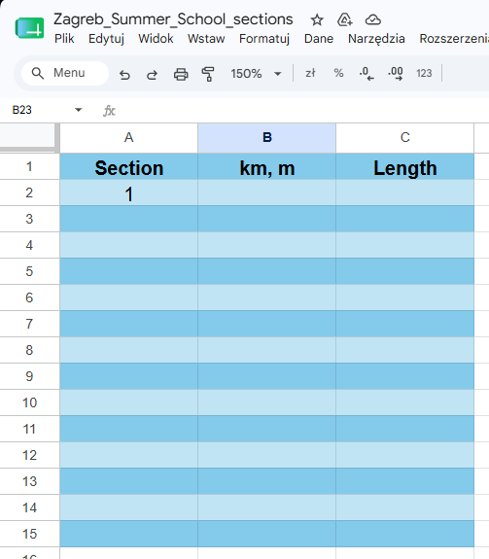
Sections
Google.docs

