Slide 1
Summer School Zagreb 2026
Importance of Road Infrastructure Safety Management
Julius Uhlmann - Bauhaus Universität Weimar / Tomasz Mackun - Gdańsk University of Technology

Slide 3


Slide 4
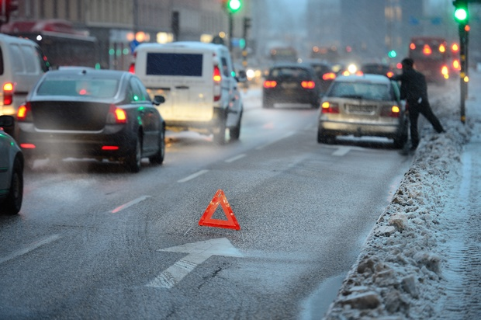
WHAT DOES IT MEAN TO MANAGE SOMETHING ?

Slide 5

MANAGE SOMETHING ?
ANALYSIS
IDENTIFICATION
PLAN
ACTION
Risk ASSESSMENT
DATABASE
EVALUATION
DATABASE OF ROAD ACCIDENTS
CONFLICTS ANALYSIS
INSPECTION / AUDIT
LOCAL ANALYSIS

Slide 6
IS ROAD SAFETY A PROBLEM ?

Slide 7
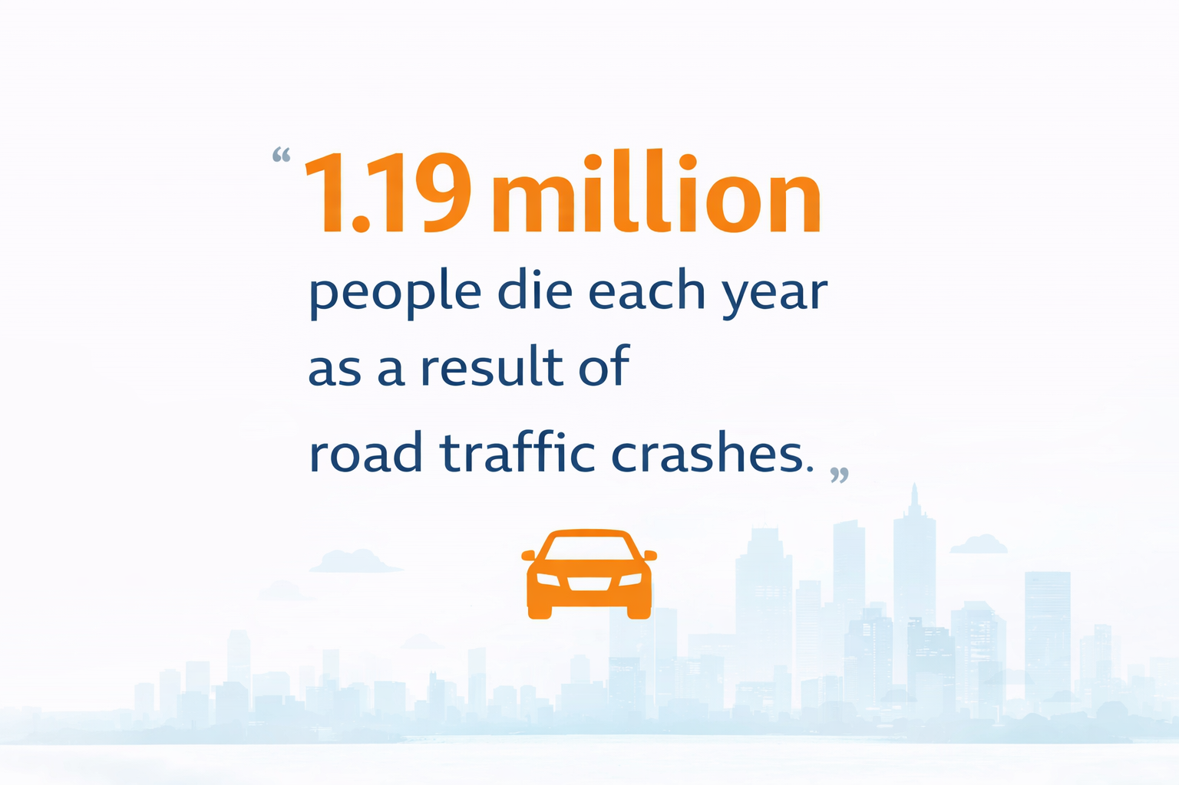
Source: World Health Organisation

Slide 8
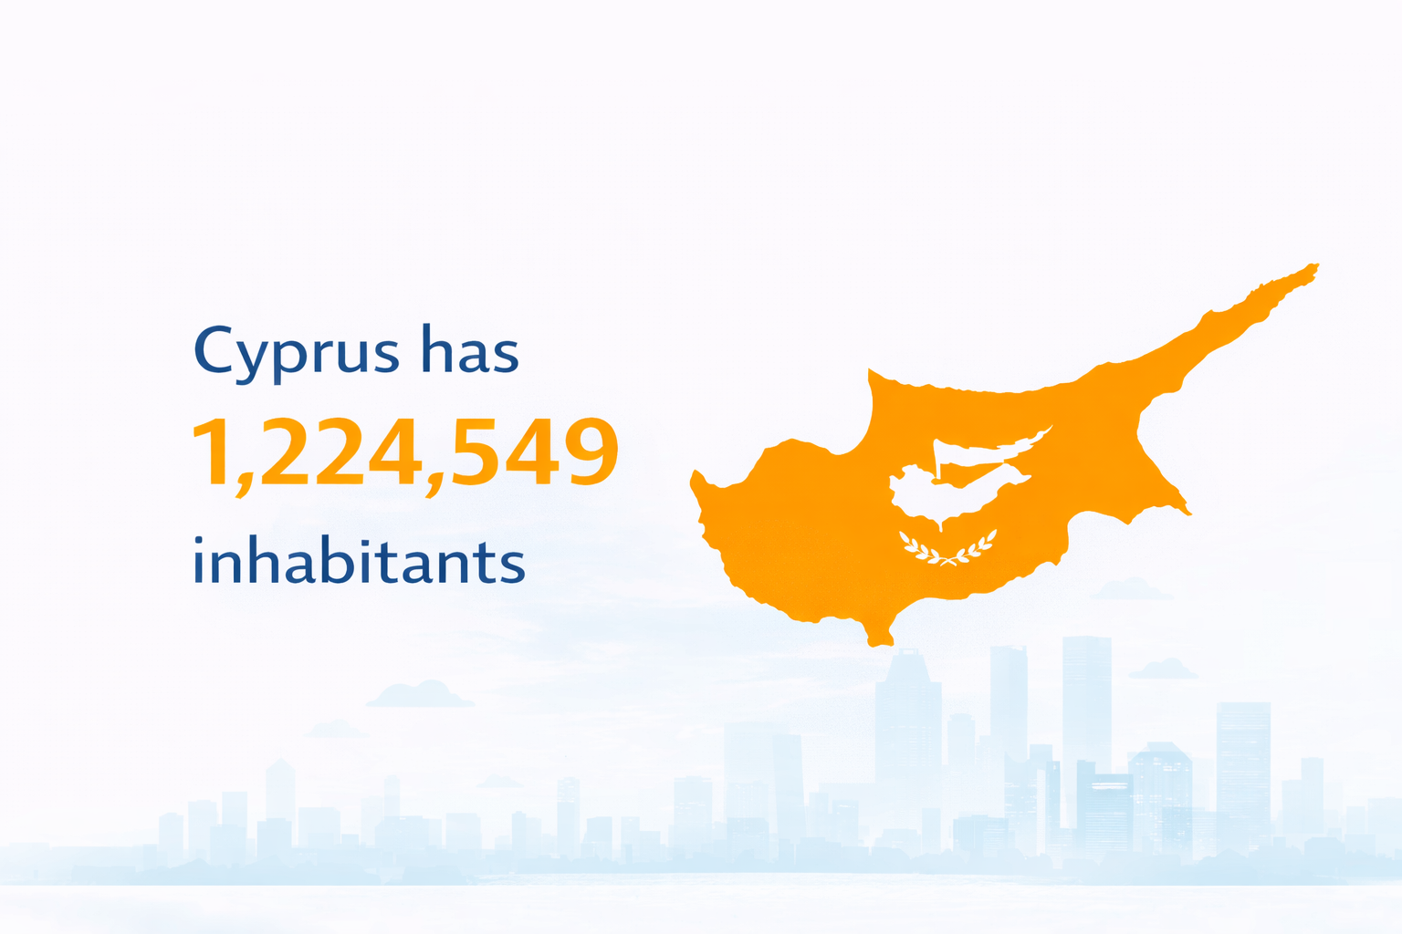

Slide 9
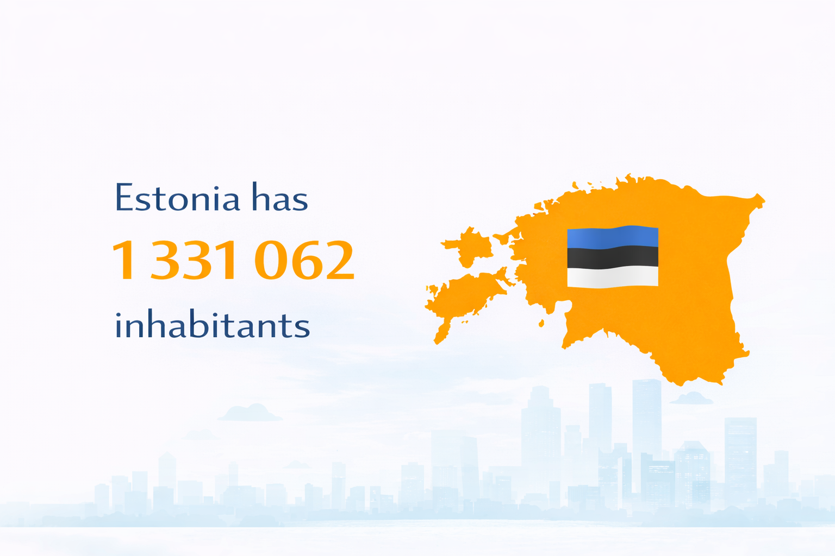

Slide 10
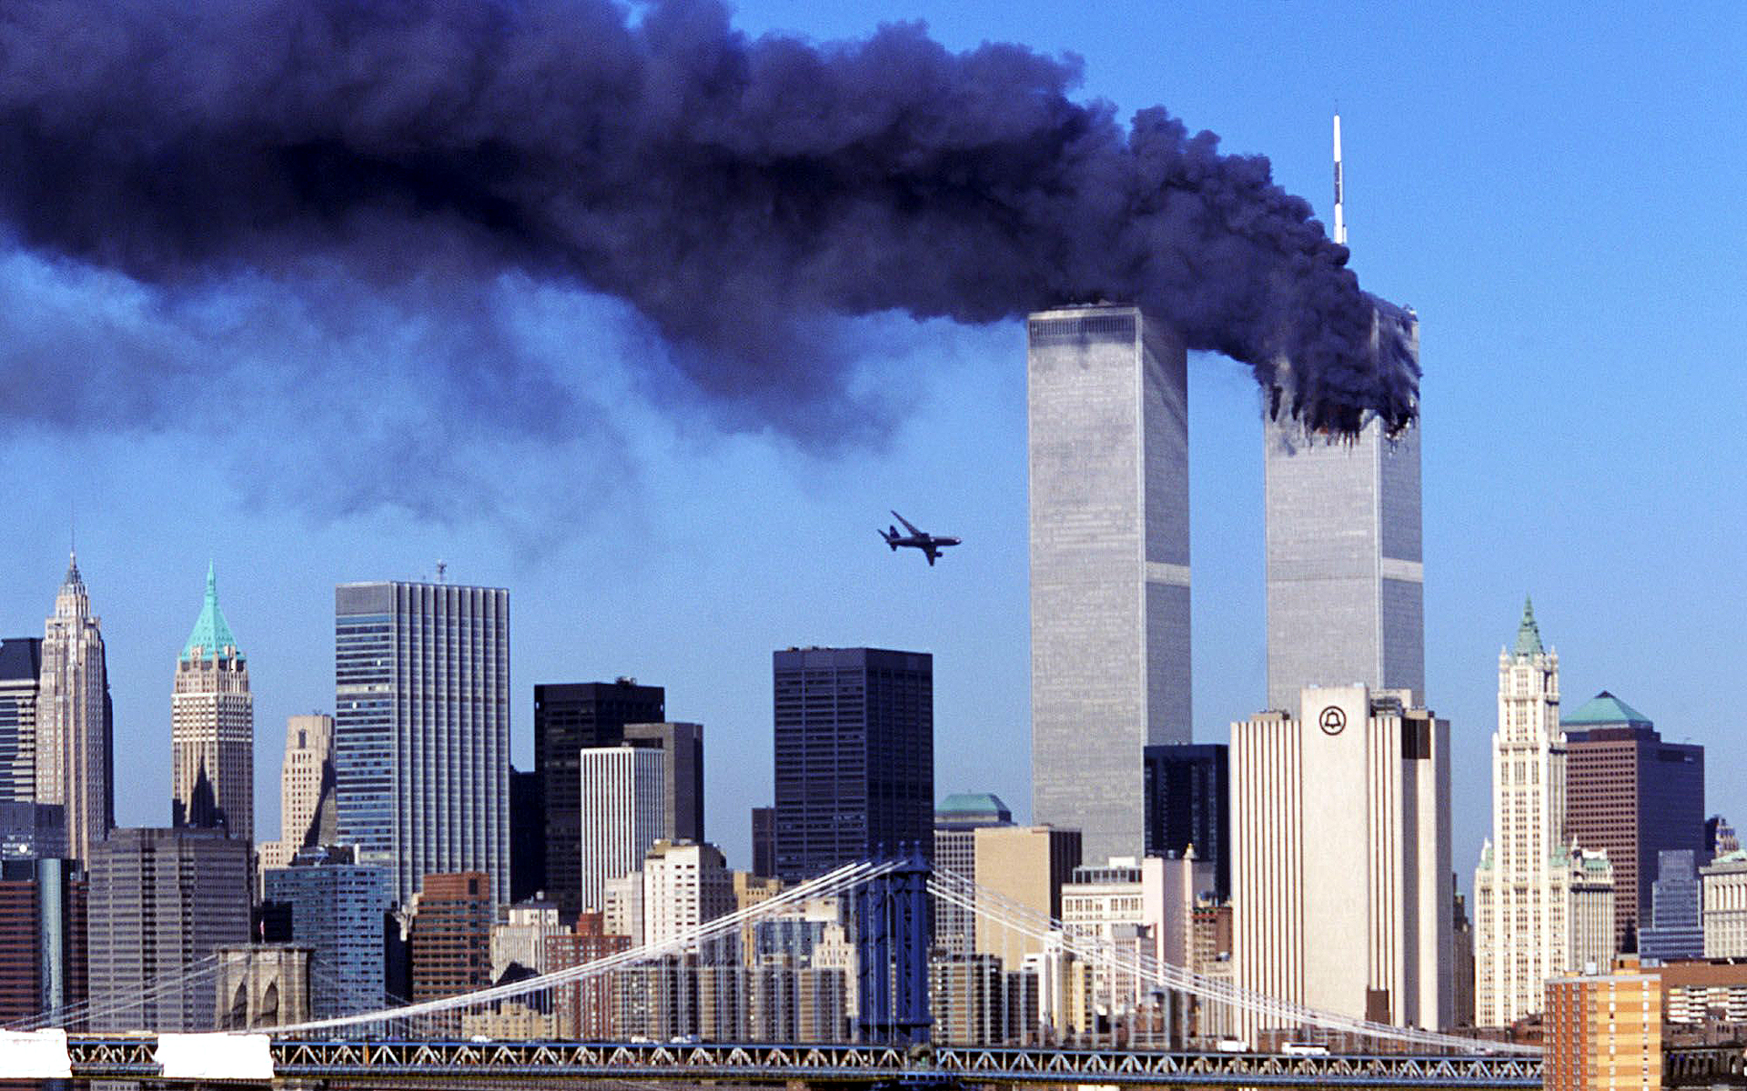
2 996 PEOPLE KILLED
DO YOU REMEMBER?

Slide 11

What were the consequences of the attack ?

Slide 12


Slide 13
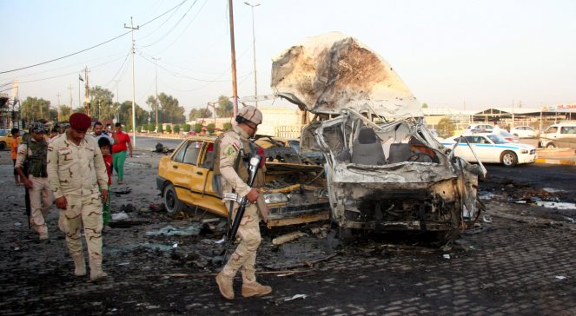
VICTIMS
Iraq `` 22 000 - 655 000 depends on source
USA and Alliances About 4 000 people killed

Slide 14
SO WHY WE START A WAR FOR 3000 VICTIMS AND AT THE SAME TIME DO SO LITTLE WHEN OVER 1.3 MILLION PEOPLE GET KILLED ON THE ROAD ?
WHAT DO YOU THINK NOW ?
IS ROAD SAFETY A PROBLEM ?

Slide 15
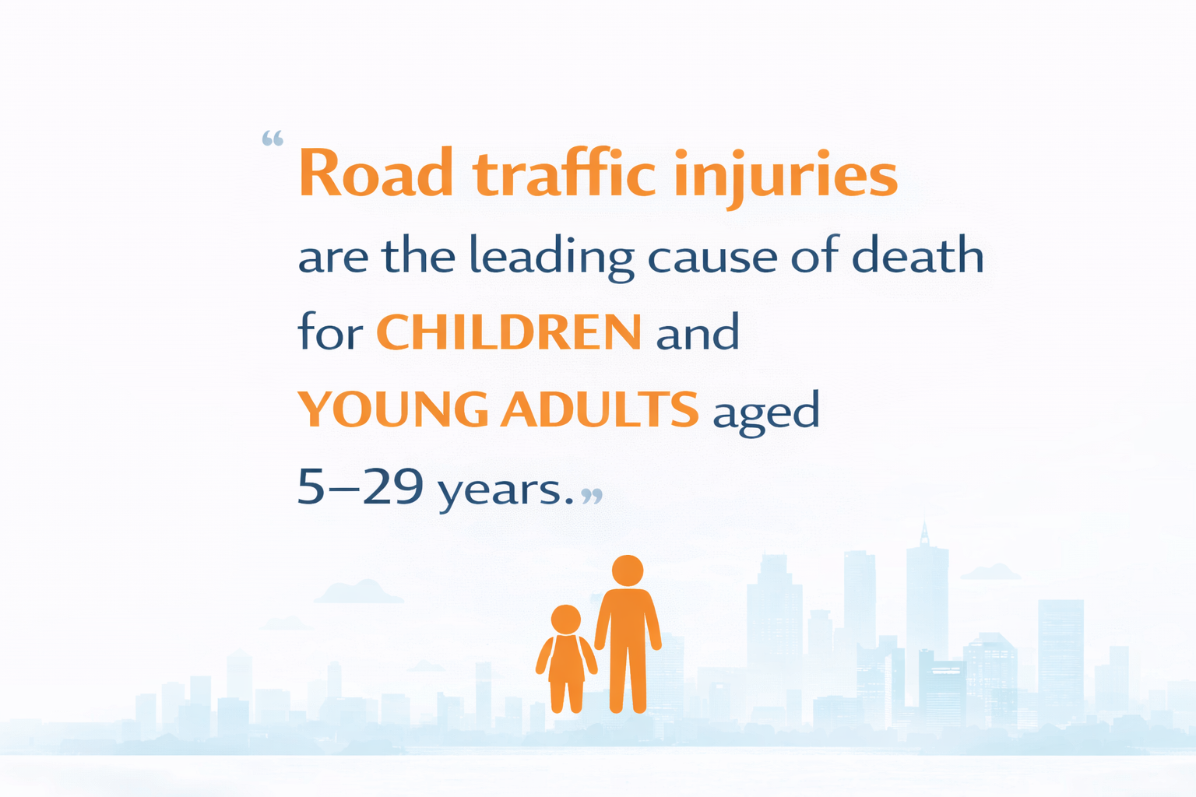
Source: World Health Organisation

Slide 16
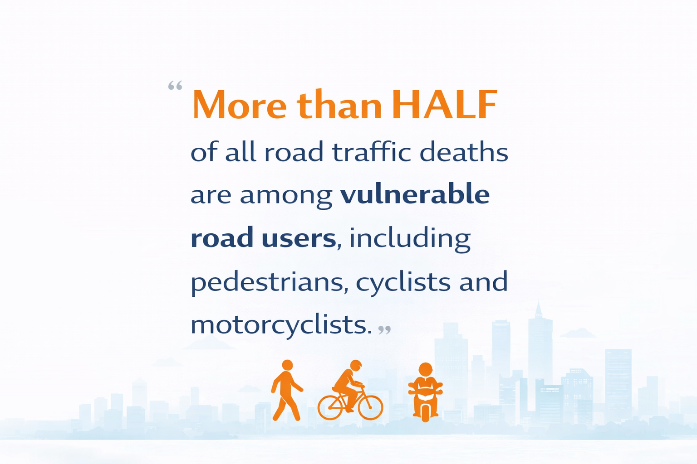
Source: World Health Organisation

Slide 17

Source: World Health Organisation

Slide 18
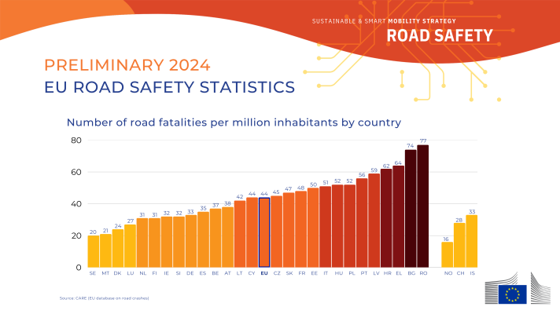
Differences between the countries
HR
IT
PL
EU
DE
SE
Source: European Comission

Slide 19
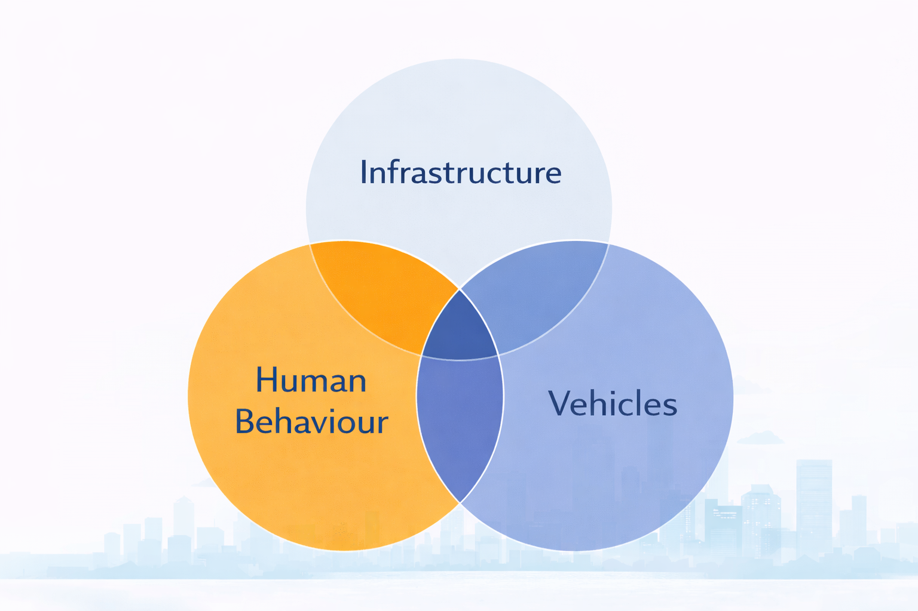
Factors influencing traffic safety
Notes:
We are focussing on Infrastructure, because that is our background. The other two domains are equally important.

Slide 20

Factors influencing traffic safety
Notes:
We are focussing on Infrastructure, because that is our background. The other two domains are equally important.

Slide 21

Darkness
Notes:
Example: A car drives on a road, it is dark

Slide 22

Rain
Darkness
Notes:
It starts to rain

Slide 23

Small curve radius
Rain
Darkness
Notes:
The road has small radius

Slide 24

Poor pavement quality
Small curve radius
Rain
Darkness
Notes:
The quality of the pavement is poor

Slide 25

Distraction
Poor pavement quality
Small curve radius
Rain
Darkness
Notes:
The driver is distracted – CRASH

Slide 26

Crash
Distraction
Poor pavement quality
Small curve radius
Rain
Darkness
Notes:
The driver is distracted – CRASH

Slide 27
Factors influencing traffic safety
Distraction
Threshold
Poor pavement quality
Small curve radius
Rain
Darkness
Notes:
On a good road in good condtions, the distraction might not have been enough to cause an accident, but in the sum of factors it did, as it surpassed a threshold.

Slide 28
Factors influencing traffic safety
Threshold
Distraction
Small curve radius
Rain
Poor pavement quality
Darkness
Notes:
Road Infrastrcture Safety Management can mitigate that. If the pavement would have been better, the accident might have been preventable.

Slide 29
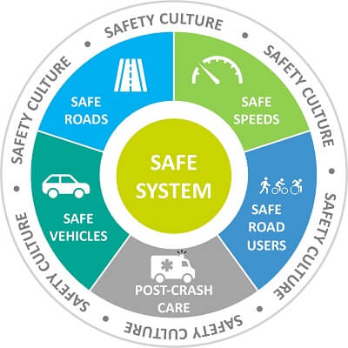
Safe System Approach
Source: National Safety Council
Notes:
In an extension, there can be more factors included in a safe system approach, such as the post crash care

Slide 30
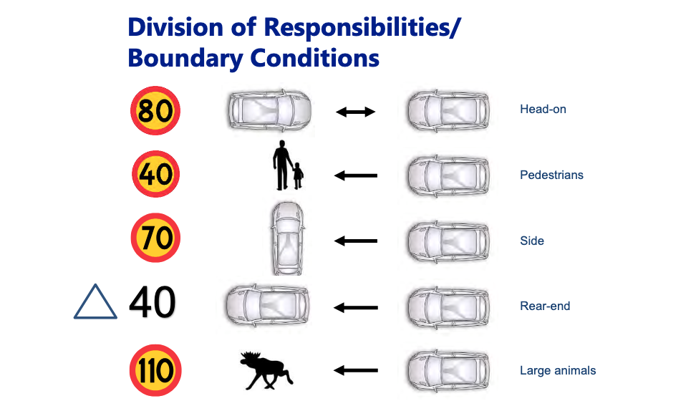
Safe System Approach
Source: Lars Ekman, Trafikverket
Notes:
Swedish safe system Approach:
There are only certain sppeds up to which a crash is survivable. So adjust the speed limits to reduce fatalities or prevent those accidents, e.g. with a median (first example).

Slide 31
How can we influence infrastructure safety?
Good design standards
Good planning
Good building quality
Good maintainance
Good management
Notes:
Good management of the whole process

Slide 32
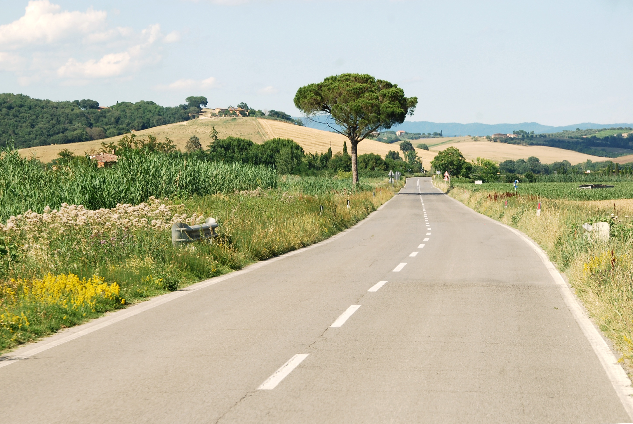
Undivided rural
Regional road sections
Poland
EXERCISE

Slide 33
Undivided rural
Regional road sections
Poland
Risk calculations
20 minutes

Slide 34
Risk calculations
Select road safety management methods that could solve the problem – to find the most dengerous regional road section
Road | Section | FROM | TO | Length | AADT | Accident | Fatalities | Seriously injured | Light injuries | Ped. Crossings | Schools | Speed limit
RR211 | A | 0 | 1550 | 1.55 | 14000 | 8 | 0 | 3 | 12 | 1 | No | 90
RR211 | B | 1550 | 3640 | 2.09 | 13000 | 2 | 1 | 1 | 2 | 4 | Yes | 50
RR211 | C | 3640 | 5570 | 1.93 | 7500 | 0 | 0 | 0 | 0 | 3 | Yes | 70
RR211 | D | 5570 | 8250 | 2.68 | 4000 | 3 | 0 | 2 | 4 | 2 | No | 50
RR211 | E | 8250 | 10030 | 1.78 | 12500 | 6 | 2 | 4 | 6 | 0 | No | 100
RR211 | F | 10030 | 12750 | 2.72 | 9000 | 4 | 0 | 0 | 8 | 5 | Yes | 50
RR211 | G | 12750 | 15300 | 2.55 | 17500 | 5 | 1 | 5 | 10 | 0 | No | 90

Slide 35

Indicate the order in which interventions should be implemented. Select the top three priority sections.
1…..
2…..
3…..

Slide 36
EXERCISE
Three approaches to prioritising road safety interventions

Slide 37
Approach 1: Key Points
Objective: identify sections with the highest number of crashes.
Advantages: simple, transparent, easy to communicate.
Limitation: ignores severity, exposure and vulnerable road users.
Discussion: Should many minor crashes outweigh one fatal crash?

Slide 38
Approach 1: Crash Frequency
Rank | Section | Crashes
1 | A | 8
2 | E | 6
3 | G | 5
4 | F | 4
5 | D | 3
6 | B | 2
7 | C | 0

Slide 39
Approach 2: Key Points
Objective: reduce fatalities and serious injuries.
Aligned with Safe System and Vision Zero principles.
Focuses on societal harm rather than crash counts.
Discussion: Should one fatal crash outweigh ten minor injury crashes?

Slide 40
Approach 2: Crash Severity (Vision Zero)
Rank | Section | Reason
1 | E | 2 fatalities + 4 serious injuries
2 | G | 1 fatality + 5 serious injuries
3 | B | 1 fatality near school
4 | D | 2 serious injuries
5 | A | 3 serious injuries
6 | F | No severe injuries
7 | C | No crashes

Slide 41
Approach 3: Combines factores
Combines crash frequency, severity and exposure.
Considers AADT, speed, pedestrian crossings and schools.
Supports proactive safety management.
Example ranking: E, B, G, F, A, D, C.

Slide 42
Comparison of Rankings
Method | Top Priorities
Crash Frequency | A, E, G
Crash Severity | E, G, B
Combines factores | E, B, G

Slide 43
Key Takeaway
There is no single correct ranking.
Different objectives lead to different priorities.
Data alone do not determine decisions.
The methodology determines the ranking.

Slide 44
How can we achive good management?
RISM =
  Road Infrastructure – Scope
  Safety – Prevention of negative effects
  Management – A conceptual approach to steering differnt activities

Slide 45
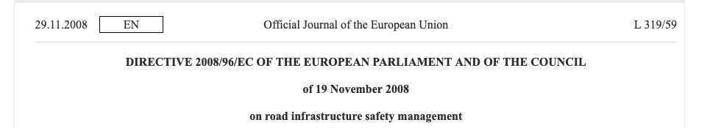
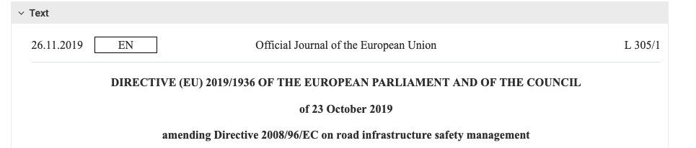
EU Directives on Road Infrastructure Safety Management

Slide 46
RISM Levels
Planning
Road
Safety
Impact
Assessment
Design
Road
Safety
Audit
Operation
Road
Safety
Inspection
Monitoring
Network-wide
Road
Safety
Assessment
Notes:
The four parts of RISM according to the directive

Slide 47
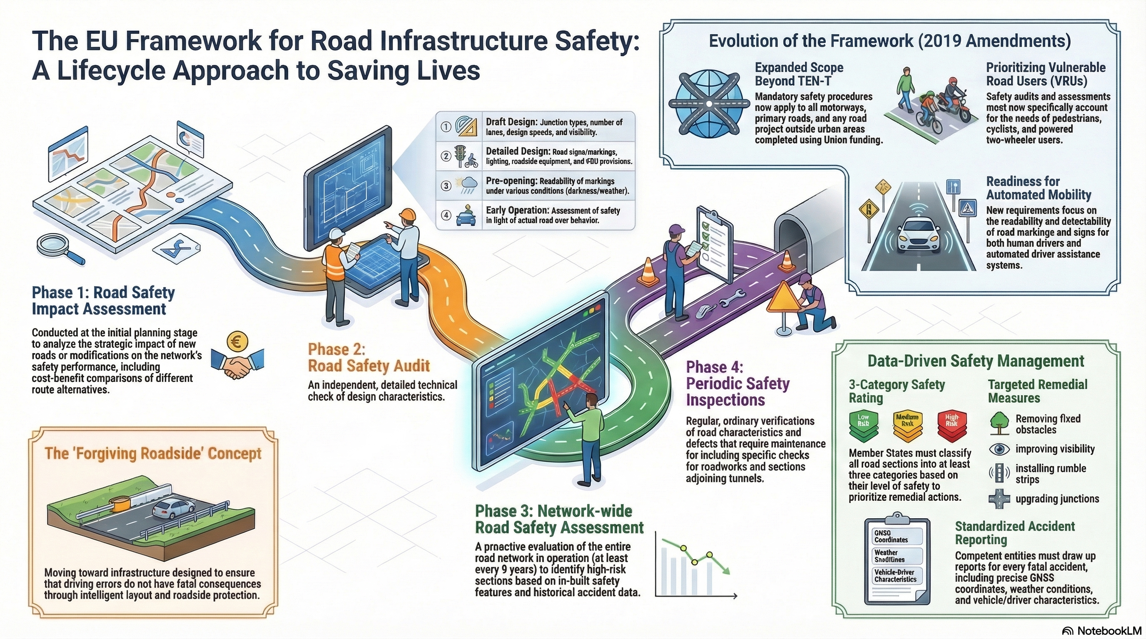
Notes:
The four parts of RISM according to the directive

Slide 48
Road Safety Impact Assessment
Purpose:
  Compare different implementation scenarios from road safety point of view
When:
  Generally undertaken at planning stage and before a major upgrading of the infrastructure
Scope:
  Part of the road network potentially influenced by a measure
Example (Germany):
  Handbuch für Verkehrssicherheit
Source: International Transport Forum

Slide 49
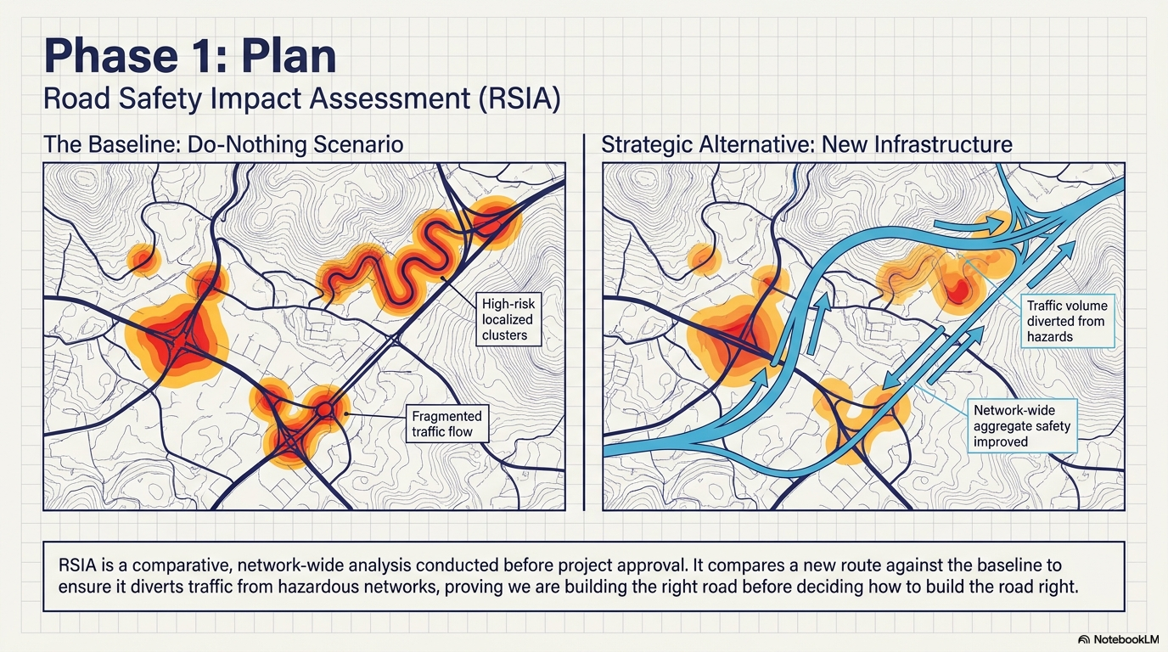

Slide 50
Road Safety Audit
Purpose:
  Identify infrastructure or traffic related factors increasing injury or accident risk
When:
  Undertaken during planning, design, construction, pre-opening and early operation stages
Scope:
  A designed road infrastructure
Example (Germany):
  Richtlinie für das Sicherheitsaudit von Straßen (RSAS)
Source: International Transport Forum

Slide 51
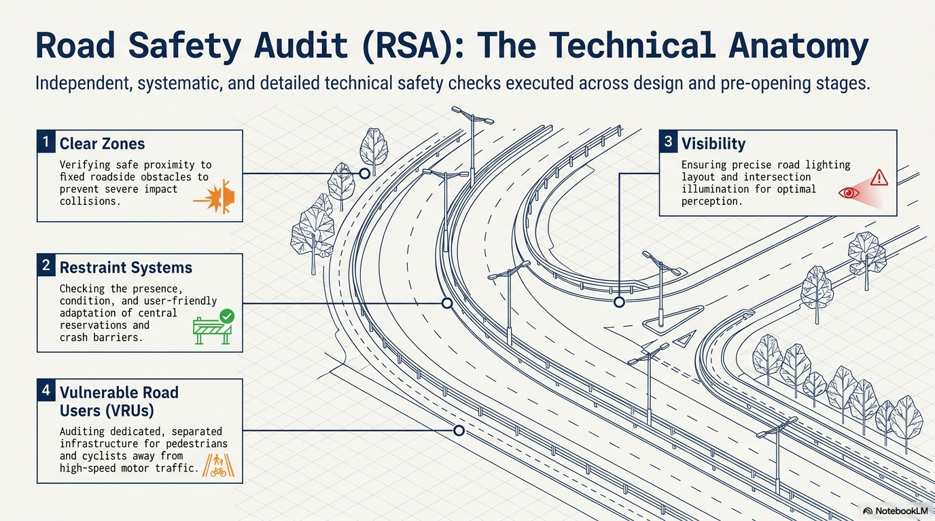

Slide 52
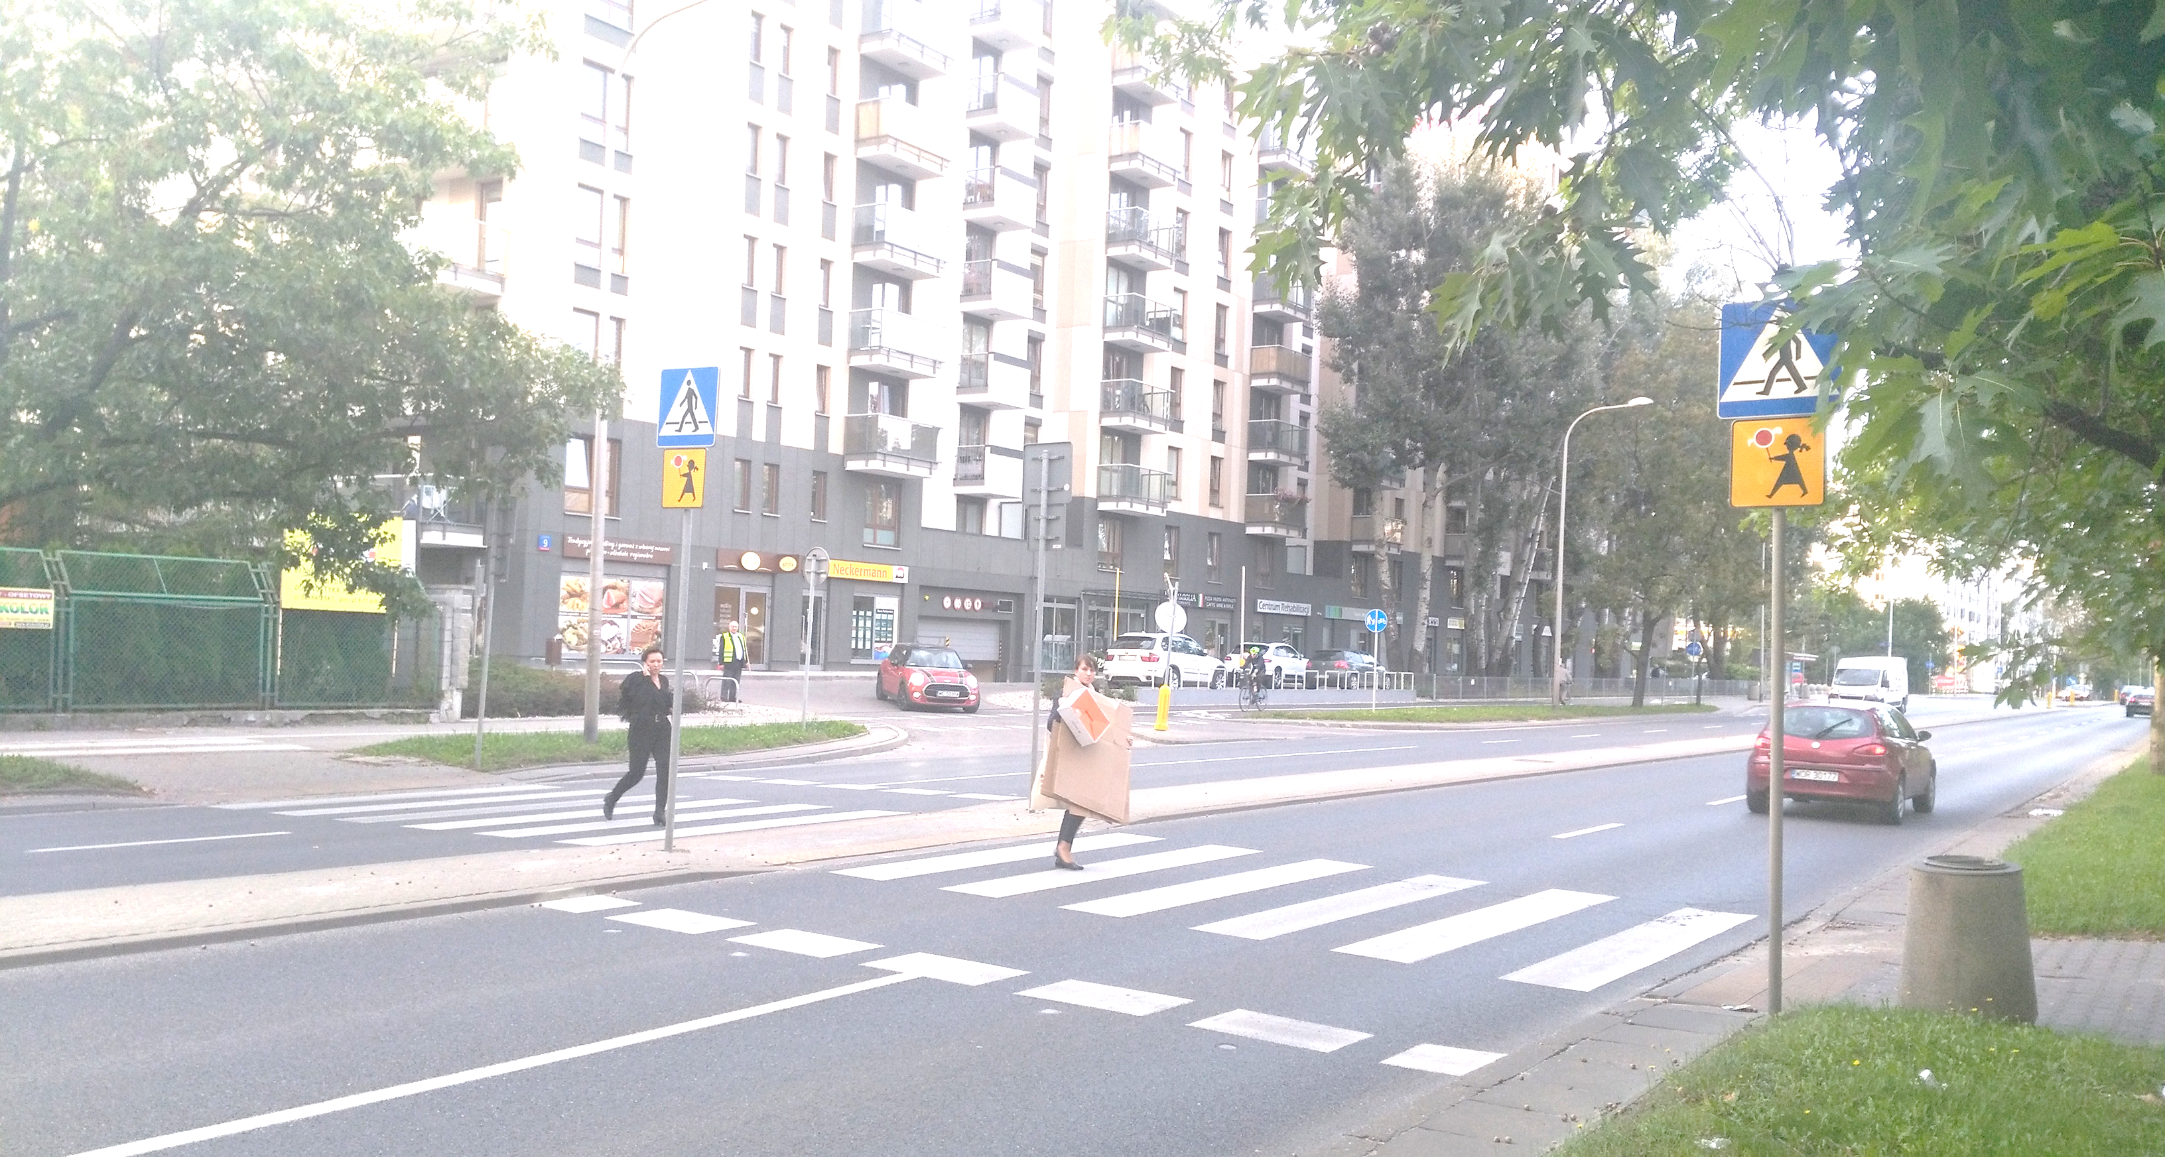
Sokratesa street
Potentially high speed,
Excessively long pedestrian crossing,
Pedestrians have to cross two lanes in one direction.
There is a risk that one vehicle may stop while the other continues moving, with limited visibility of the pedestrian.
Risk of hitting a pedestrian and risk of severe consequences of the incident,
Risk assessment: 1

Slide 53
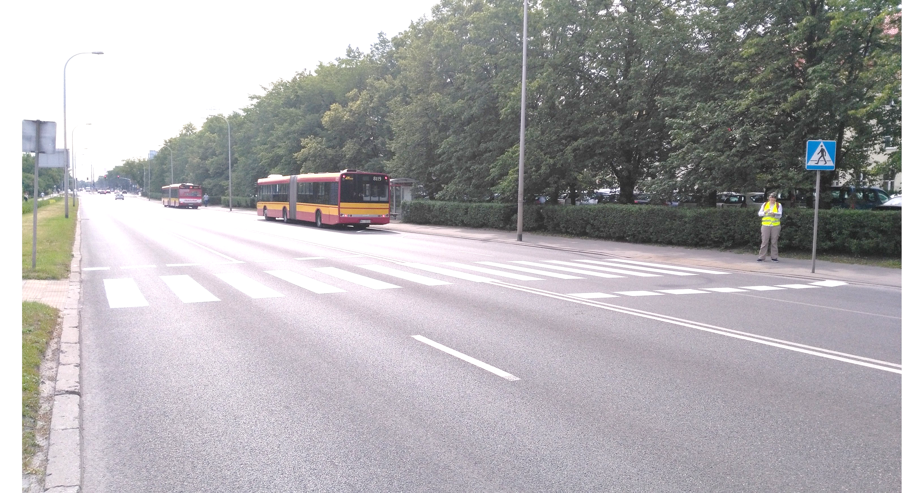
Woronicza street
The pedestrian crossing is exceptionally long: 13.0 m, four lanes.
The long straight section encourages drivers to reach high speeds.
Drivers do not slow down in the area of the pedestrian crossing.
Pedestrians either hesitate or run across the crossing.
The situation is unacceptable and may lead to crashes. The observed speed is significantly higher than 50 km/h, which means that a collision at this location would likely result in a seriously injured or fatal casualty.
Risk rating: 0

Slide 54
Road Safety Inspection
Purpose:
  Identify infrastructure or traffic related factors increasing injury or accident risk
When:
  Generally undertaken during normal operation of a road and may also contribute to error correction and hazard elimination
Scope:
  Part or the entire urban, rural and/or motorway network
Example (Germany):
  Not that clearly implemented – maybe Verkehrsschau
Source: International Transport Forum

Slide 55
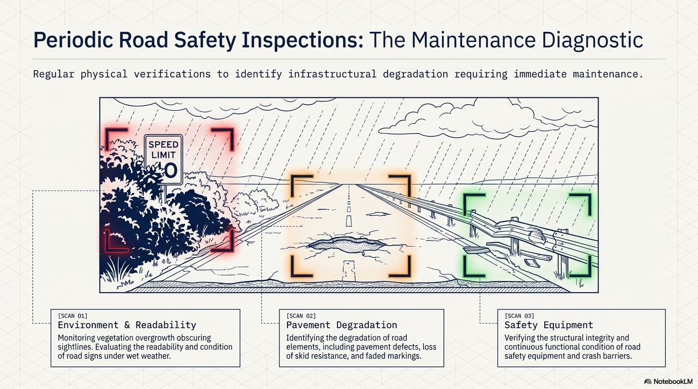

Slide 56
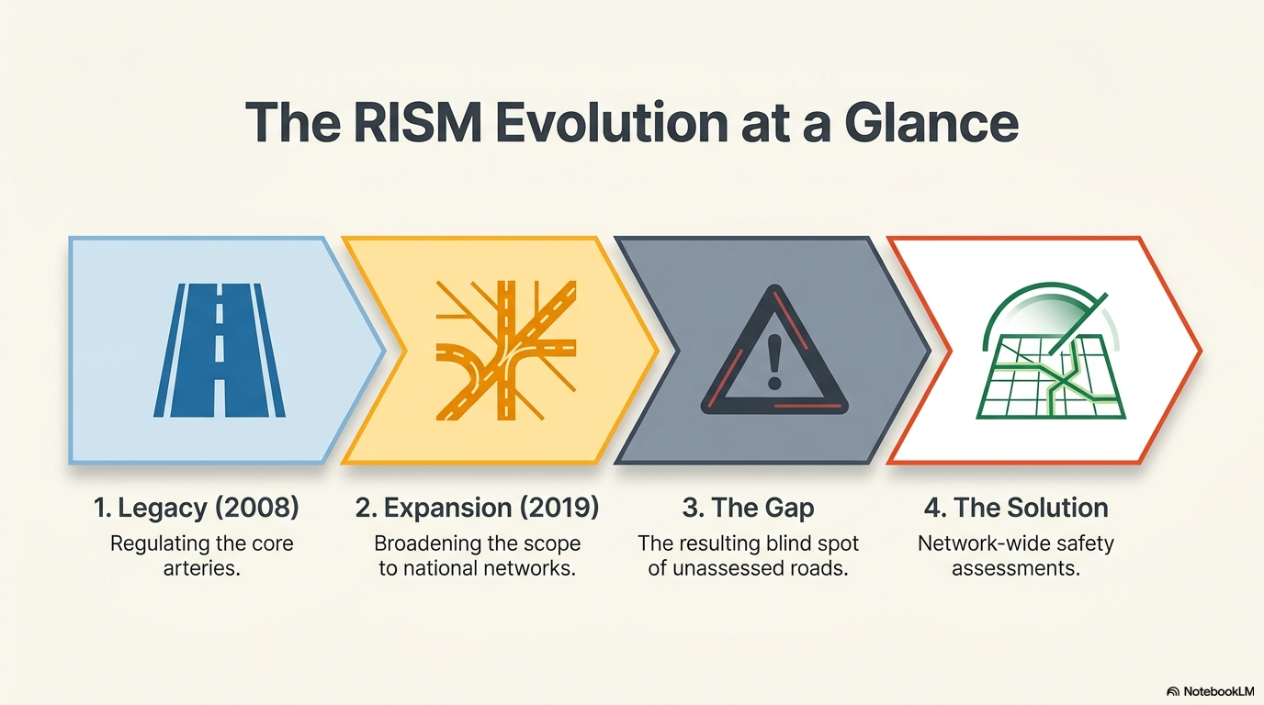

Slide 57
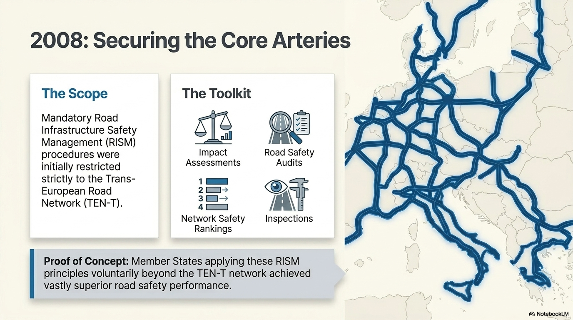

Slide 58
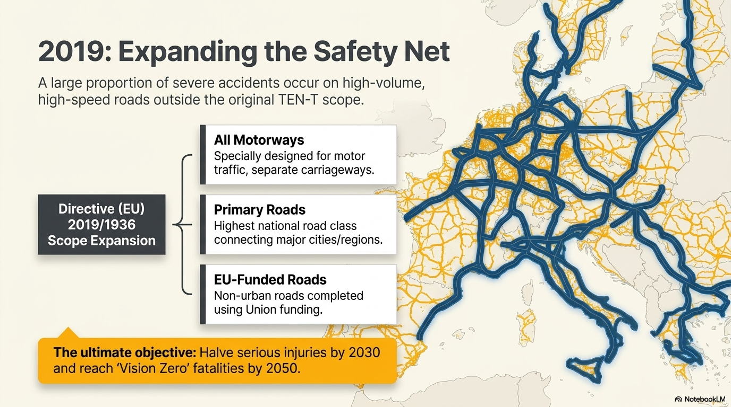

Slide 59
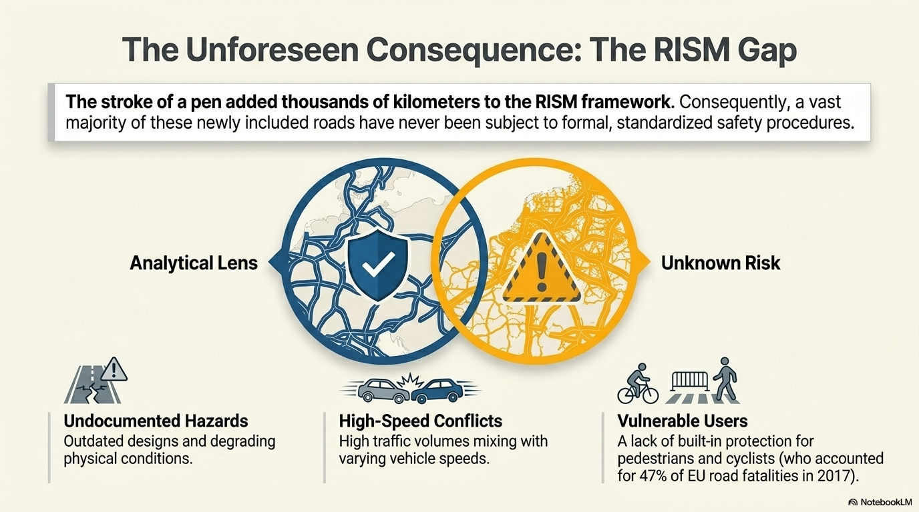

Slide 60
Network-wide Road Safety Assessment
Purpose:
  Identify parts of the network with a high likelihood of crashes
When:
  During the operation of the road network, every few years
Scope:
  Entirety of the road network
Example (Germany):
  Empfehlungen für die Sicherheitsanalyse von Straßennetzen (ESN)

Slide 61
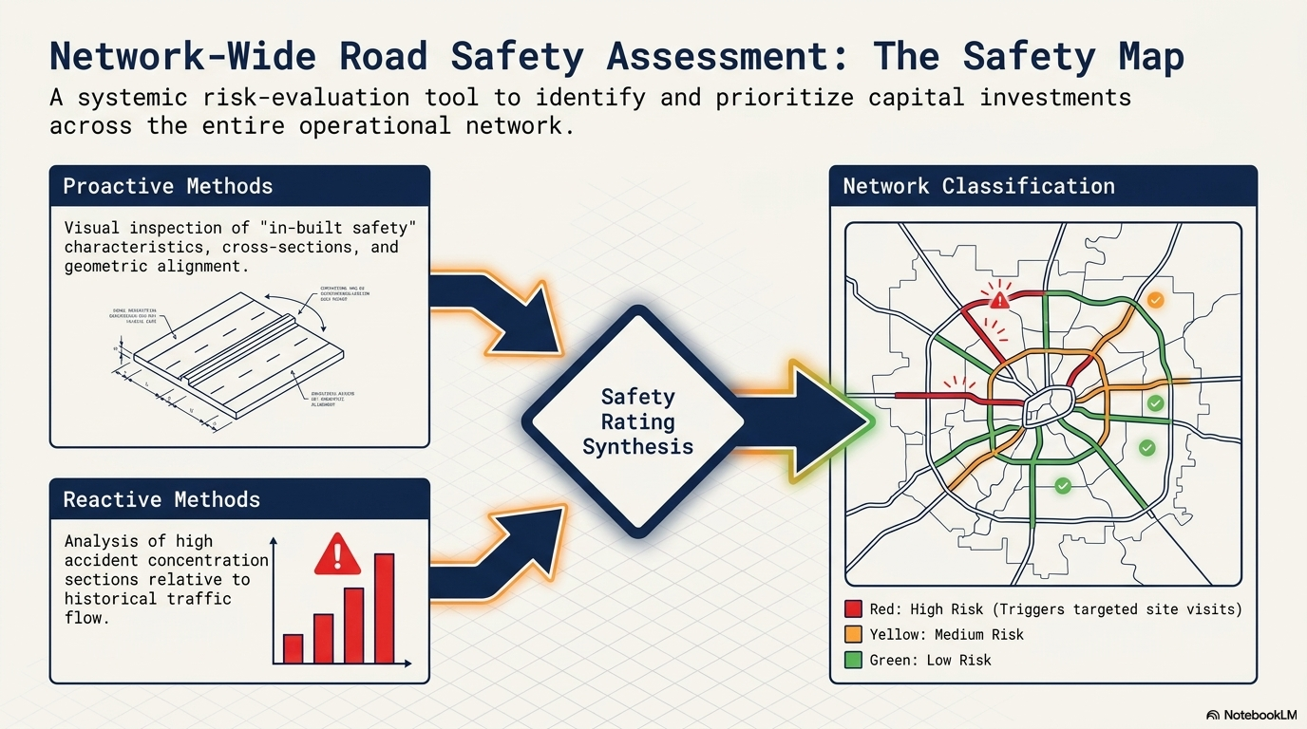

Slide 62
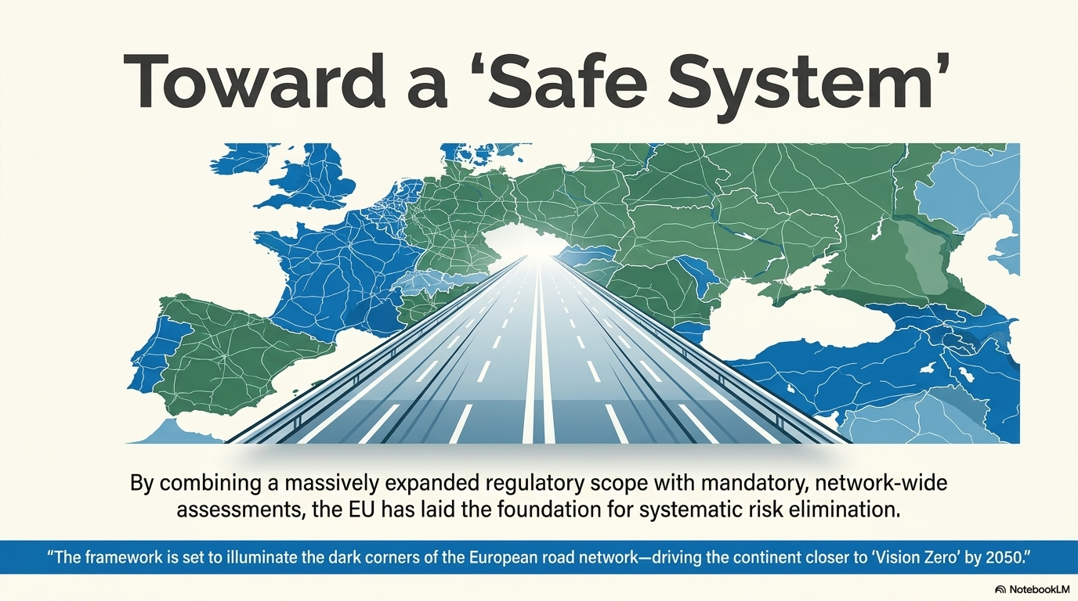

Slide 63
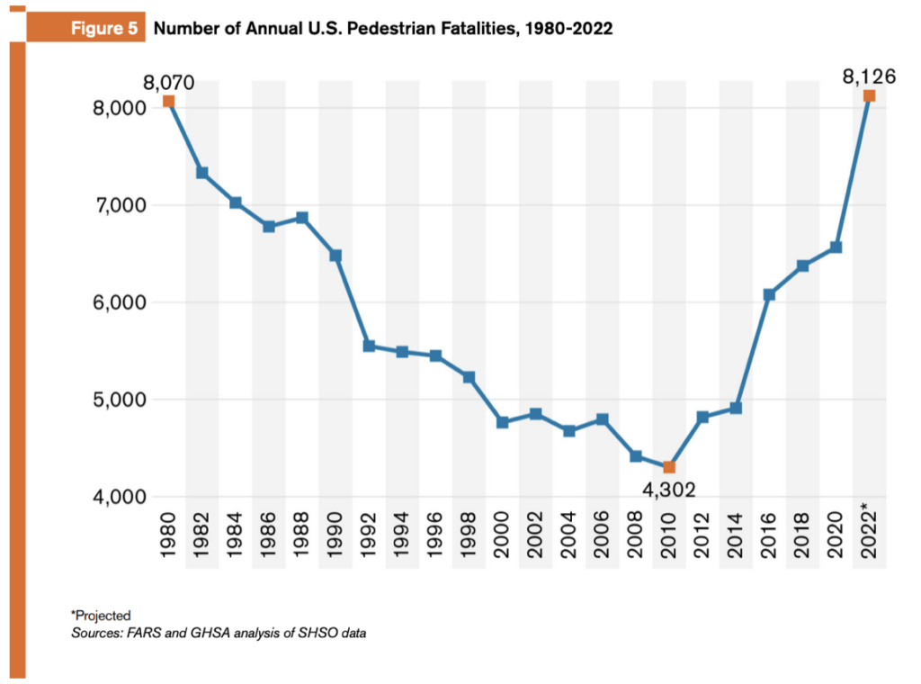

Slide 64
Sources
https://www.who.int/news-room/fact-sheets/detail/road-traffic-injuries
https://transport.ec.europa.eu/background/road-safety-statistics-2024_en
https://www.ictct.net/wp-content/uploads/32-Warsaw-2019/32-Ekman-presentation.pdf
https://www.nsc.org/speeches-testimony/building-safer-roads-for-all
https://www.itf-oecd.org/sites/default/files/docs/15irtadsafetymanagement.pdf

