Slide 1
KICK OF MEETING
LUND 15.01.2024

Slide 3

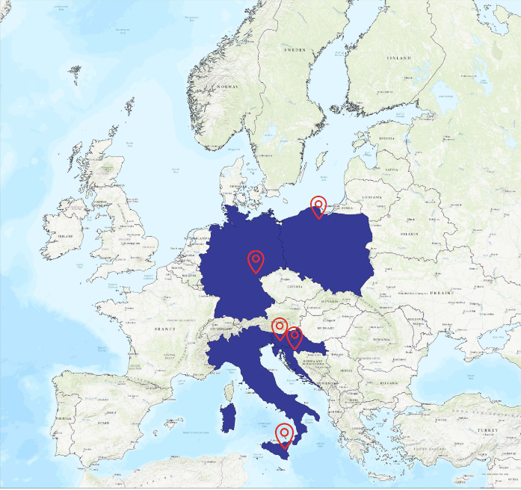

European Road Safety Partnership – history
EuroS@P
Project start/ends | 2020-09-01 2023-08-31

Slide 4

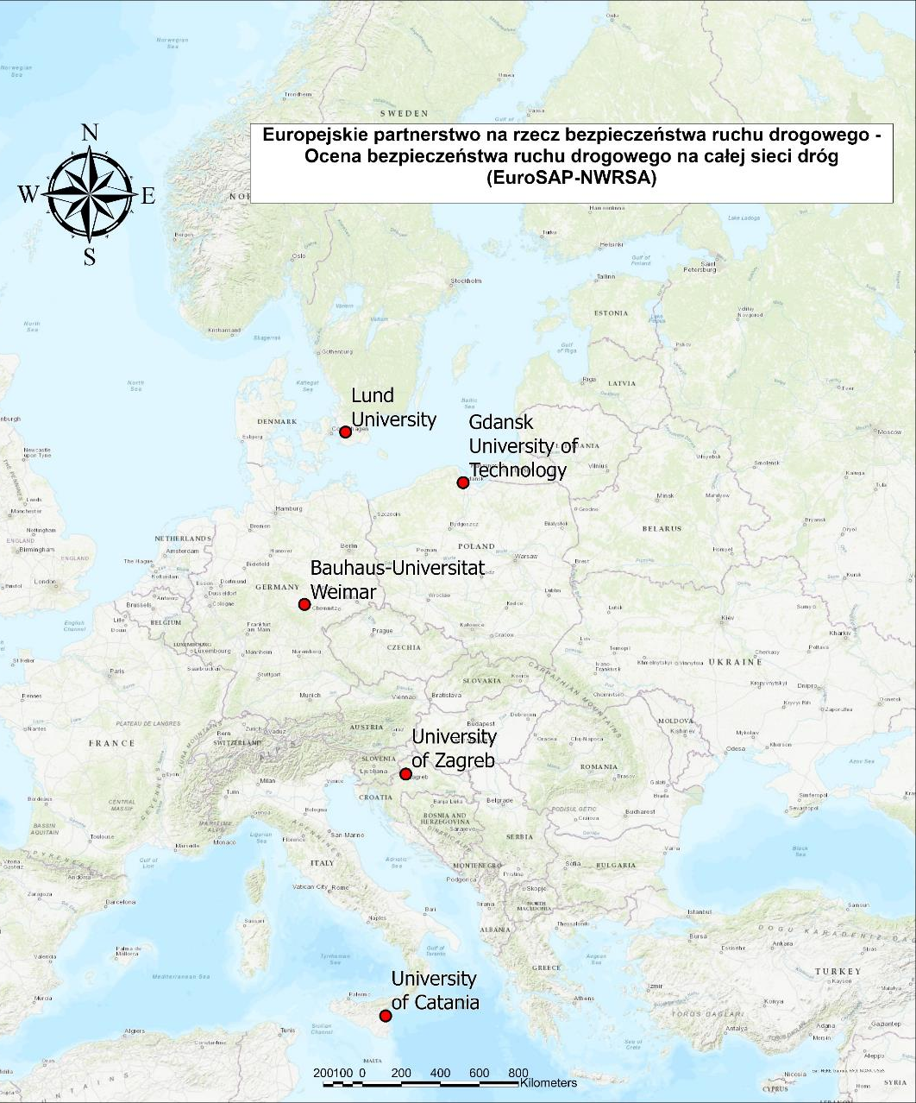
EuroS@P - NWRSA
Success
Project Title: European Road Safety Partnership on Road Safety - Network Wide Road Safety Assessment
Project Acronym: EuroSAP-NWRSA
Project Start Date: 2023-09-01
Project Total Duration 36 months
Project End Date 2026-08-31
European Road Safety Partnership on Road Safety - Network Wide Road Safety Assessment

Slide 5


Partners
Gdansk University of Technology, Poland - Wojciech Kustra, Maciej Sawicki, Joanna Wachnicka, Tomasz Mackun
Universita Degli Studi di Catania, Italy - Salvatore Cafiso, Giusy Pappalardo
Bauhaus-Universitaet Weimar, Germany - Julius Uhlmann, Wido Hamel
Sveuciliste u Zagrebu, Croatia - Marko Sevrovic, Bojan Jovanović, Juraj Leonard
Lund University – Carmelo D'Agostino, Andras Varhelyi

Slide 6
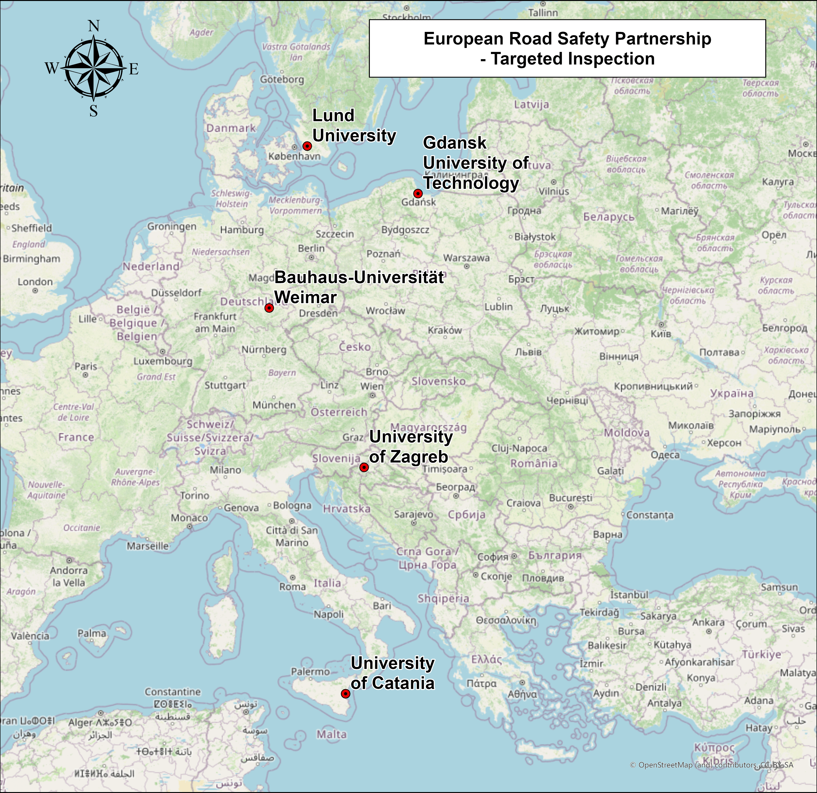
New project
EuroS@P - NWRSA
Project Title: European Road Safety Partnership on Road Safety – Targeted Inspection
Project Acronym: EuroSAP-TI
Project Start Date: 2026-09-01
Project Total Duration 36 months
Project End Date 2029-08-31
European Road Safety Partnership on Road Safety - Network Wide Road Safety Assessment

Slide 7
EU numbers
Do you know how many people died on roads during 2015-2024 (10 years) in your country?
Which city would disappear?

Slide 8
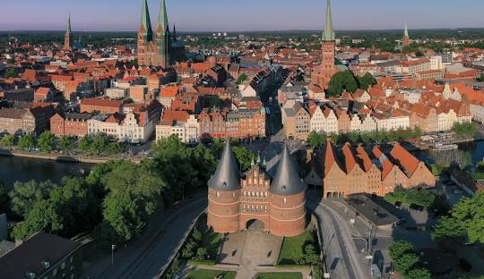
EU numbers - Which city would disappear?
GEO (Labels) | Deaths
European Union - 27 countries (from 2020) | 217,360
Belgium | 5,817
Bulgaria | 5,894
Czechia | 5,769
Denmark | 1,688
Germany | 29,844
Estonia | 596
Ireland | 1,548
Greece | 6,909
Spain | 17,130
France | 31,922
Croatia | 2,917
Italy | 31,094
Cyprus | 462
Latvia | 1,417
Lithuania | 1,706
Luxembourg | 281
Hungary | 5,621
Malta | 164
Netherlands | 5,636
Austria | 3,979
Poland | 24,987
Portugal | 6,121
Romania | 17,567
Slovenia | 976
Slovakia | 2,679
Finland | 2,226
Sweden | 2,410
Which city would disappear?
  Total: Lübeck (Germany)
  Germany - Riesa or Bernburg (Saale)
  Poland – Gorlice or Ketrzyn
  Croatia – Skradin or Vrbovsko
  Italy – Nardò or Gubbio
  Sweden - Ljungaverk och Fränsta or Norsjö

Slide 9
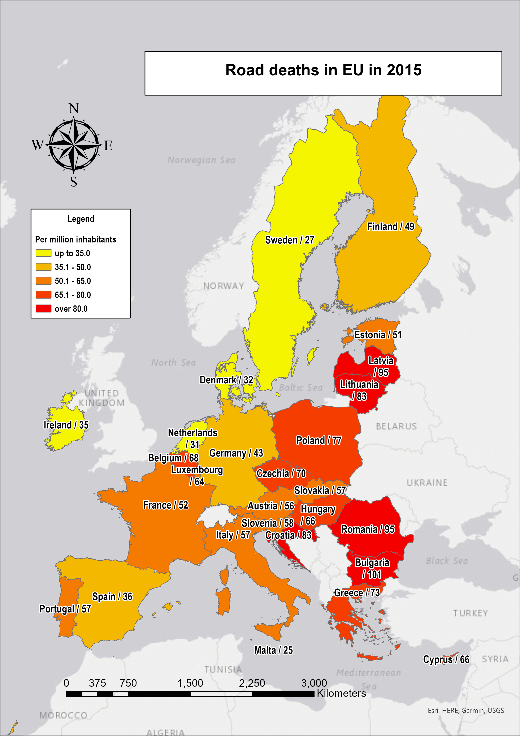
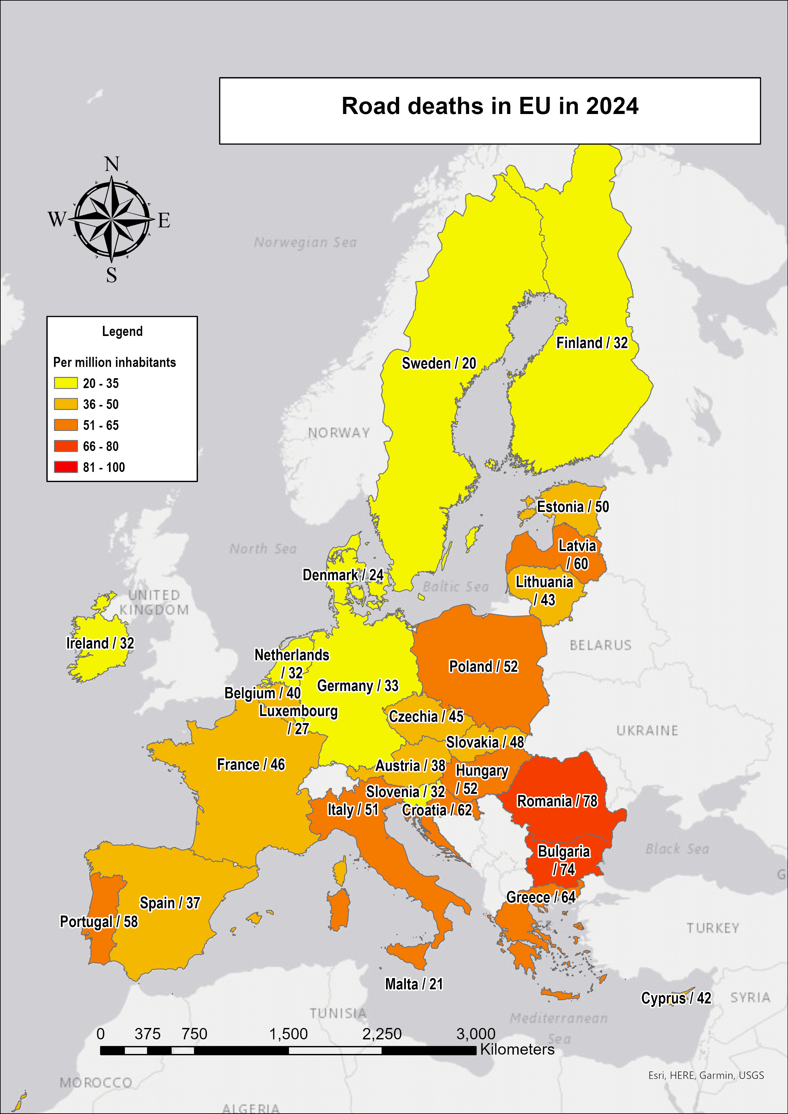

Slide 10
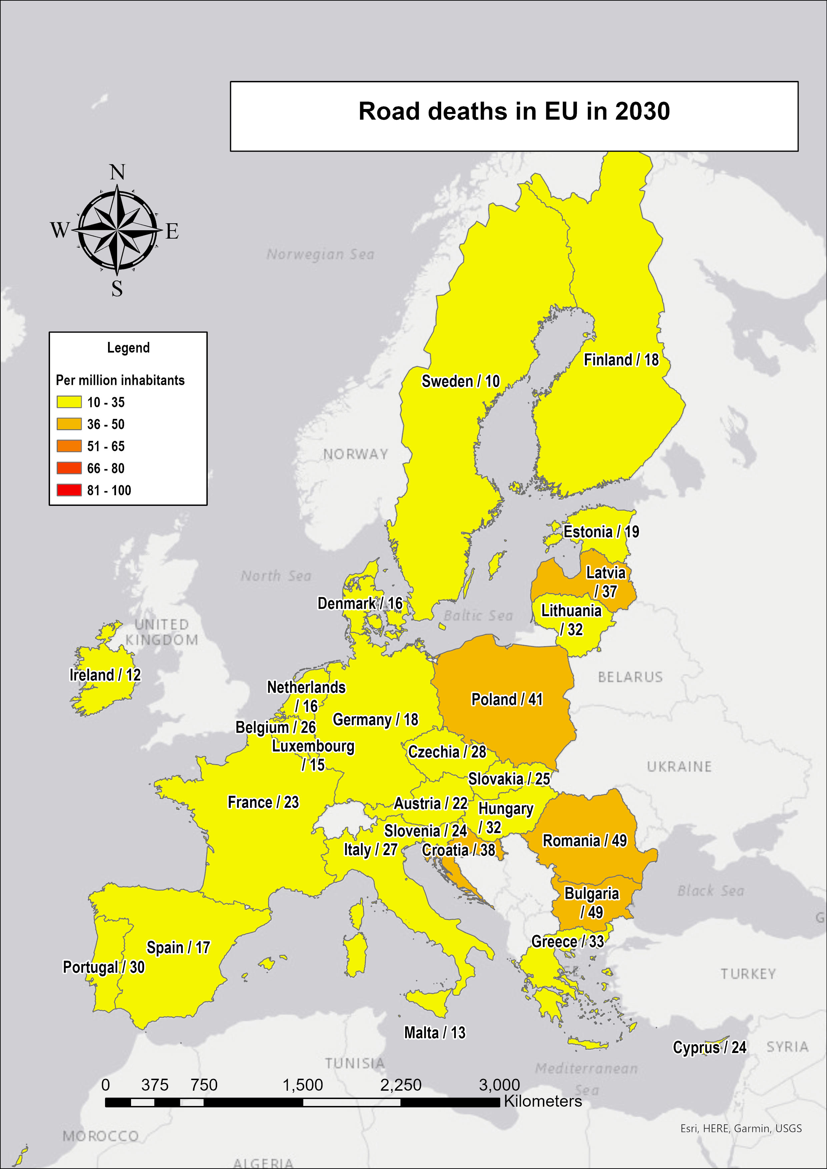

Slide 11
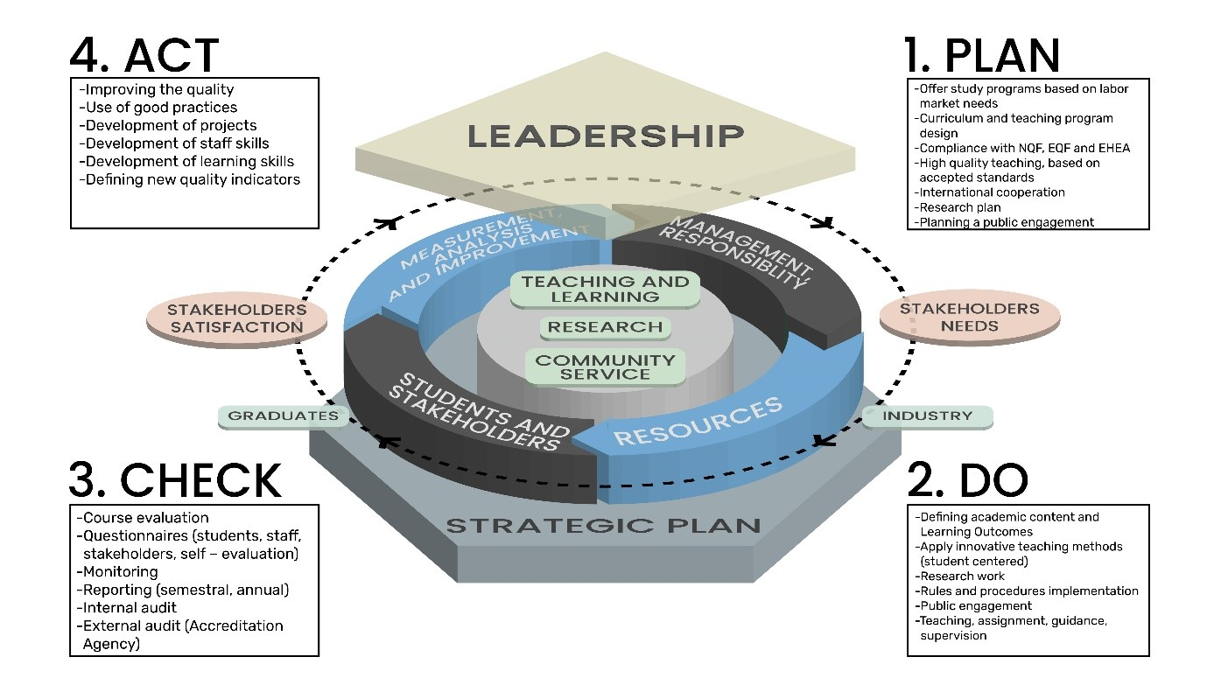
Erasmus+ Strategic Partnerships
What is the aim
Increasing quality in the work, activities and practices of organisations and institutions involved, opening up to new actors not naturally included within one sector
Building the capacity of organisations to work transnationally and across sectors

Slide 12
Our Goals
Improve the competence and gain knowledge and skills of students, road authority employees, road safety auditors and inspectors, as well as lecturers and experts in the field of Road Safety Assessment on the entire Road Network.
Development of methodologies for the creation of didactic and training materials in the NWRSA area with the development of competence certification
Knowledge database of stakeholders and professionals in RISM
3) Development of didactic and training materials for six topics in the NWRSA
E-learning platform with provided materials and methodologies from the NWRSA
5) Organising two pilot schools for road safety staff from European countries

Slide 13
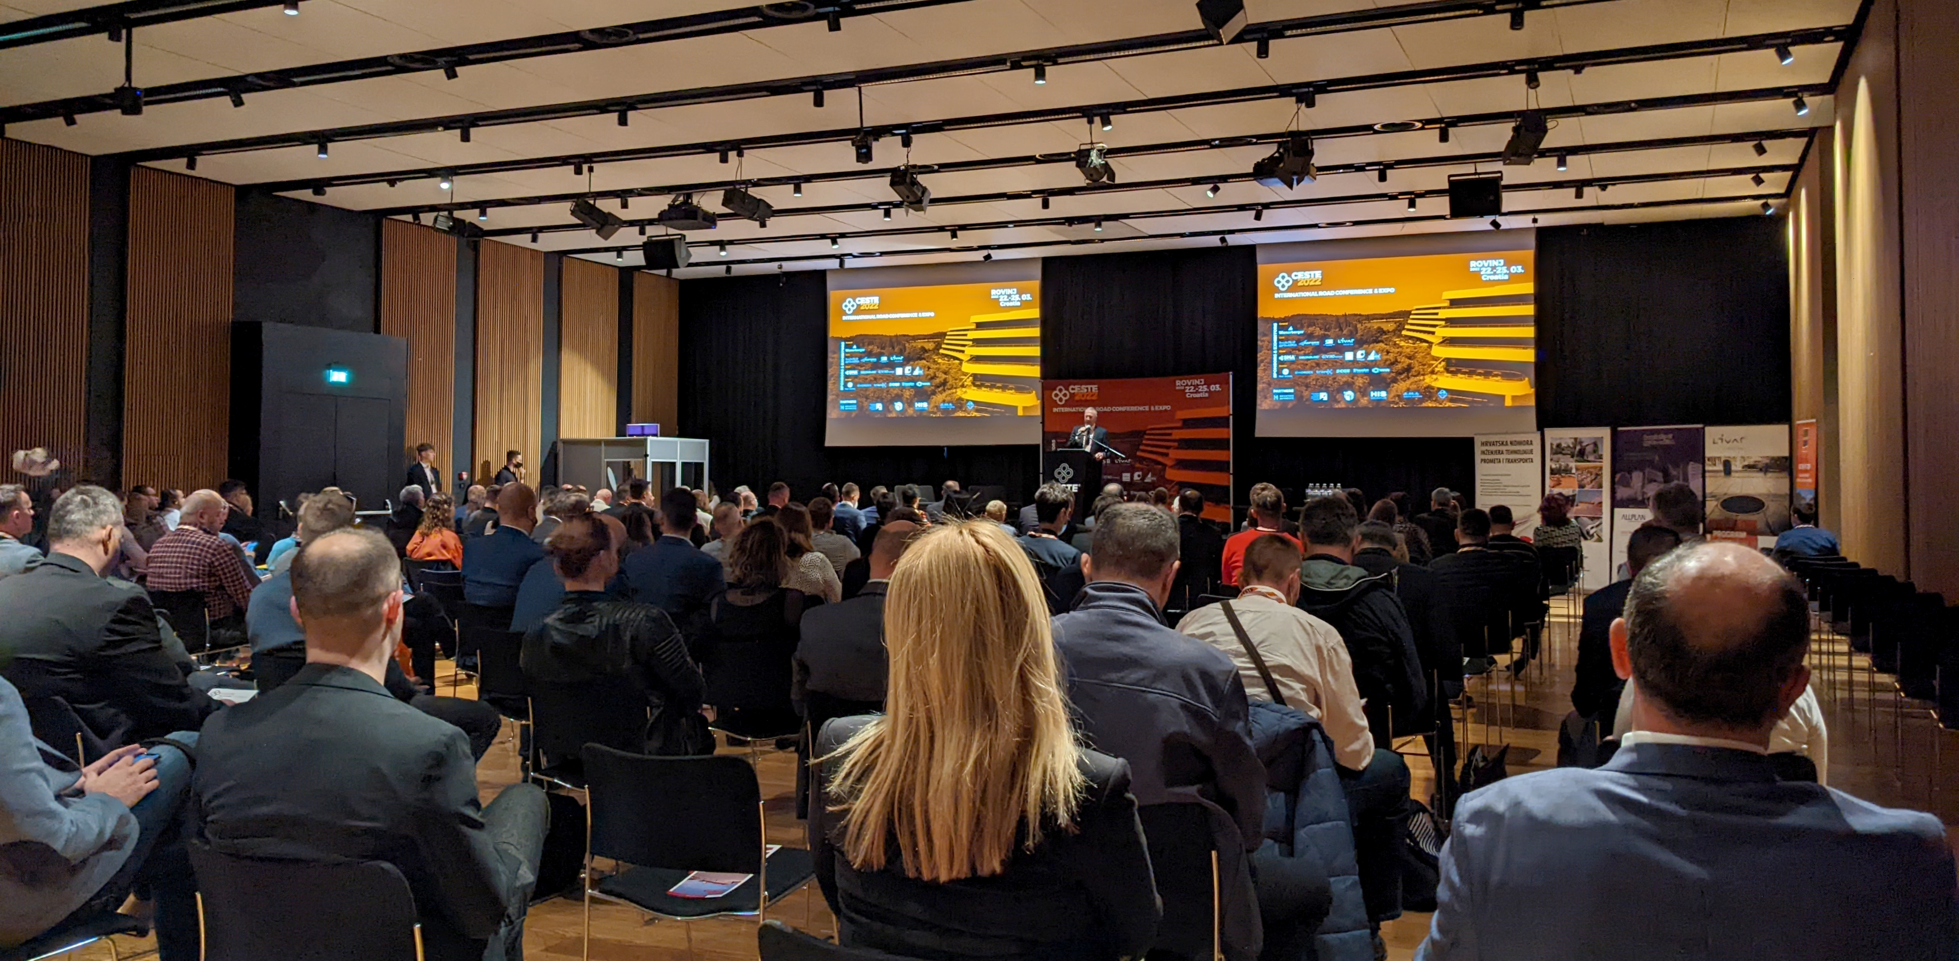
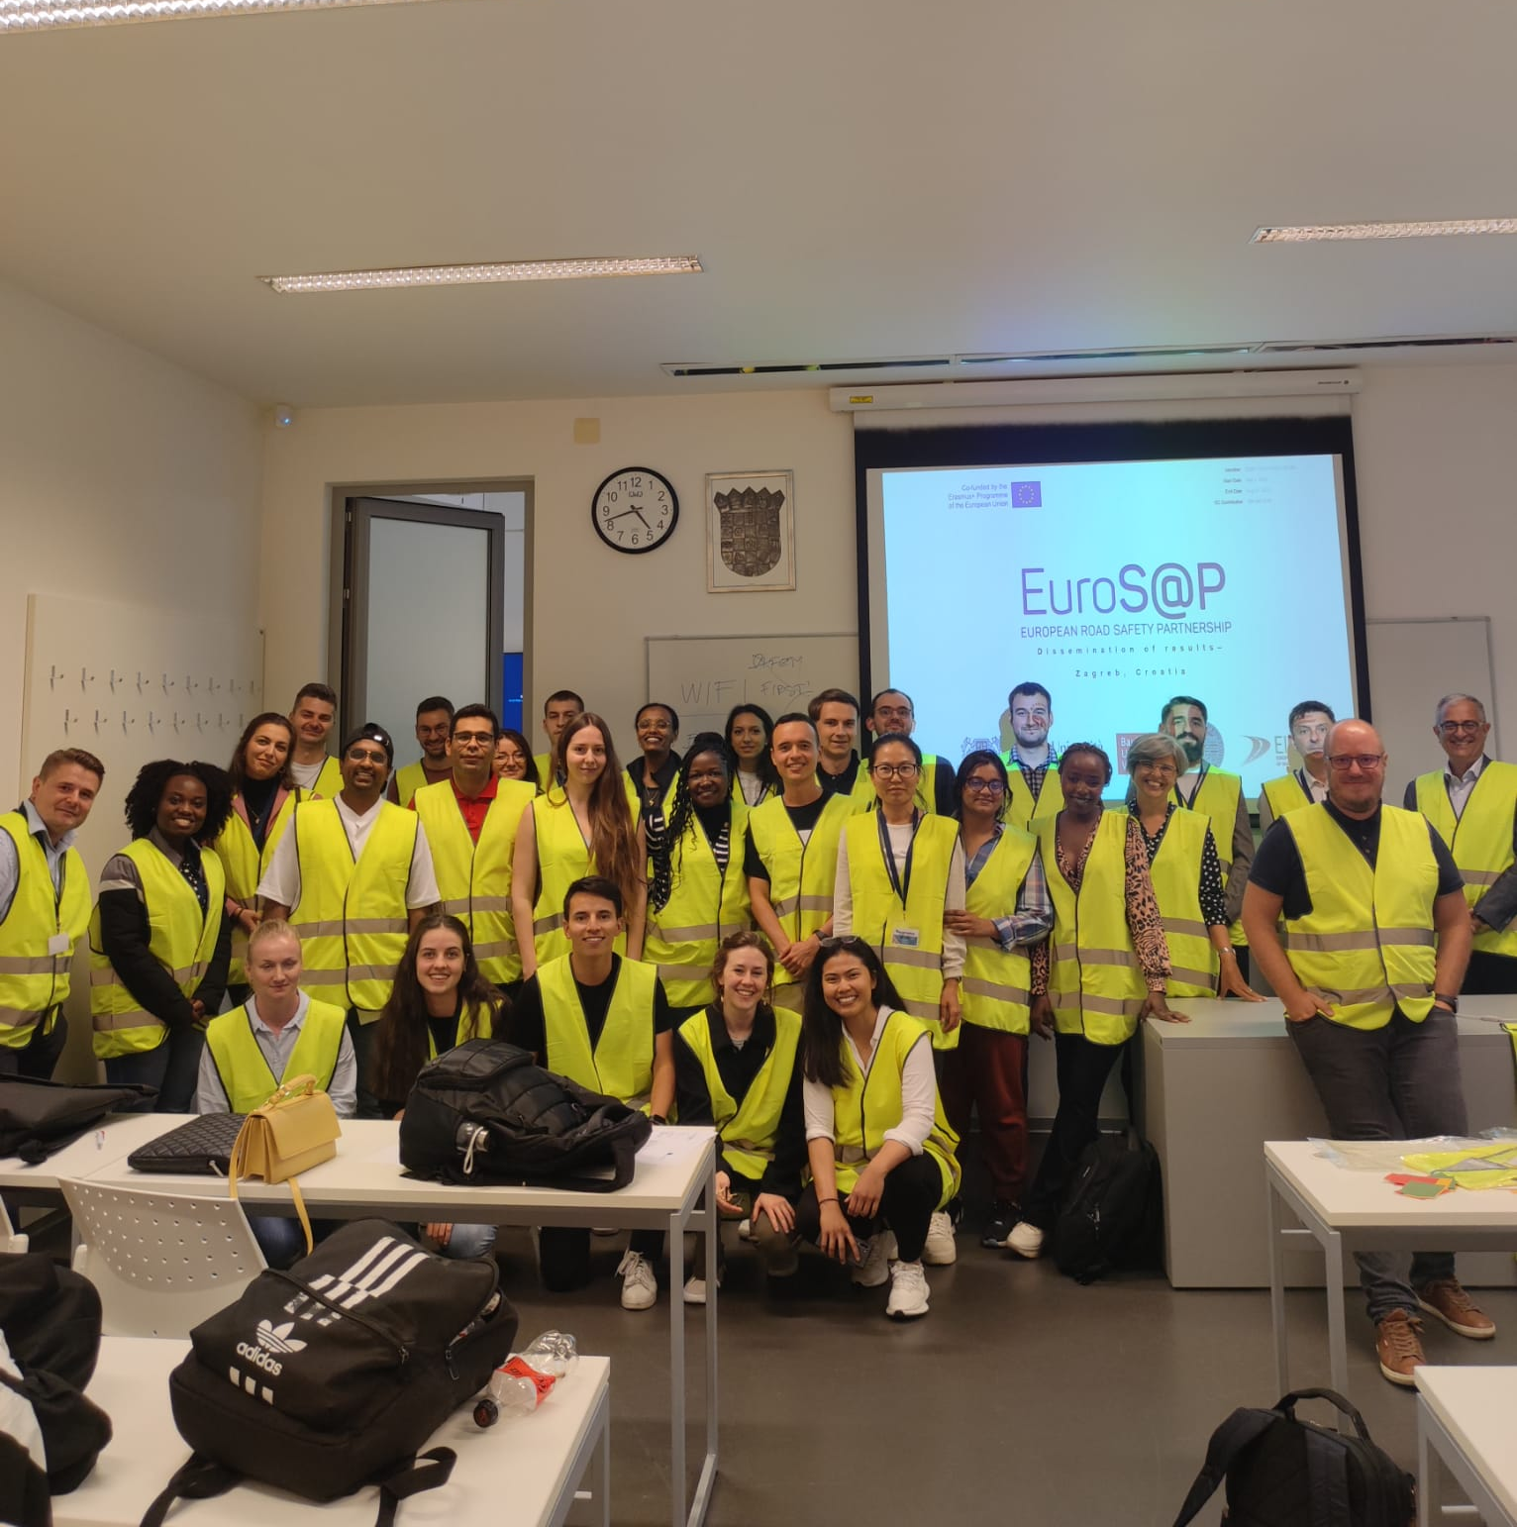
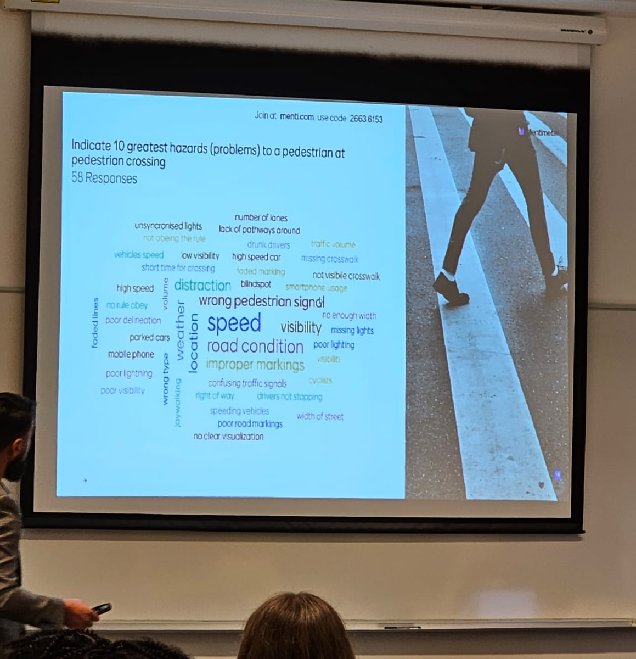
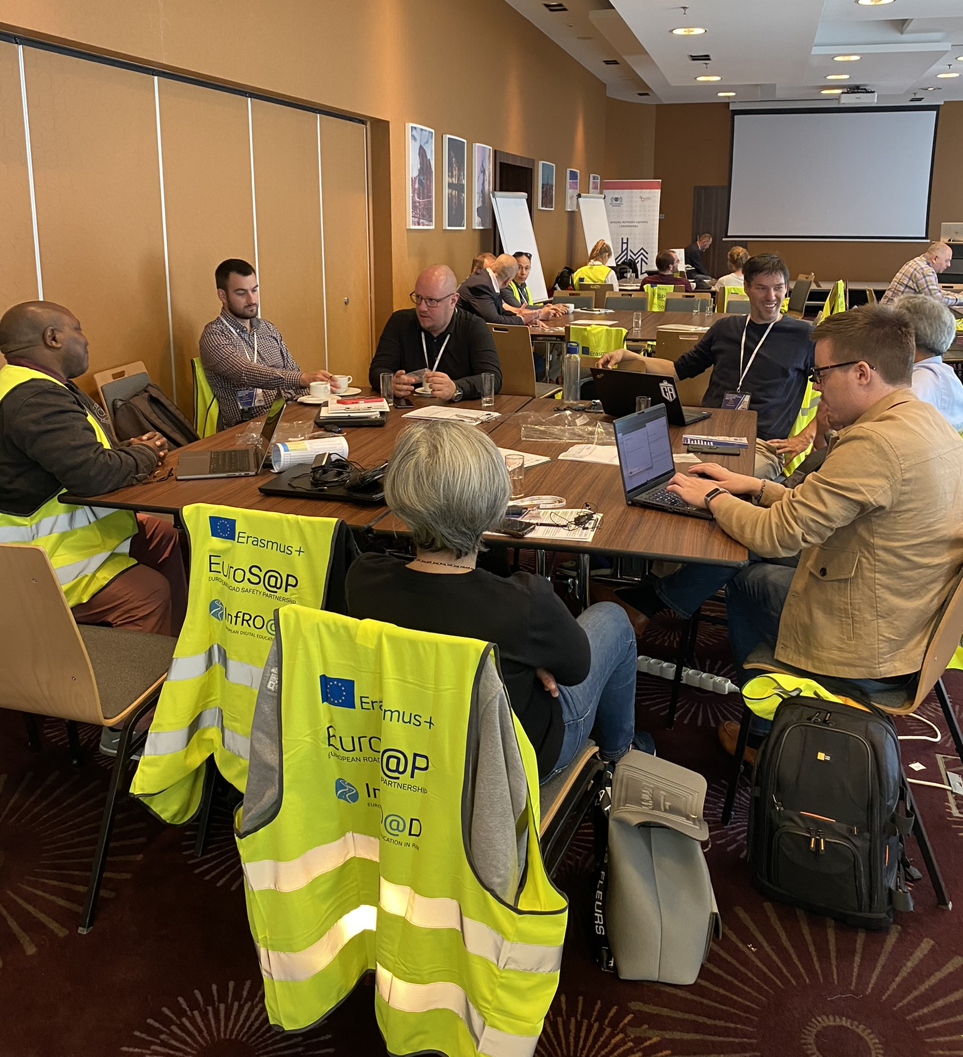
Targets groups:
Researchers, academic teachers at universities
Students
Road authority staff at national, regional and local levels
Experts, specialists, and practitioners involved in RS activities, including staff who conduct training in various RS courses
All users of road infrastructure, as an indirect target group, for whom the risk of road accidents will ultimately be reduced by increasing the effectiveness and efficiency of RISM activities

Slide 14
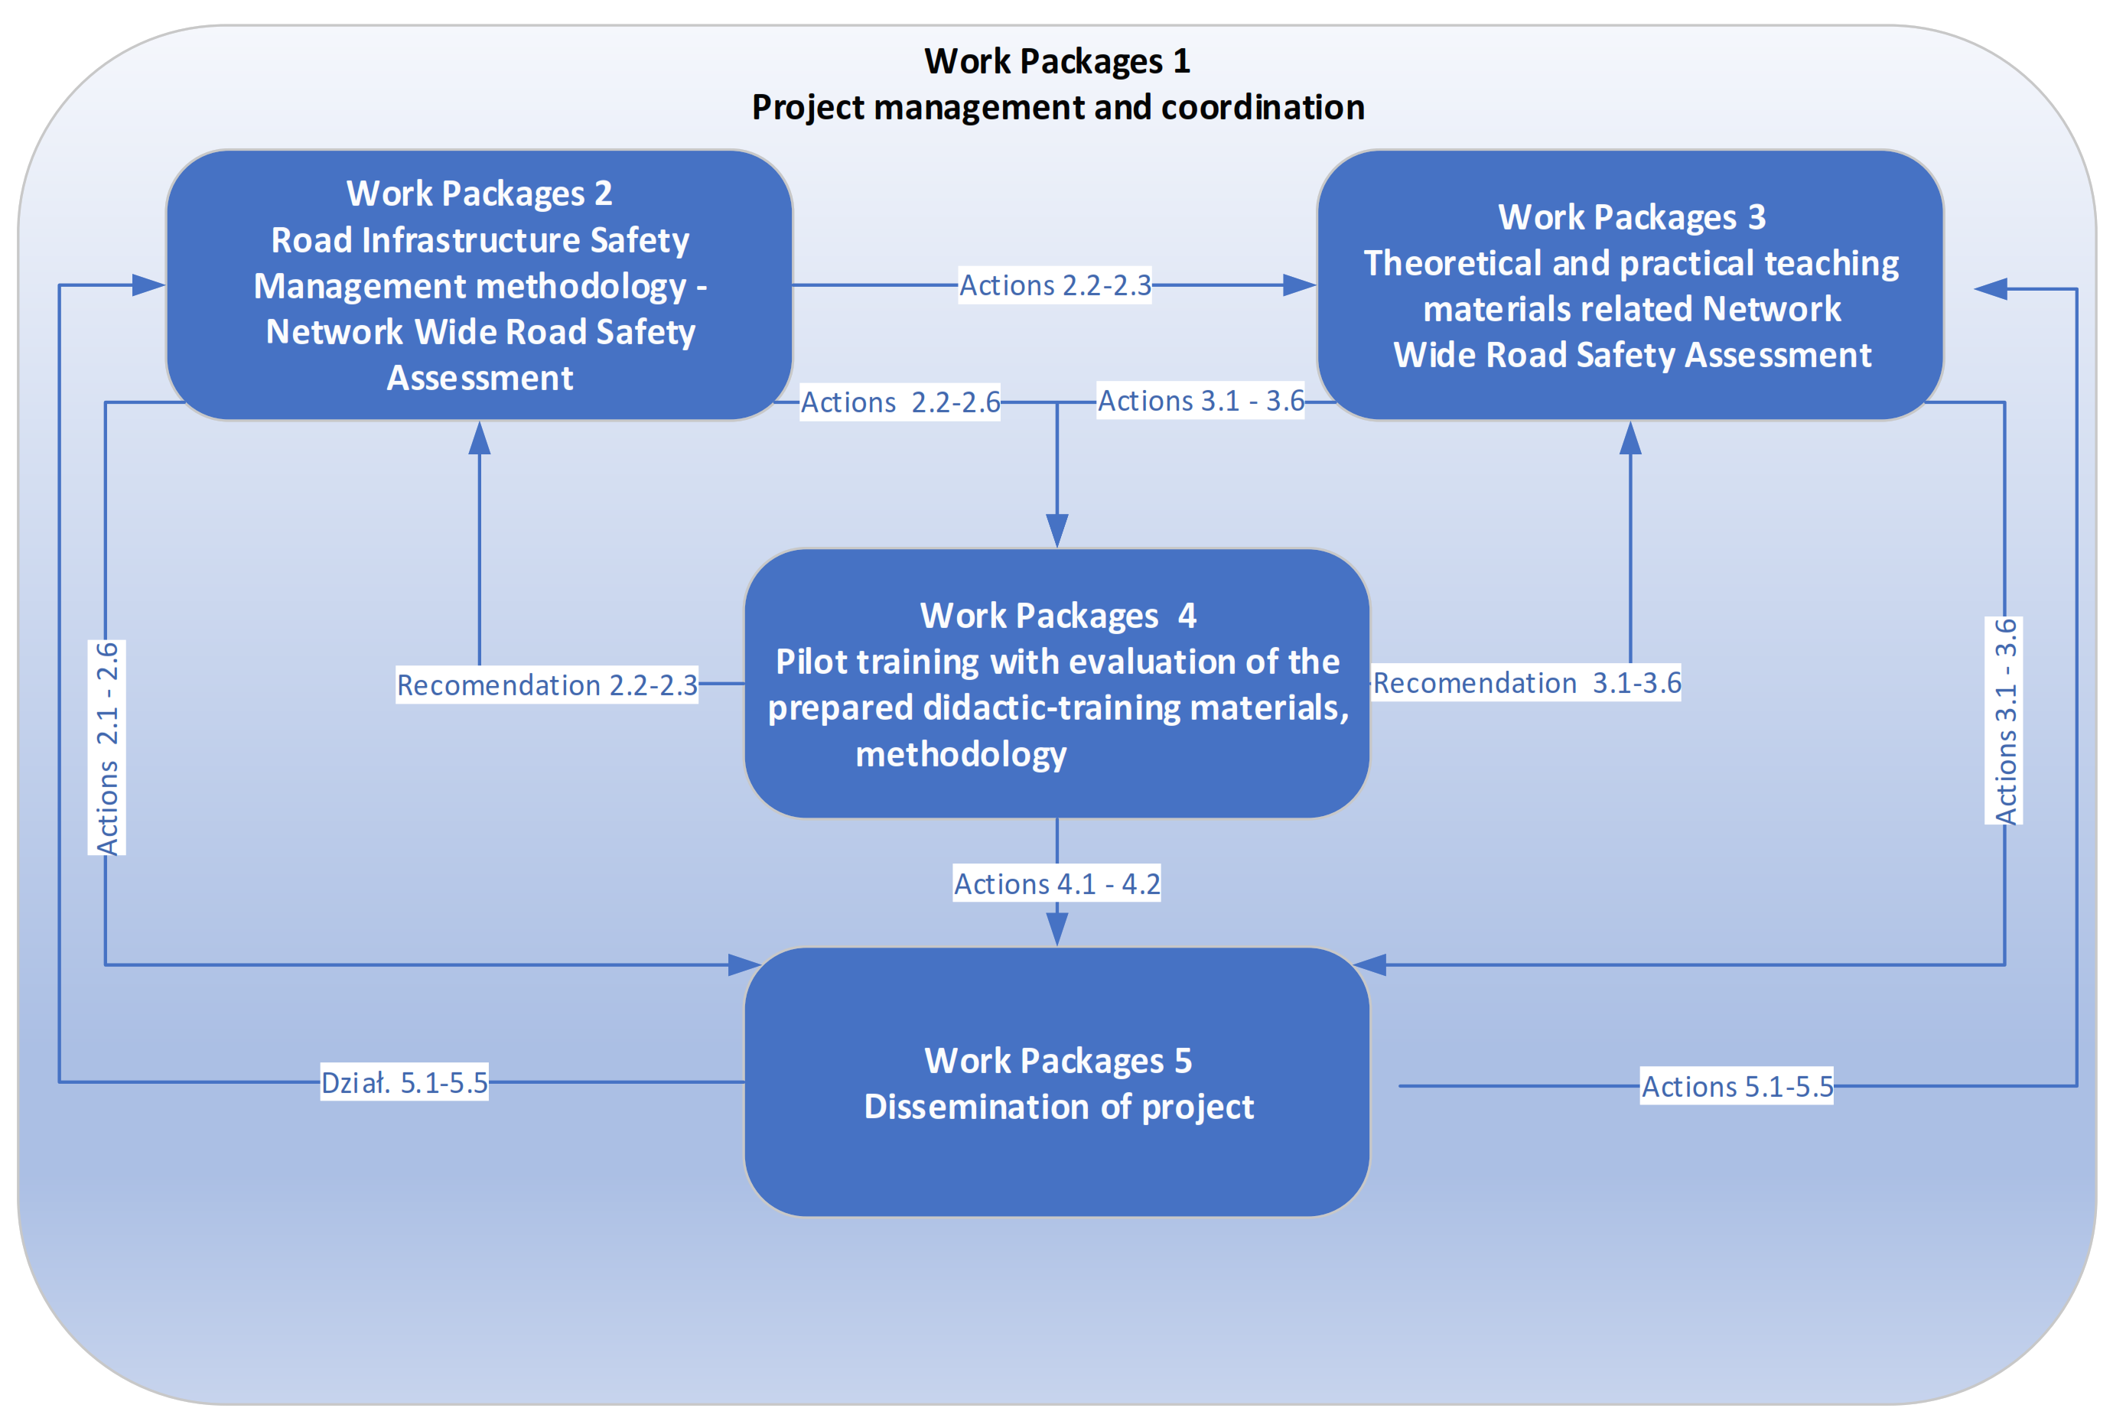
Work Packages
WP1. Project management and coordination
WP2. Road Infrastructure Safety Management methodology - Network Wide Road Safety Assessment
WP3. Theoretical and practical teaching materials related to Network Wide Road Safety Assessment
WP4. Pilot training with the evaluation of the prepared didactic-training materials, methodology
WP5. Dissemination of project

Slide 15

WP3 Theoretical and practical teaching materials related to Network Wide Road Safety Assessment

Slide 16
WP3 - Theoretical and practical teaching materials related to
Network Wide Road Safety Assessment
T3.1 Model road safety infrastructure management structure T3.2 Network Wide Road Safety Assessment fundamentals T3.3 The reactive approach of NRWSA
T3.4 The proactive approach of NRWSA
T3.5 Integration of selected activities using proactive and reactive methods
T3.6 Management of activities at strategic, operational and local levels
Notes:
Responsible for that WP is UC

Slide 17




Slide 18
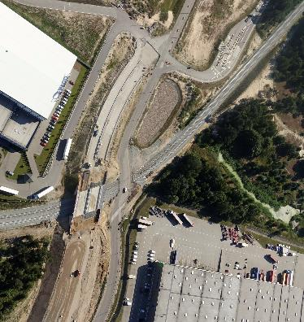
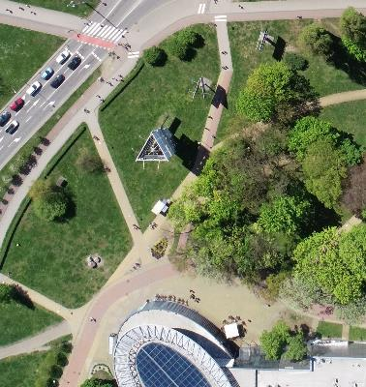
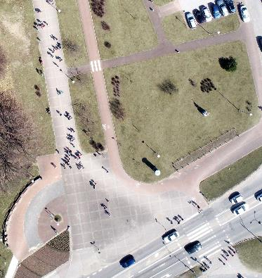
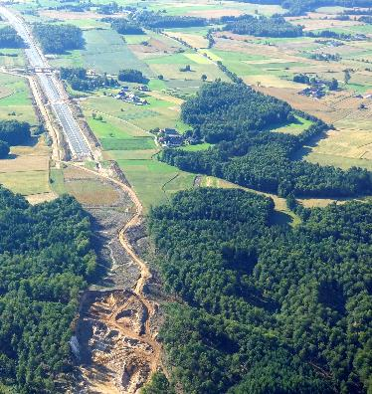
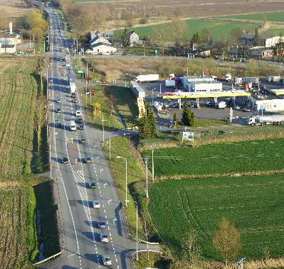
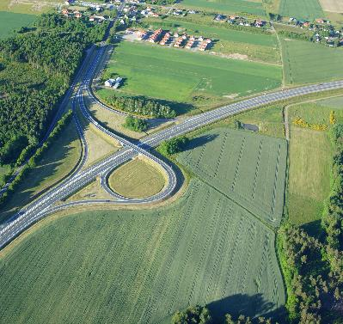
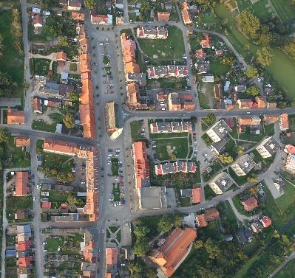
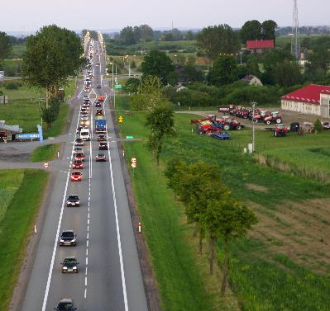

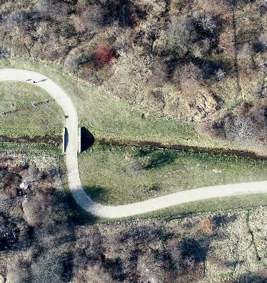
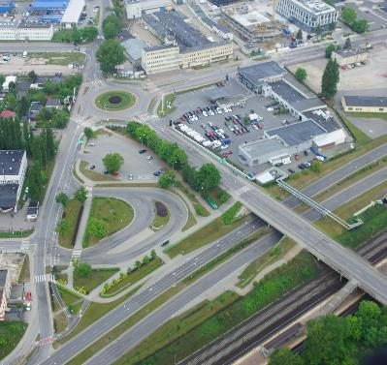
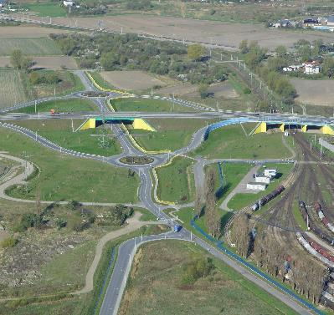
Lets learn about it

